Slide 1
Atlas of Cardiology
3rd Edition
European Heart Heath Institute
European Heart Agency
As of: 3 November 2021

Slide 2
Introduction

Slide 3
The ESC Atlas of Cardiology
The ESC Atlas of Cardiology is a unique data set containing a plethora of descriptive and quantitative data for the 57 ESC’s member countries.
The data are collected from a survey undertaken by the ESC together with the National Cardiac Societies as well as external sources.
The purpose of the ESC Atlas is to map the status of European healthcare systems, from a cardiovascular medicine perspective, and to provide evidence that may improve decision making in cardiology.

Slide 4
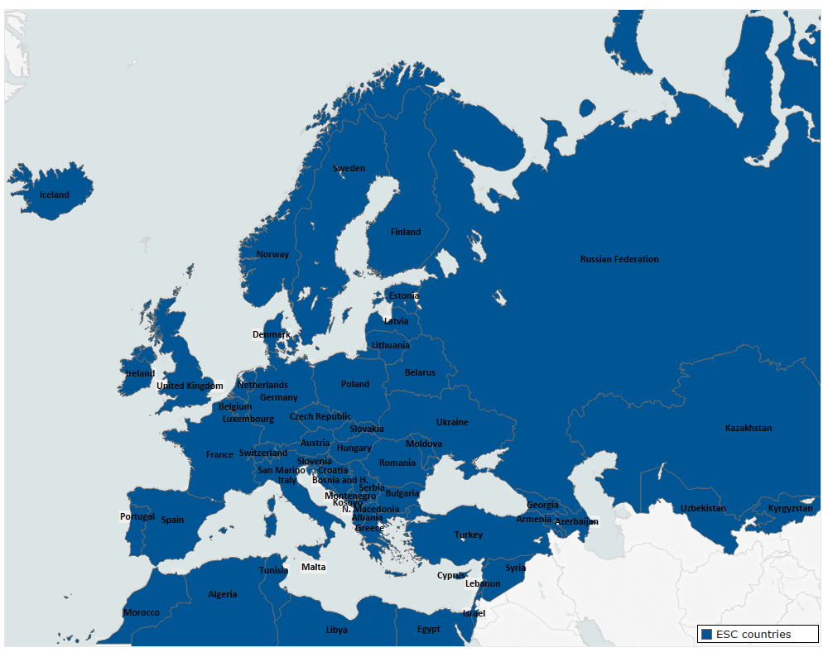
The ESC Atlas of Cardiology

Slide 5
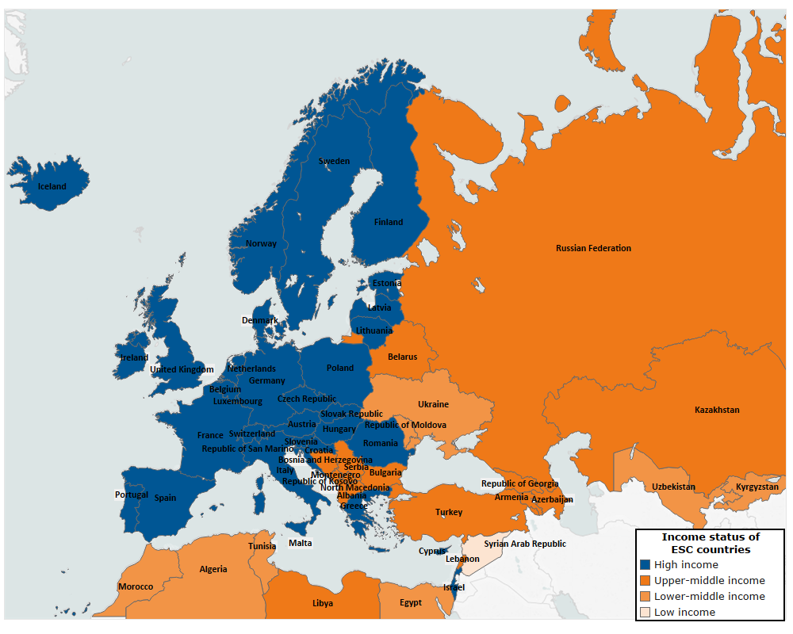
ESC member countries stratified by the World Bank income status

Slide 6
Sociodemographic factors

Slide 7
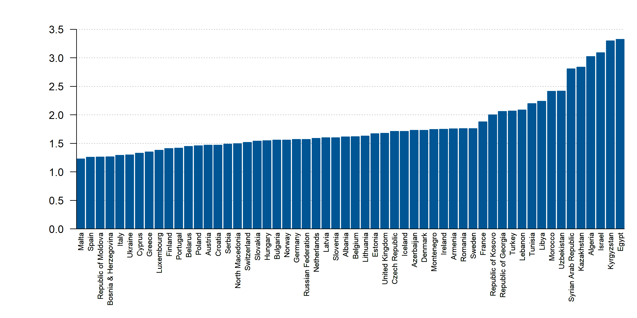
Fertility rate, total (births per woman), 2018
Source: World Bank. Data not available: San Marino

Slide 8
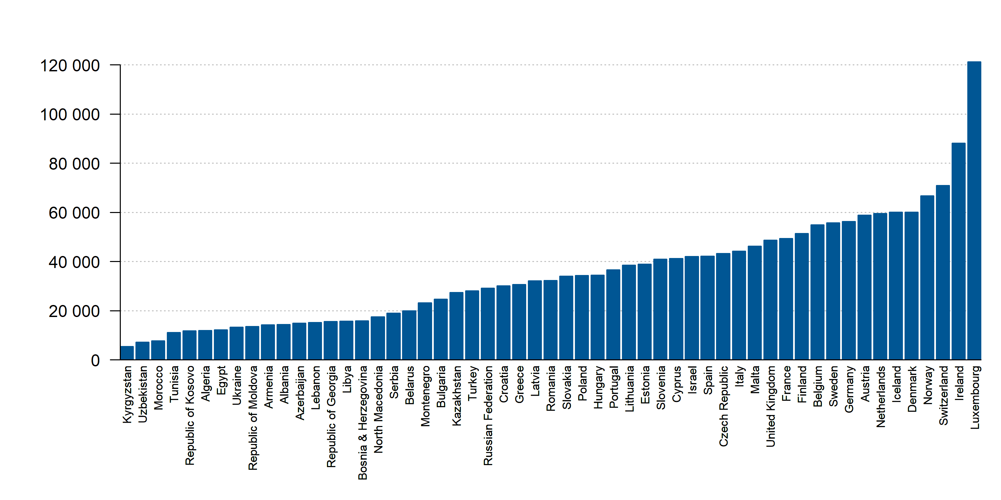
GDP per capita, PPP (current international $), 2019
Source: World Bank. Data not available: Syria

Slide 9
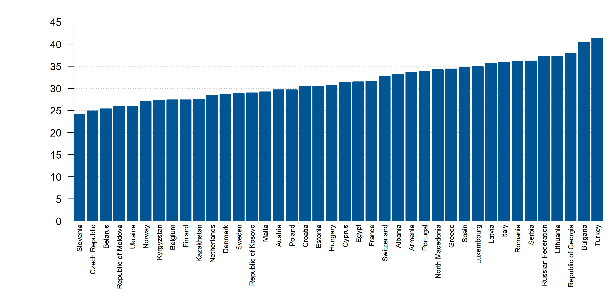
Gini index (World Bank estimate), 2017
Source: World Bank. Data not available: Libya, San Marino

Slide 10
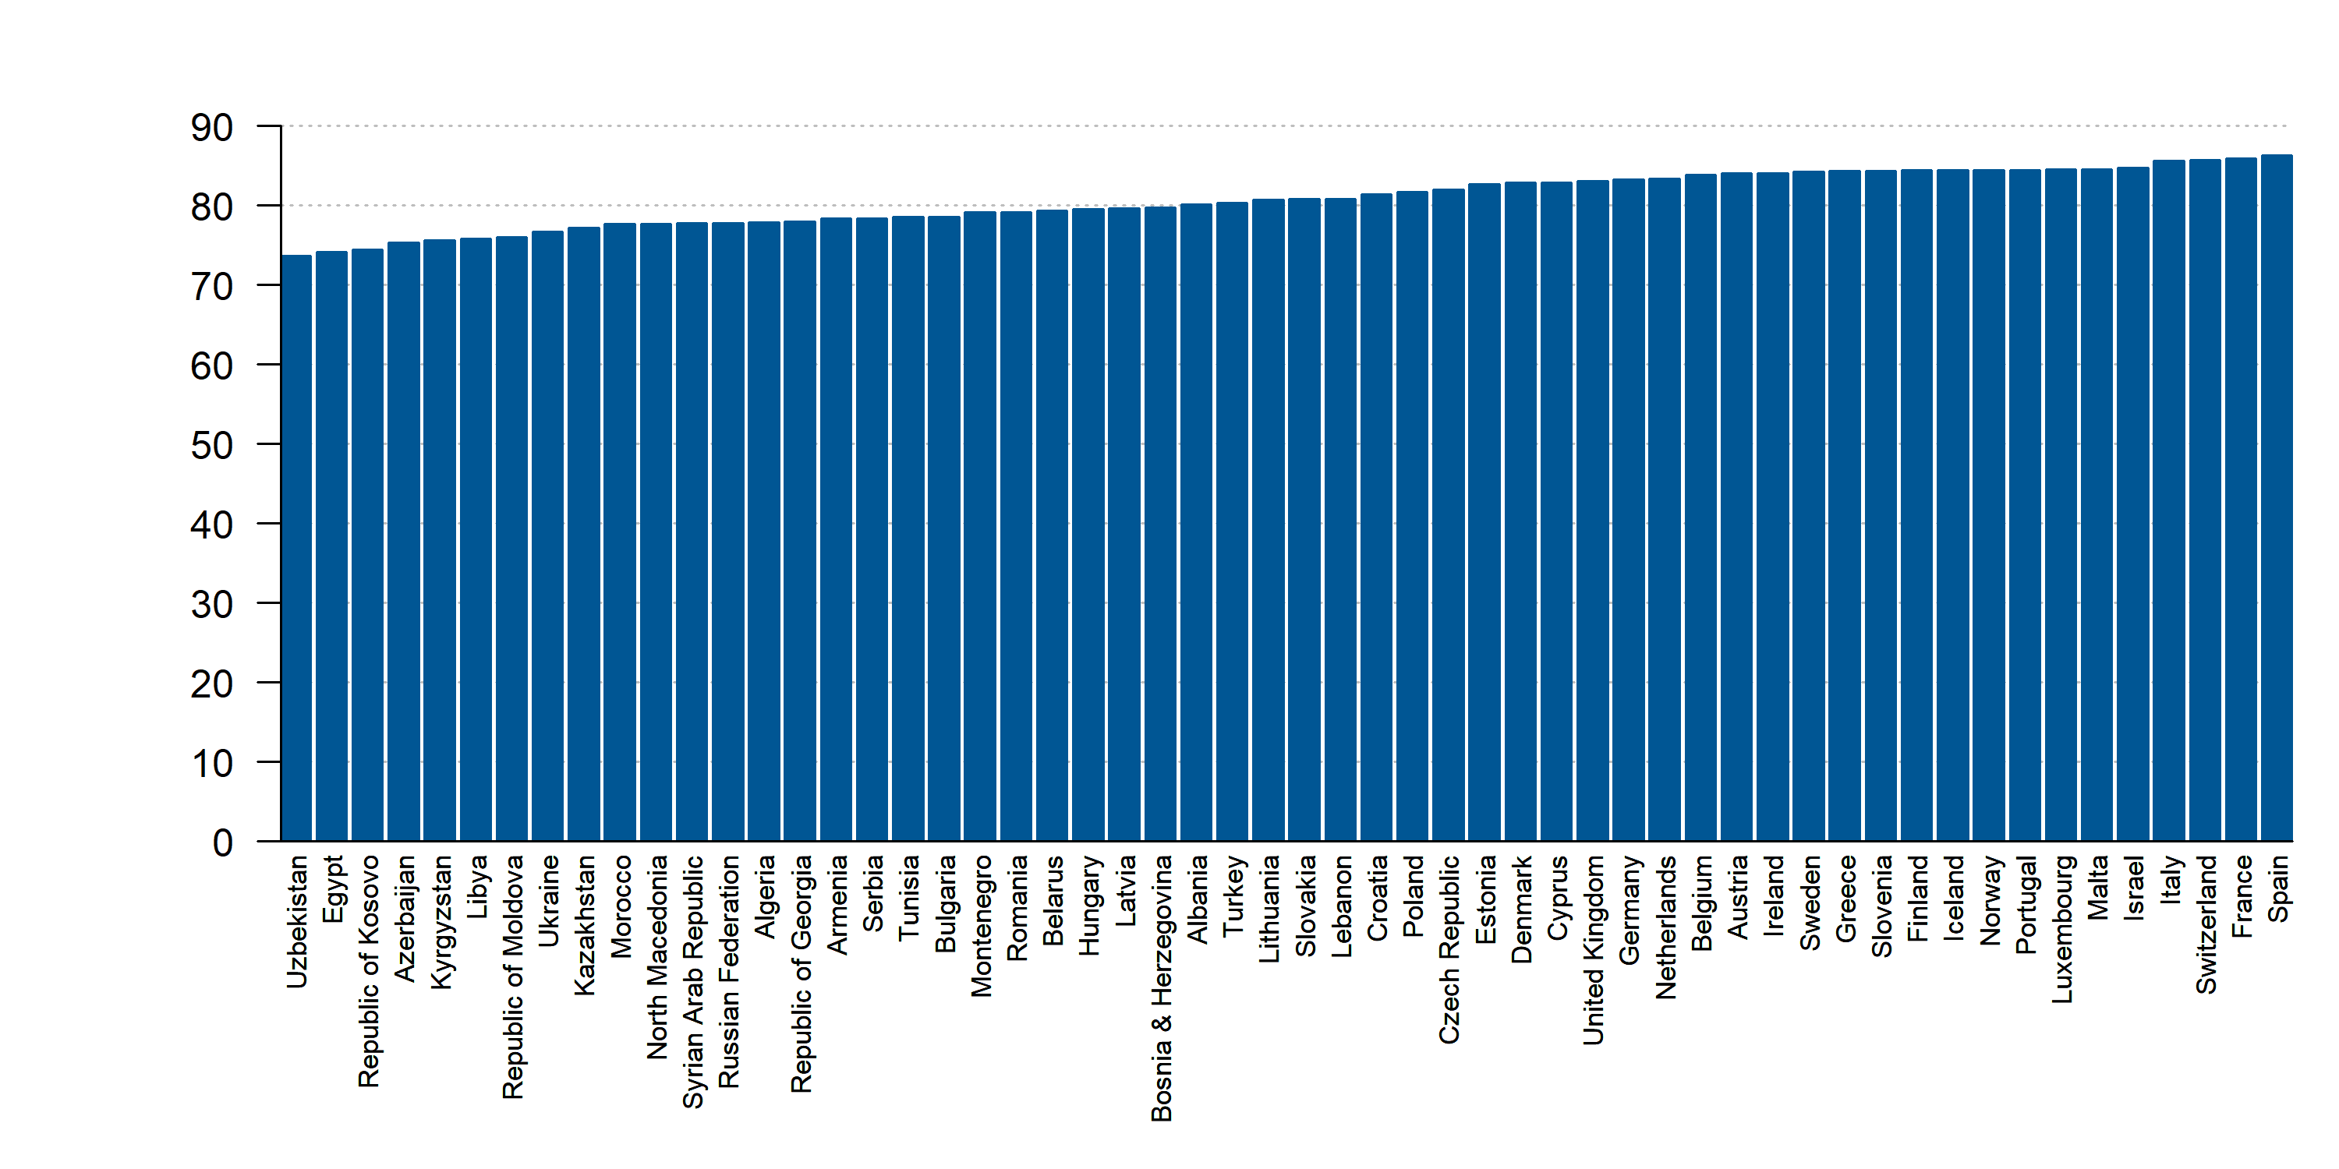
Life expectancy at birth (years) among females, 2018
Source: World Bank. Data not available: San Marino

Slide 11
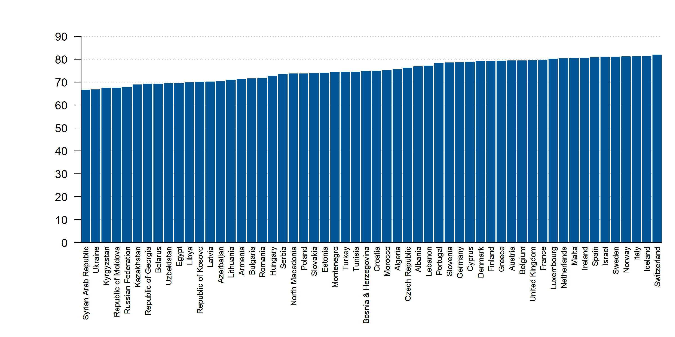
Life expectancy at birth (years) among males, 2018
Source: World Bank. Data not available: San Marino

Slide 12
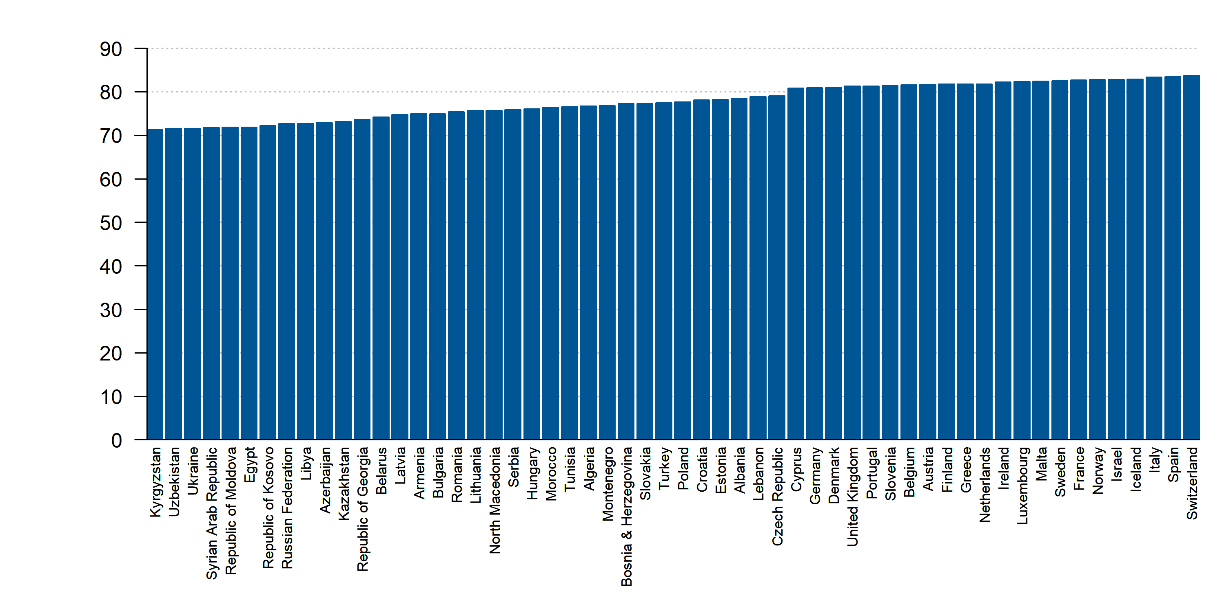
Life expectancy at birth, total (years), 2018
Source: World Bank. Data not available: San Marino

Slide 13
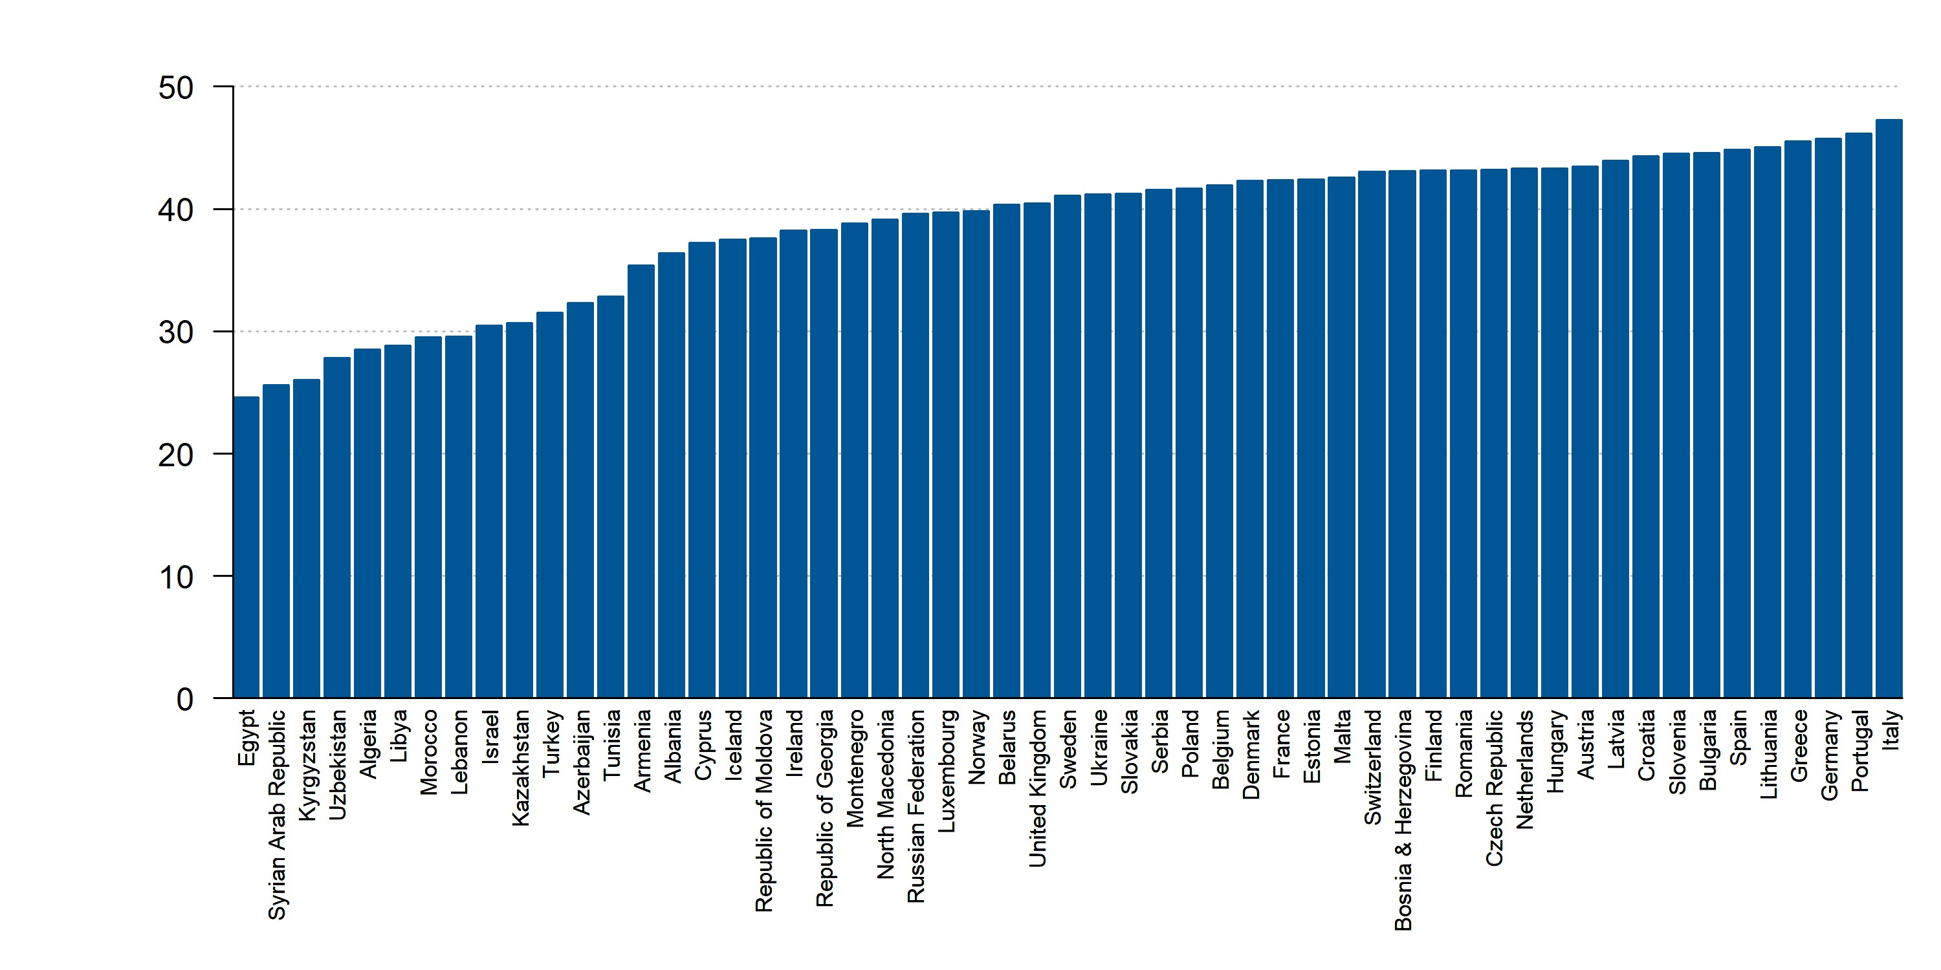
Median age by ESC countries, 2020
Source: World Bank. Data not available: Kosovo

Slide 14
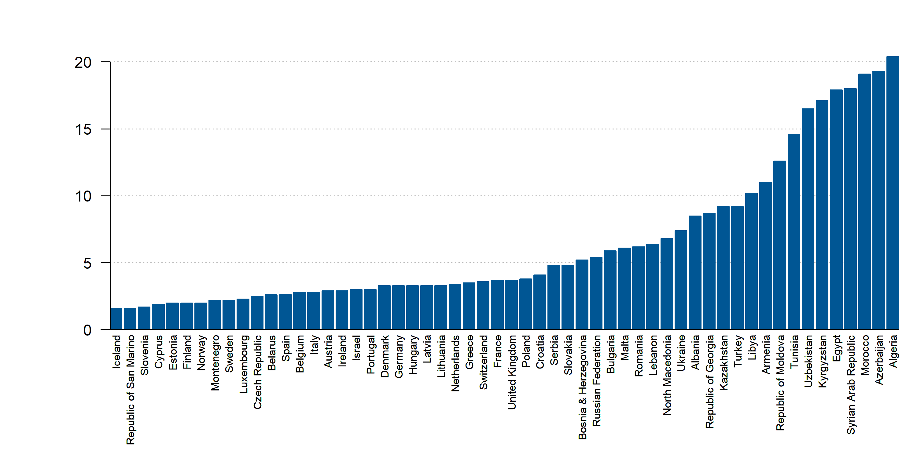
Mortality rate, infant (per 1,000 live births), 2018
Source: World Bank. Data not available: Kosovo

Slide 15
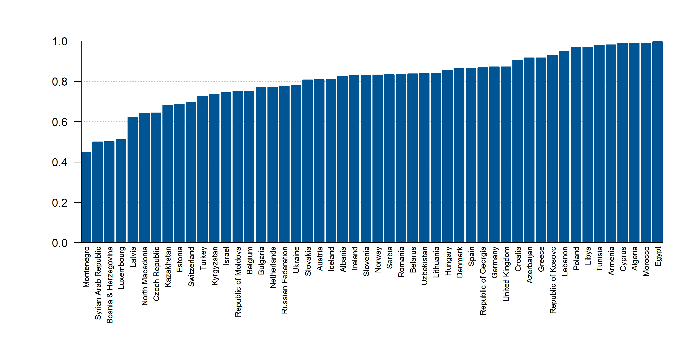
Local population (% of total population), 2018 or latest year
Source: CIA. Data not available: Finland, France, Italy, Malta, Portugal, San Marino, Sweden

Slide 16
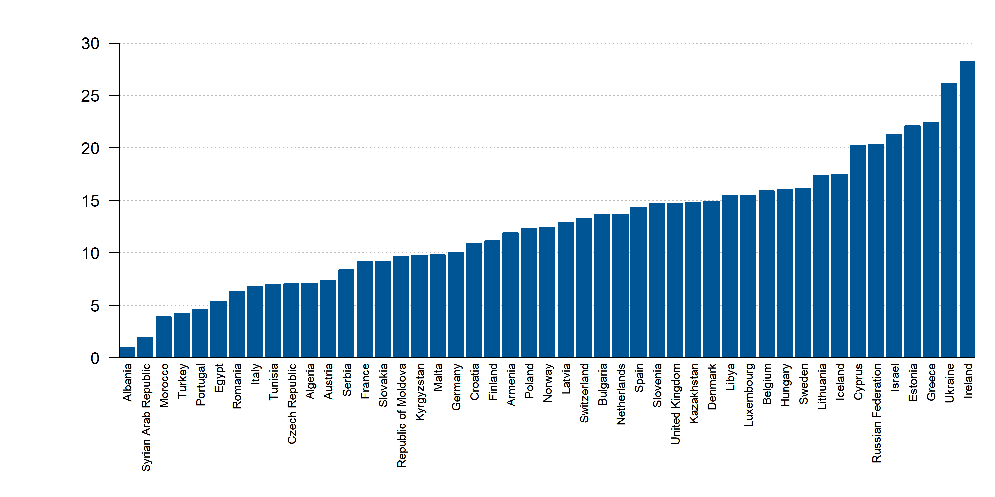
Percentage of female population age 15+ with tertiary schooling, 2010
Source: World Bank. Data not available: Azerbaijan, Belarus, Bosnia and Herzegovina, Georgia, Kosovo, Lebanon, Montenegro, North Macedonia, San Marino, Uzbekistan

Slide 17
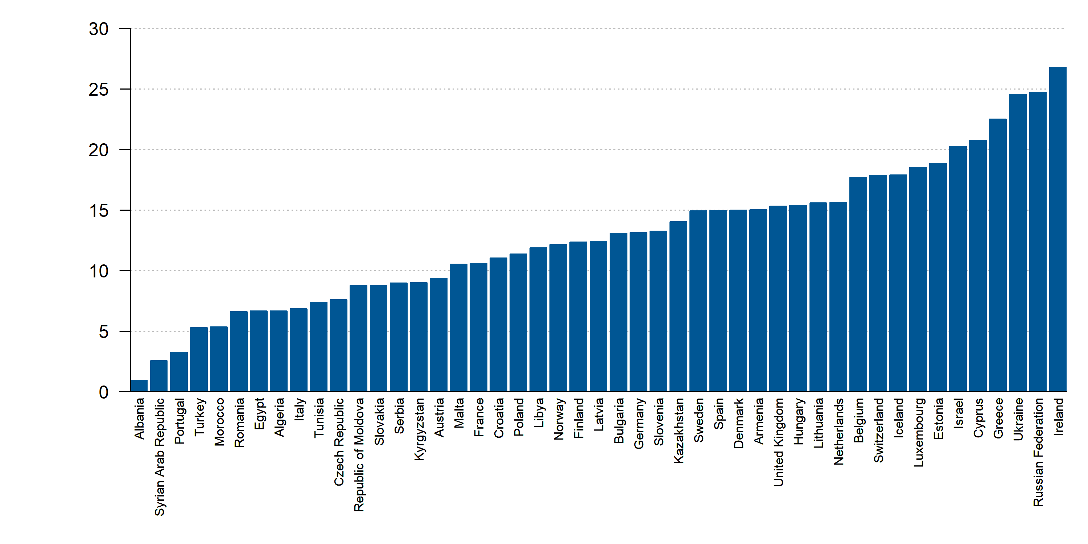
Percentage of population age 15+ with tertiary schooling Completed Tertiary, 2010
Source: World Bank. Data not available: Azerbaijan, Belarus, Bosnia and Herzegovina, Georgia, Kosovo, Lebanon, Montenegro, North Macedonia, San Marino, Uzbekistan

Slide 18
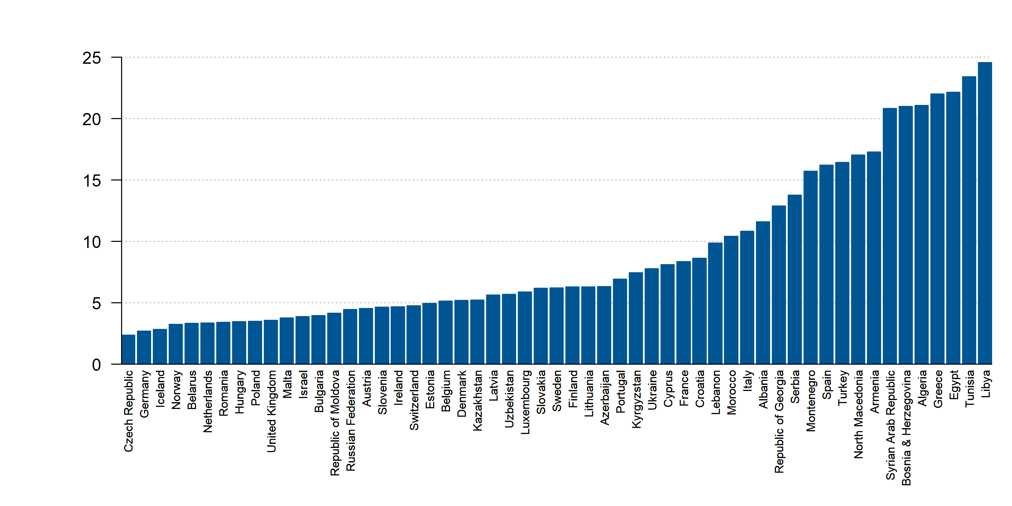
Unemployment, female (% of female labor force) (modeled ILO estimate), 2019
Source: World Bank. Data not available: Kosovo, San Marino

Slide 19
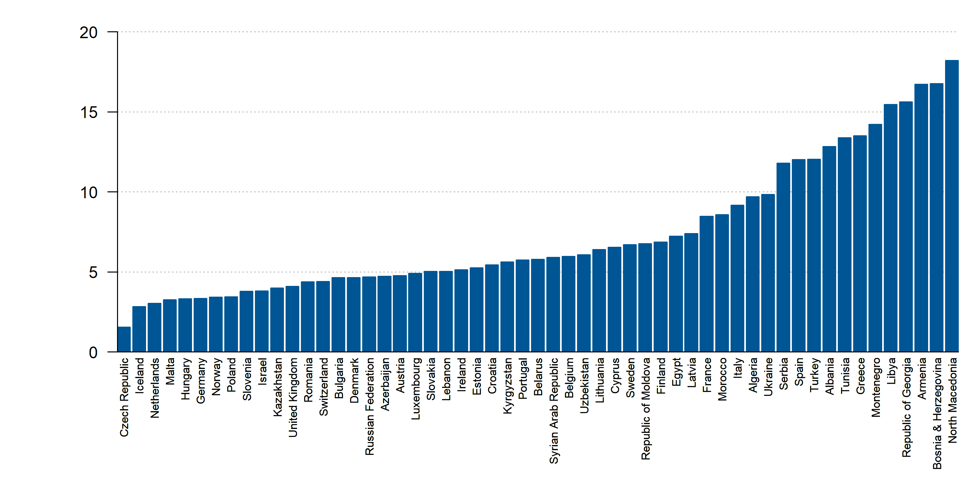
Unemployment, male (% of male labor force) (modeled ILO estimate), 2019
Source: World Bank. Data not available: Kosovo, San Marino

Slide 20
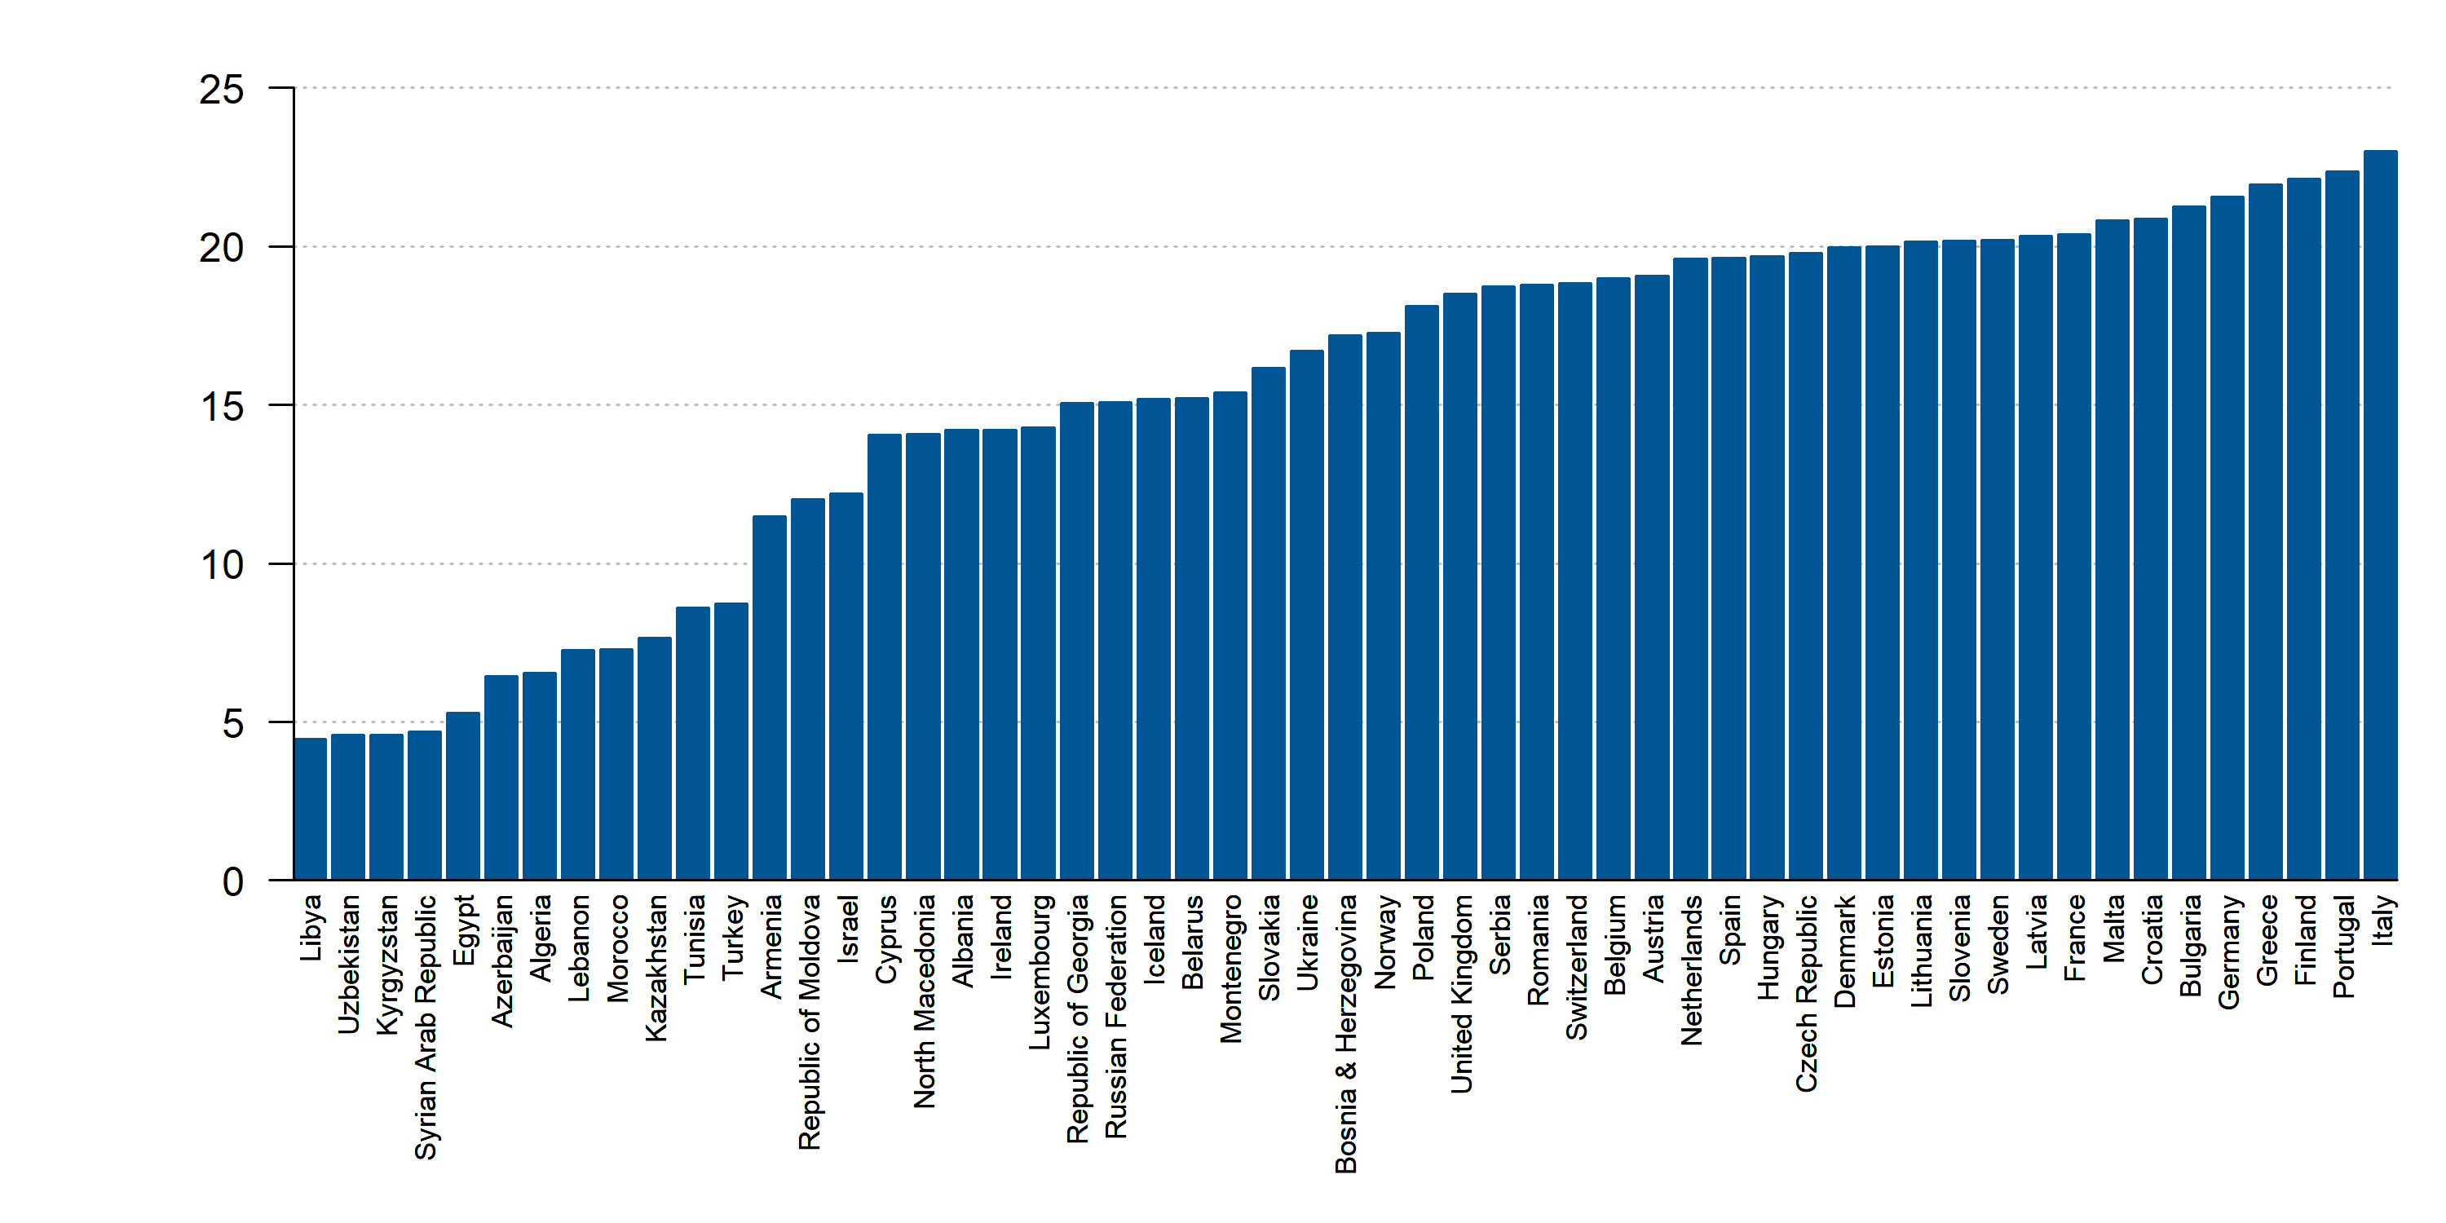
Population ages 65 and above (% of total population), 2019
Source: World Bank. Data not available: Kosovo, San Marino

Slide 21
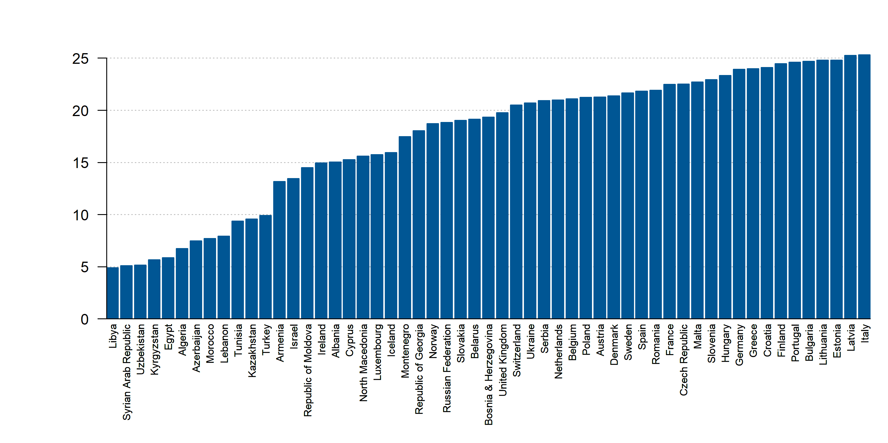
Population ages 65 and above (% of female population) among females, 2019
Source: World Bank. Data not available: Kosovo, San Marino

Slide 22
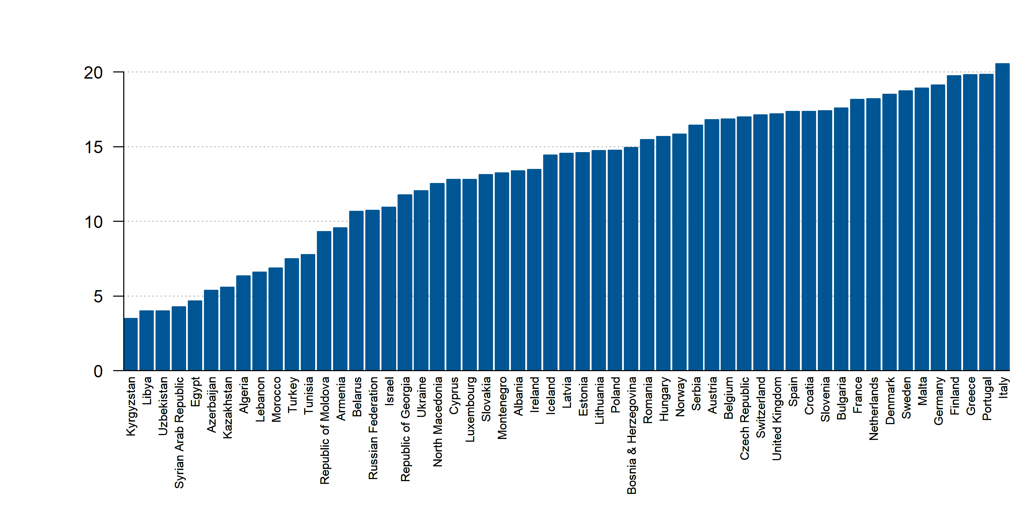
Population ages 65 and above (% of male population) among males, 2019
Source: World Bank. Data not available: Kosovo, San Marino

Slide 23
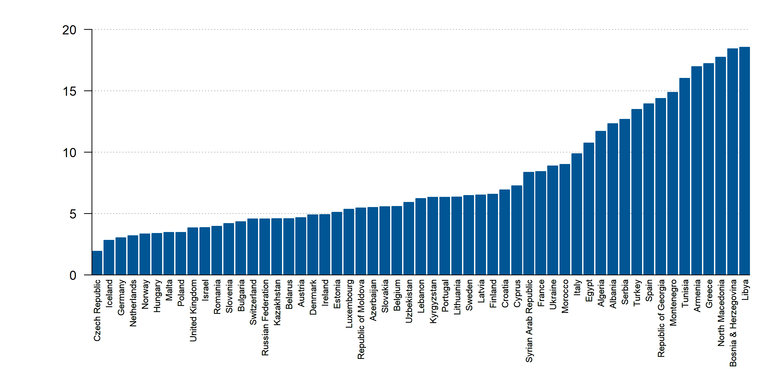
Unemployment, total (% of total labor force) (modeled ILO estimate), 2019
Source: World Bank. Data not available: Kosovo, San Marino

Slide 24
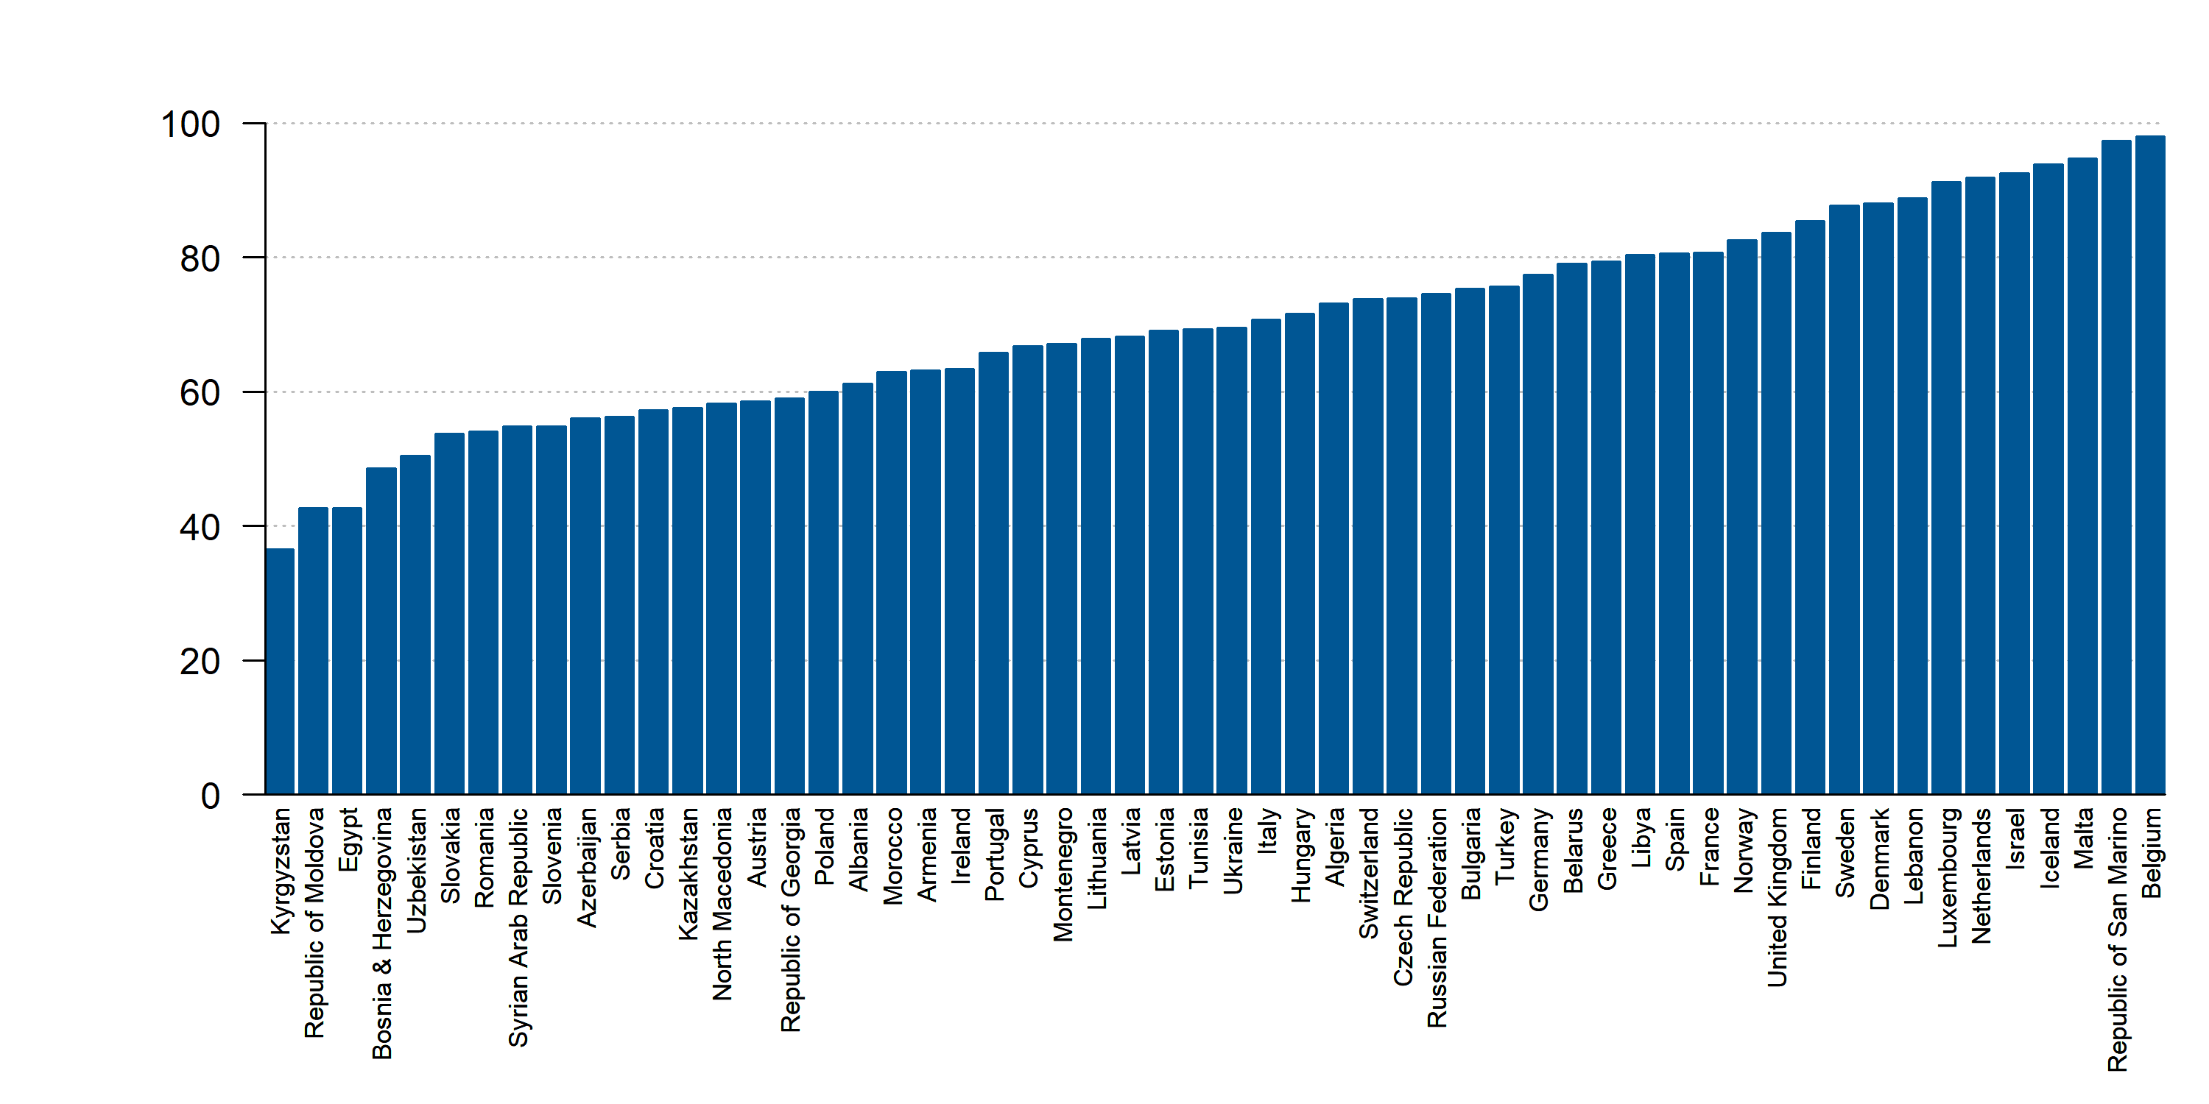
Urban population (% of total population), 2019
Source: World Bank. Data not available: Kosovo

Slide 25
Healthcare Expenditure

Slide 26
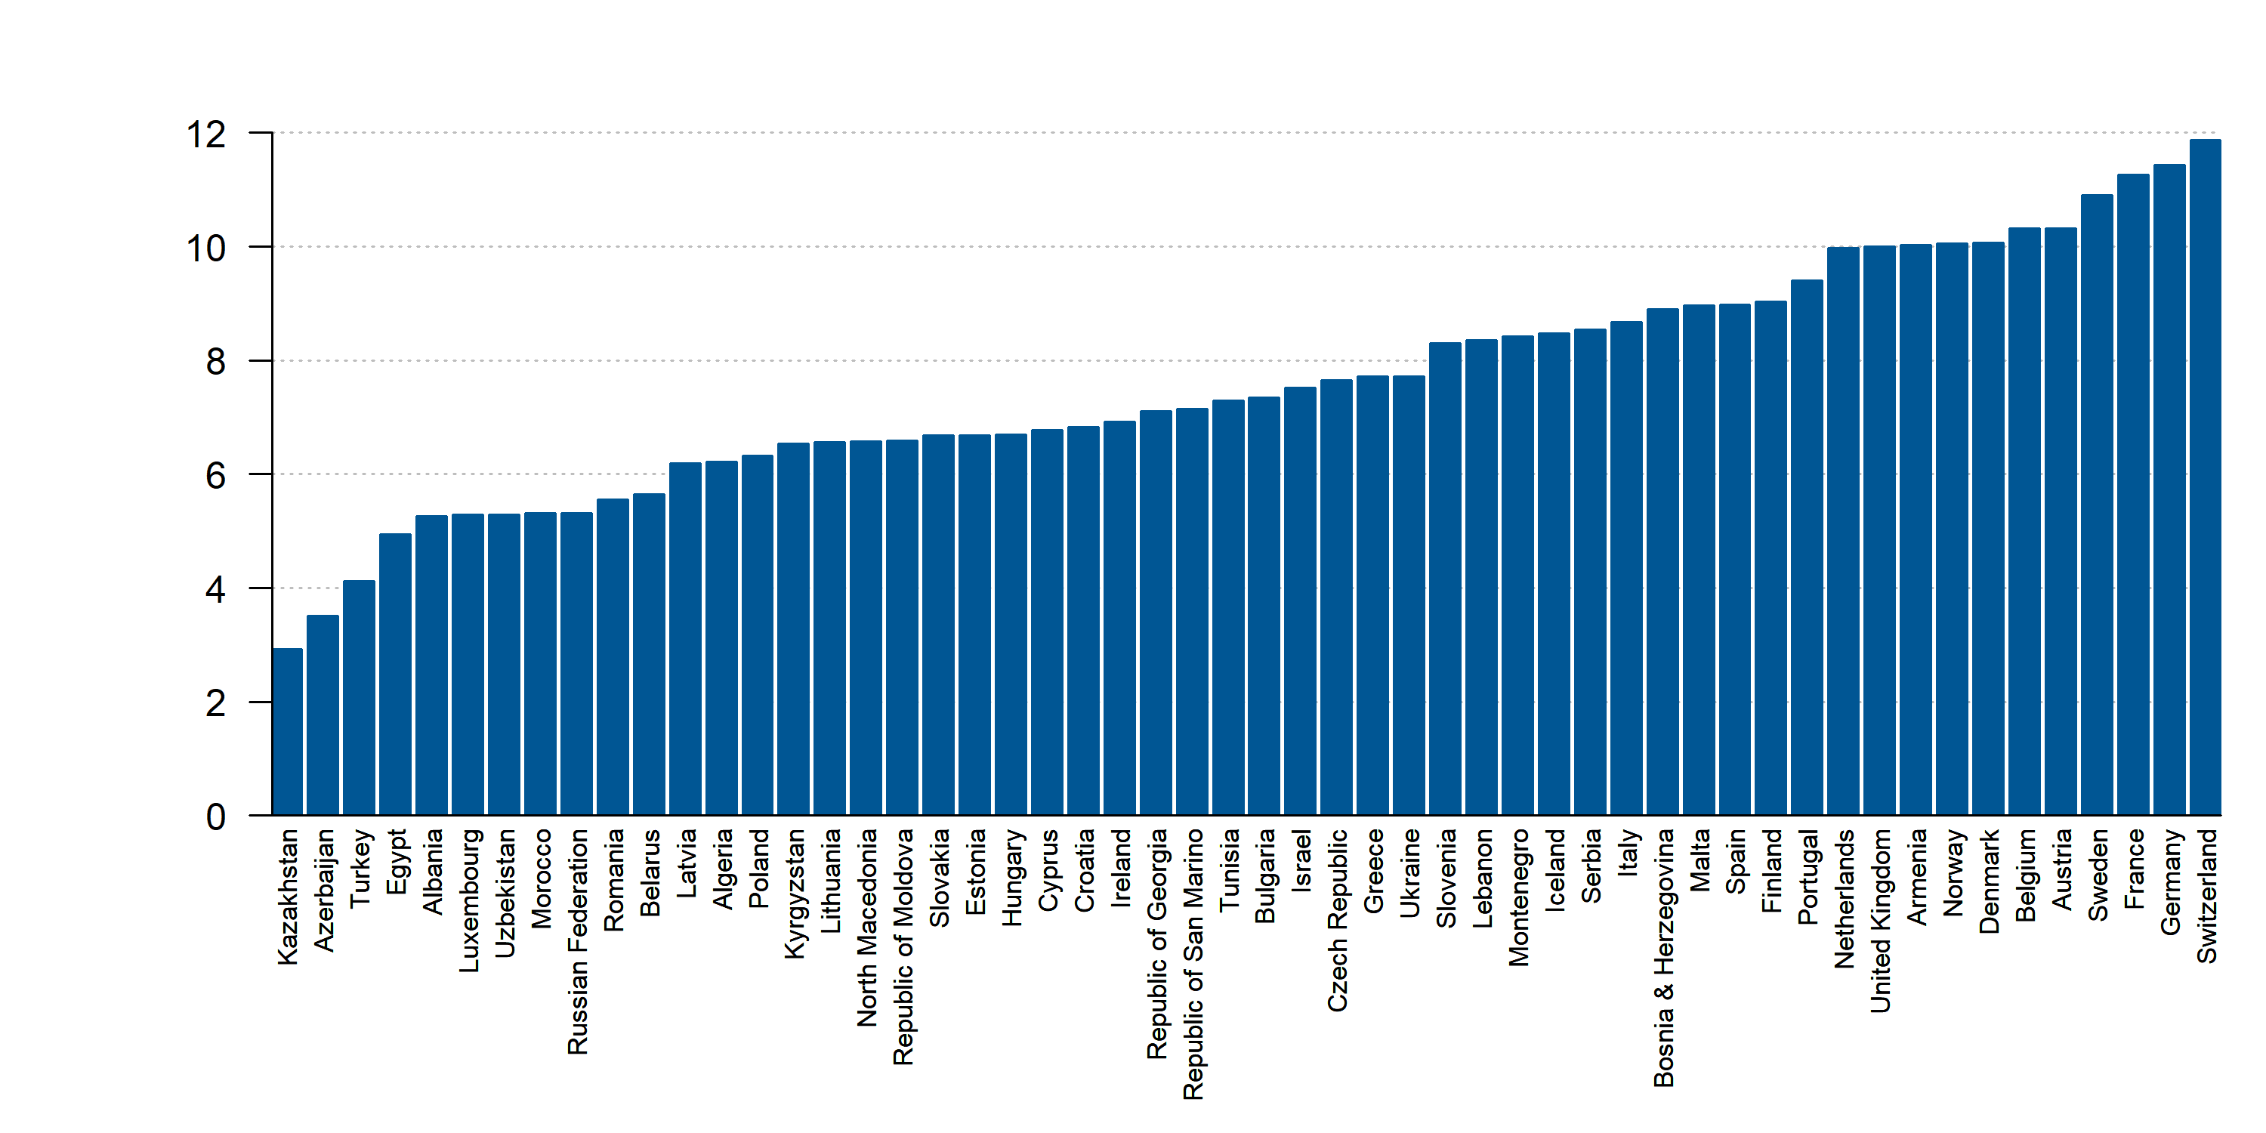
Current health expenditure (% of GDP), 2018
Source: World Bank. Data not available: Kosovo

Slide 27
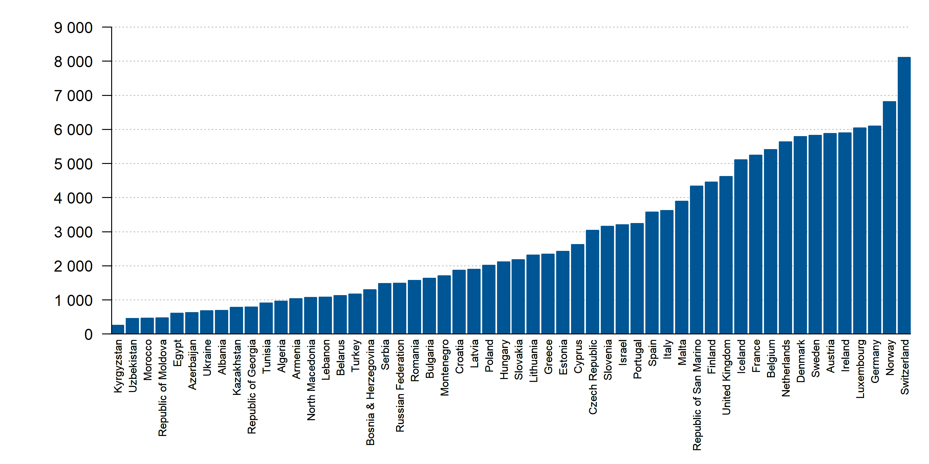
Current health expenditure per capita, PPP (current international $), 2018
Source: World Bank. Data not available: Kosovo

Slide 28
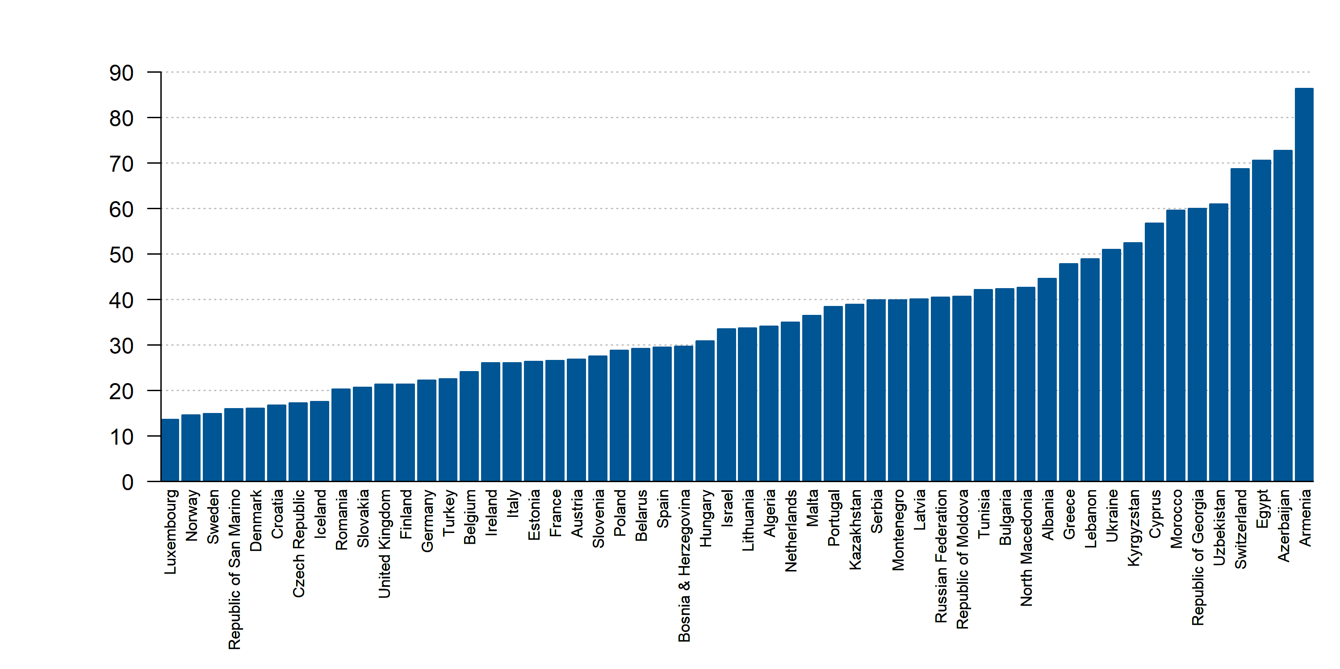
Domestic private health expenditure (% of current health expenditure), 2018
Source: World Bank. Data not available: Kosovo

Slide 29
Risk factors

Slide 30
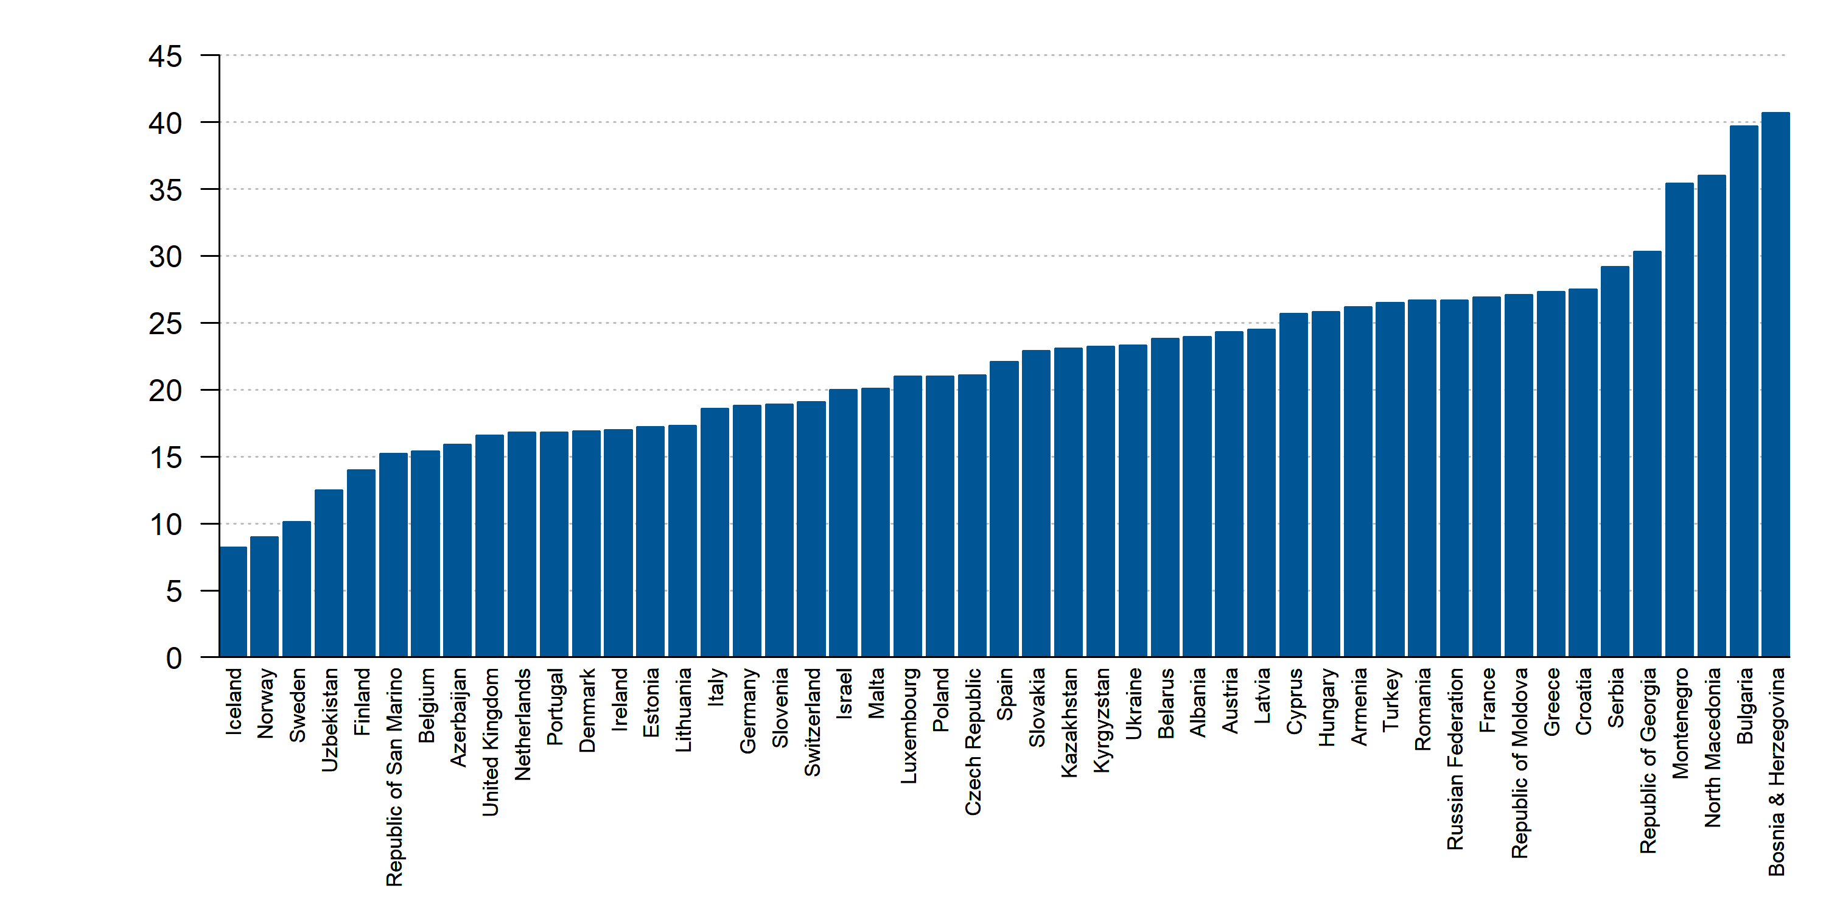
Percentage of regular daily smokers in the population, total age 15+,
2018 or latest year
Source: WHO. Data not available: Algeria, Egypt, Kosovo, Lebanon, Libya, Morocco, Syria, Tunisia

Slide 31
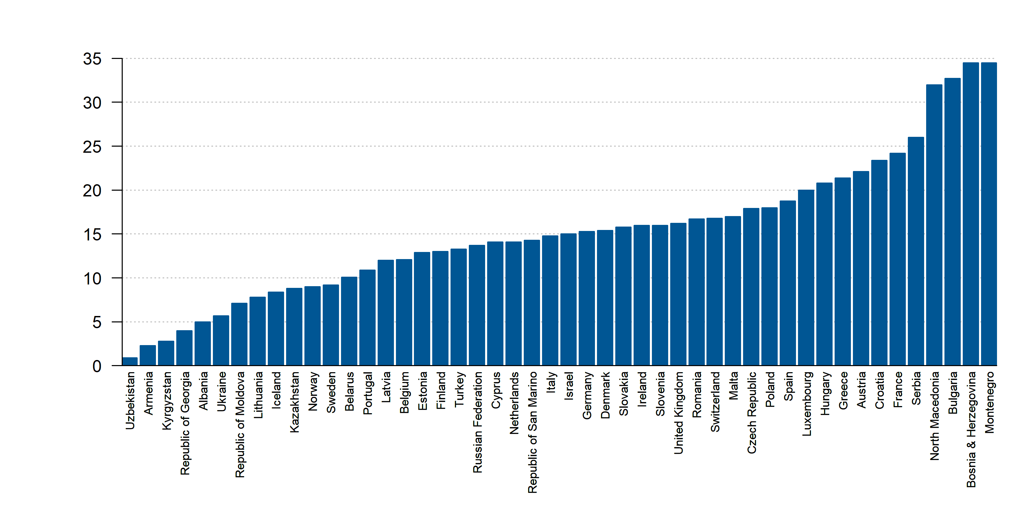
Percentage of regular daily smokers in the population, female age 15+, 2018 or latest year
Source: WHO. Data not available: Algeria, Egypt, Kosovo, Lebanon, Libya, Morocco, Syria, Tunisia

Slide 32
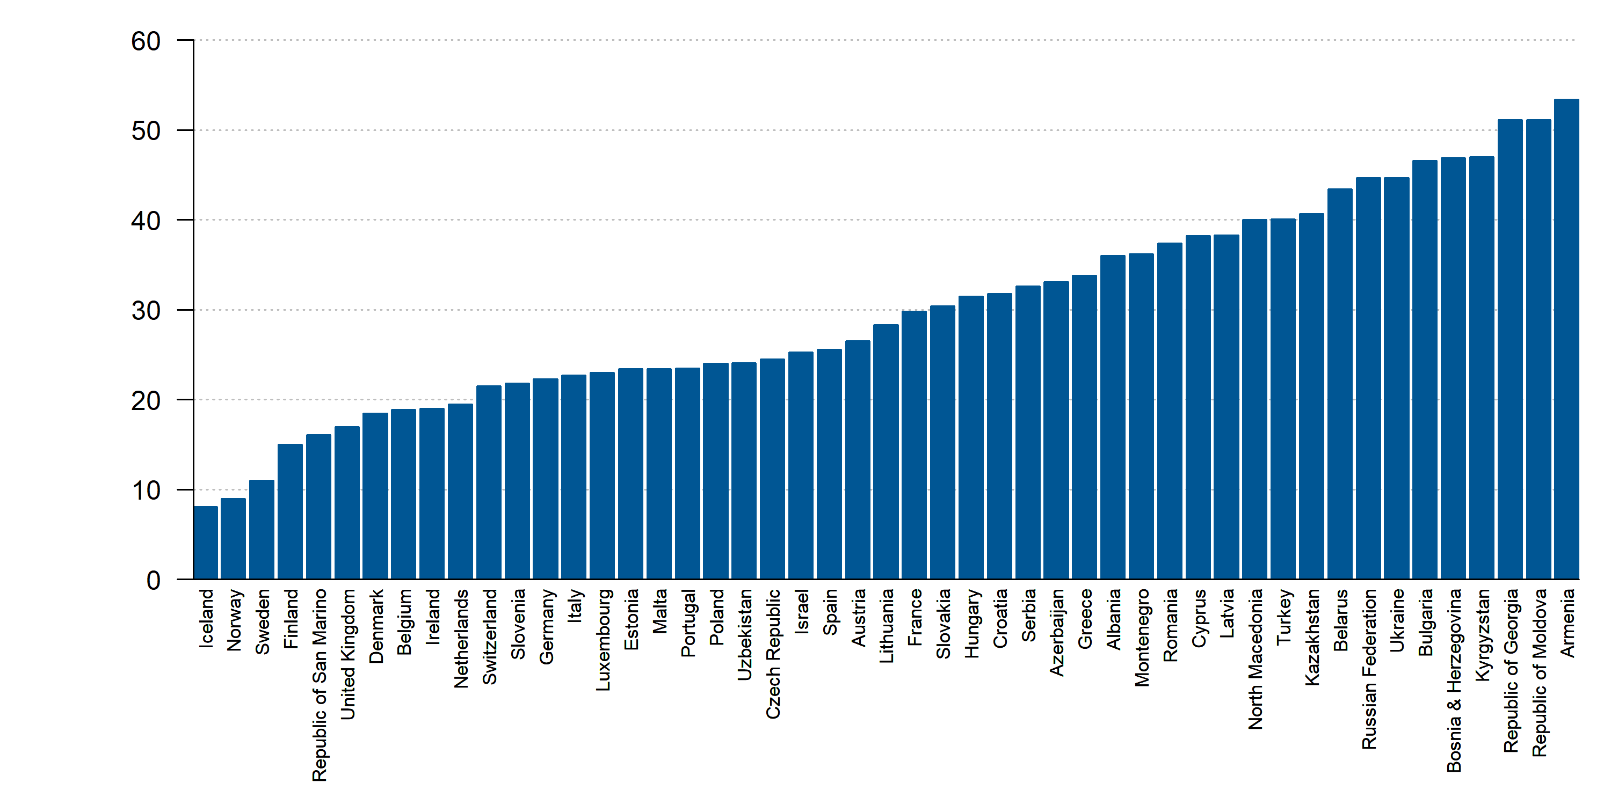
Percentage of regular daily smokers in the population,male age 15+, 2018 or latest year
Source: WHO. Data not available: Algeria, Egypt, Kosovo, Lebanon, Libya, Morocco, Syria, Tunisia

Slide 33
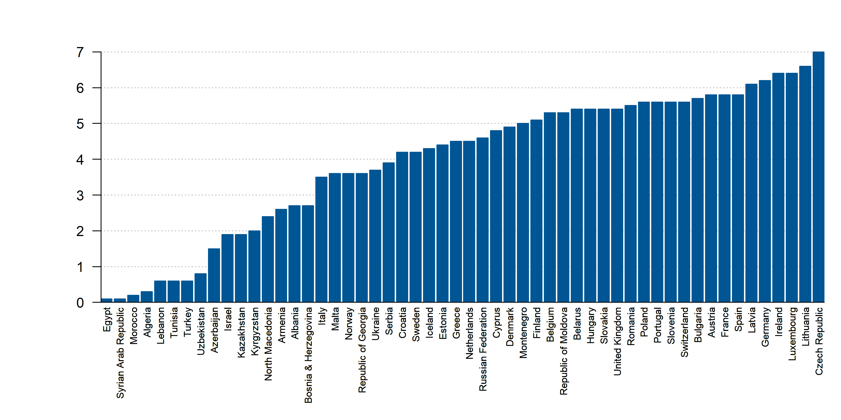
Alcohol, total per capita (15+) consumption (in litres of pure alcohol) among females, 2016-2018
Source: World Bank. Data not available: Kosovo, San Marino

Slide 34
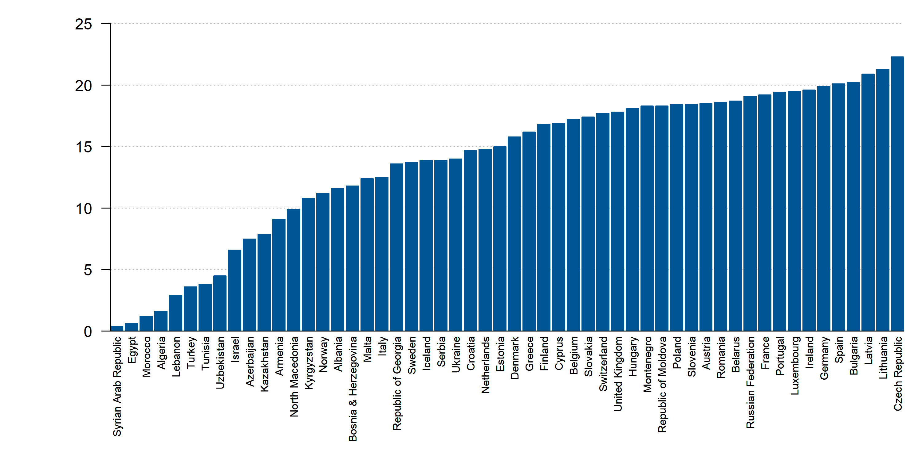
Alcohol, total per capita (15+) consumption (in litres of pure alcohol) among males, 2016-2018
Source: World Bank. Data not available: Kosovo, San Marino

Slide 35
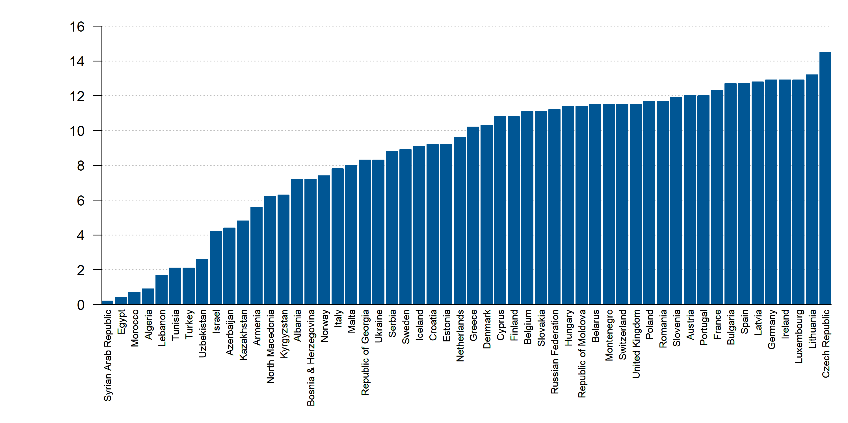
Alcohol, total per capita (15+) consumption (in litres of pure alcohol), 2016-2018
Source: World Bank. Data not available: Kosovo, San Marino

Slide 36
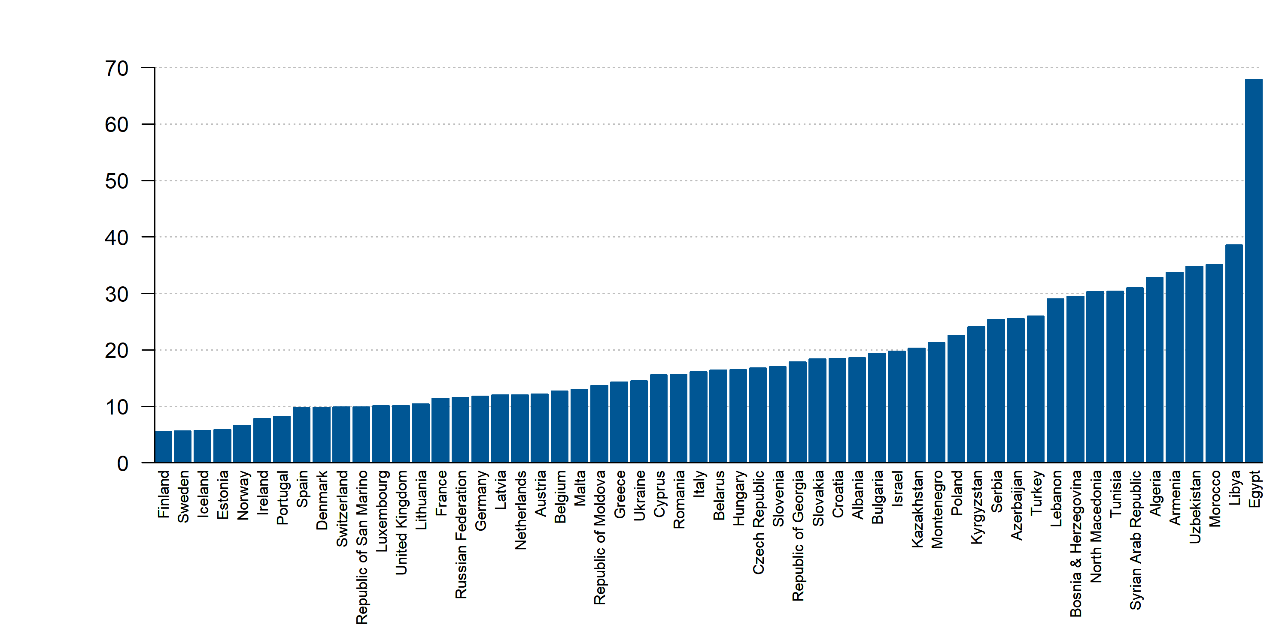
Average Annual Population-Weighted PM2.5, (ug/m3), 2019
Source: State of Global Air. Data not available: Kosovo

Slide 37
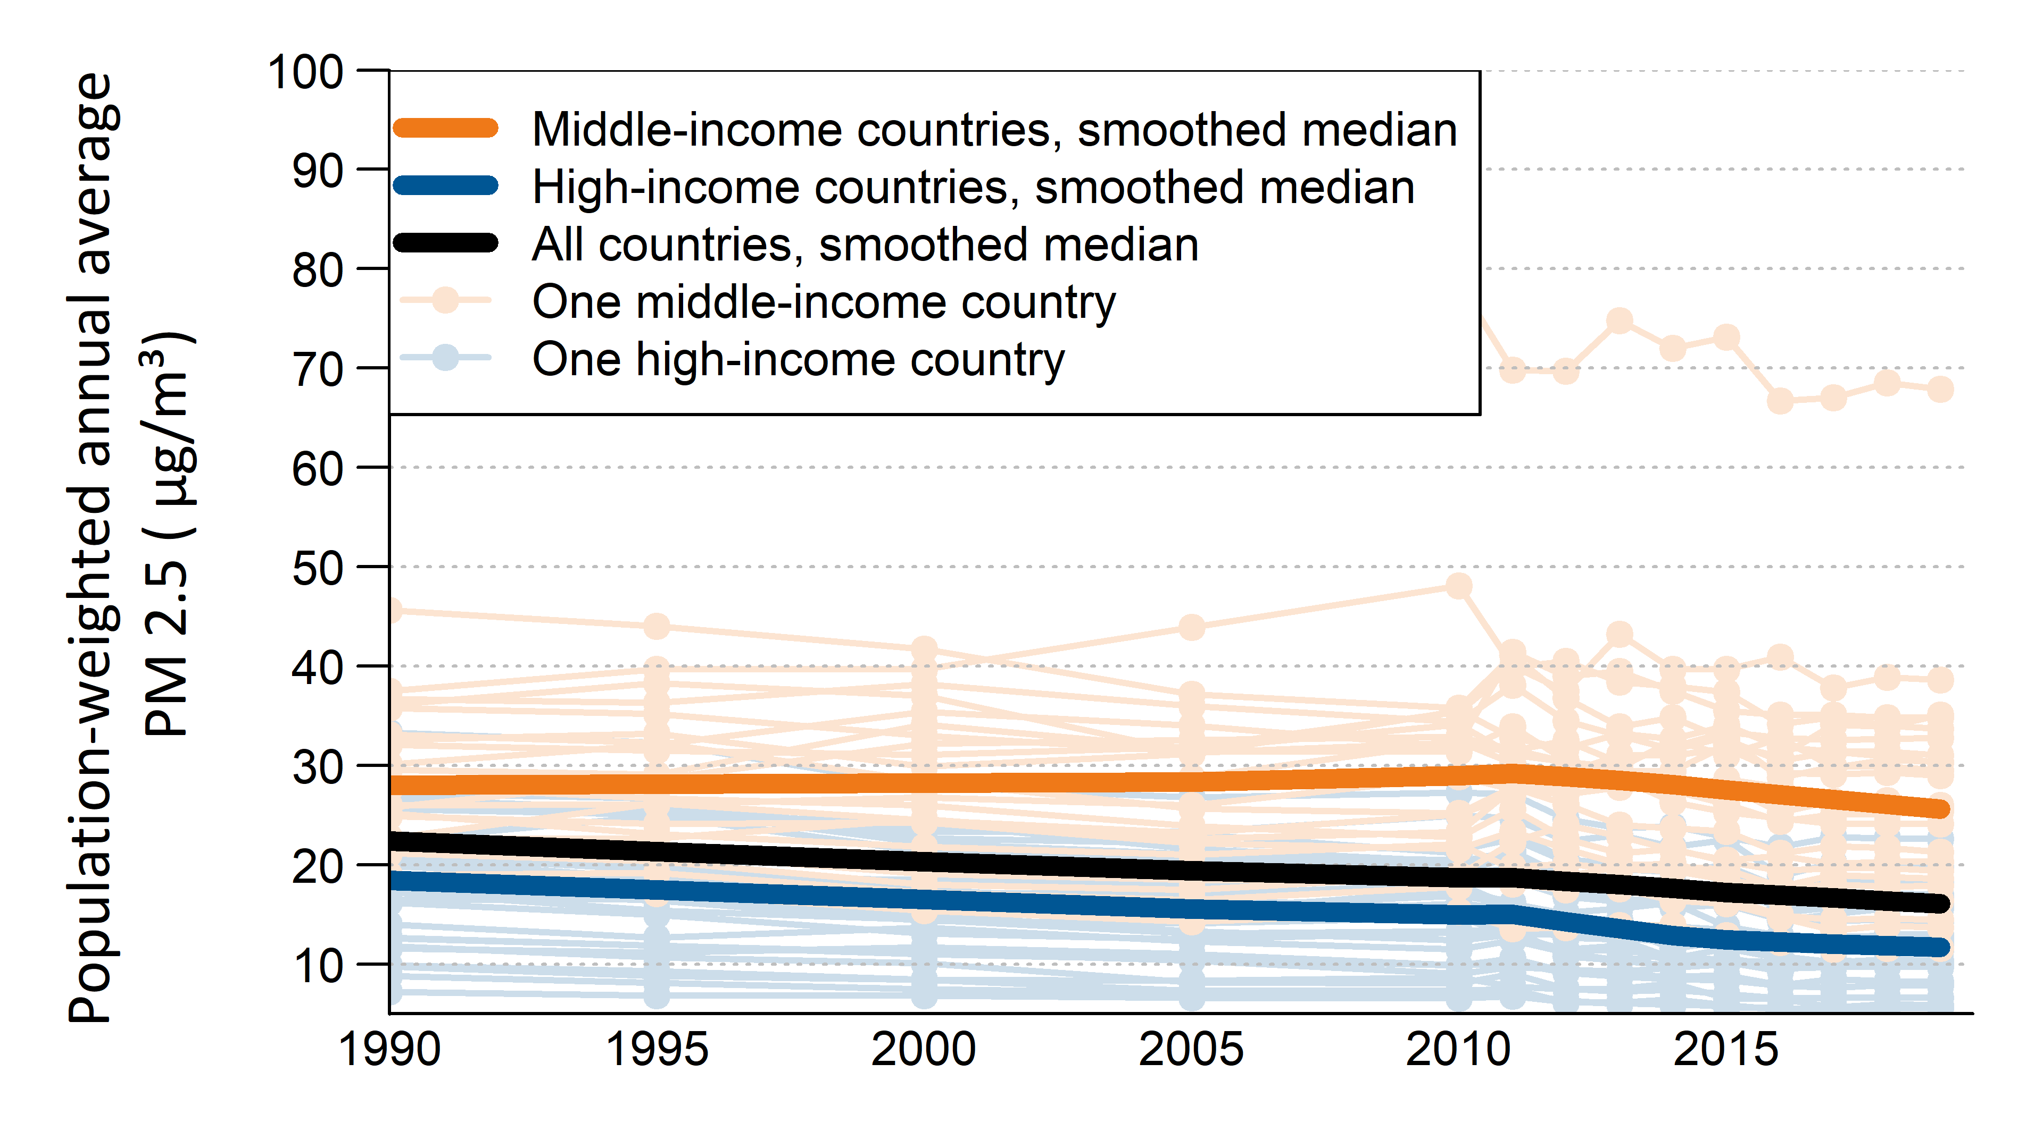
Average Annual Population-Weighted PM2.5, (ug/m3), 1990- 2019
Source: State of Global Air. Data not available: Kosovo

Slide 38
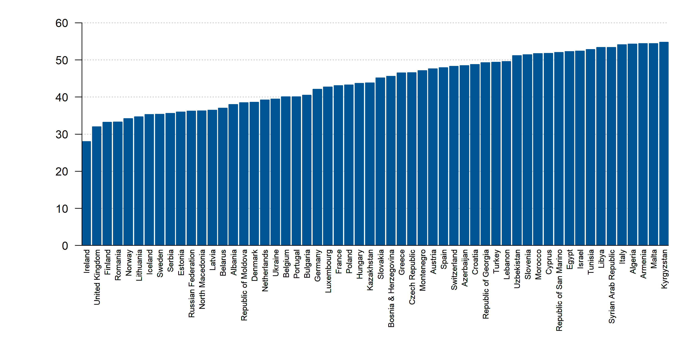
Average Seasonal Population-Weighted Ozone, (ppb), 2019
Source: State of Global Air. Data not available: Kosovo

Slide 39
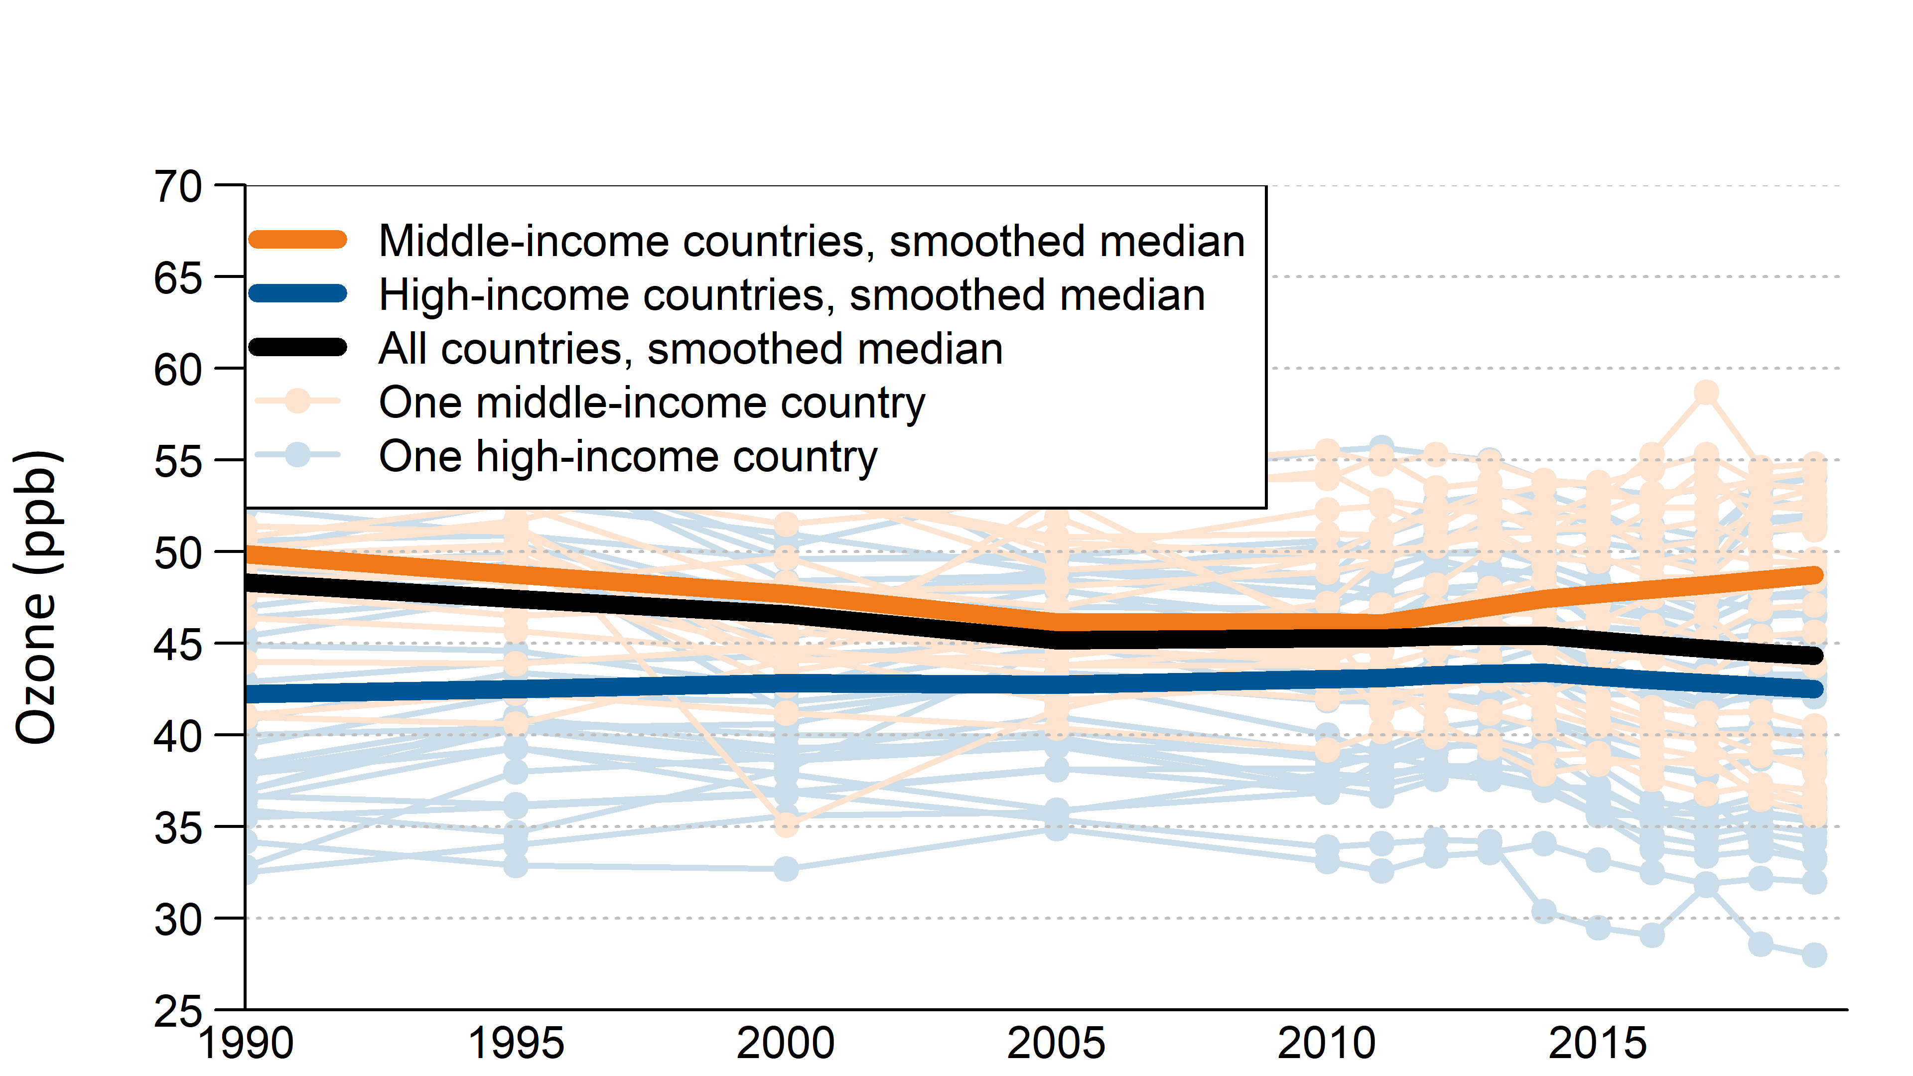
Average Seasonal Population-Weighted Ozone, (ppb), 1990-2019
Source: State of Global Air. Data not available: Kosovo

Slide 40
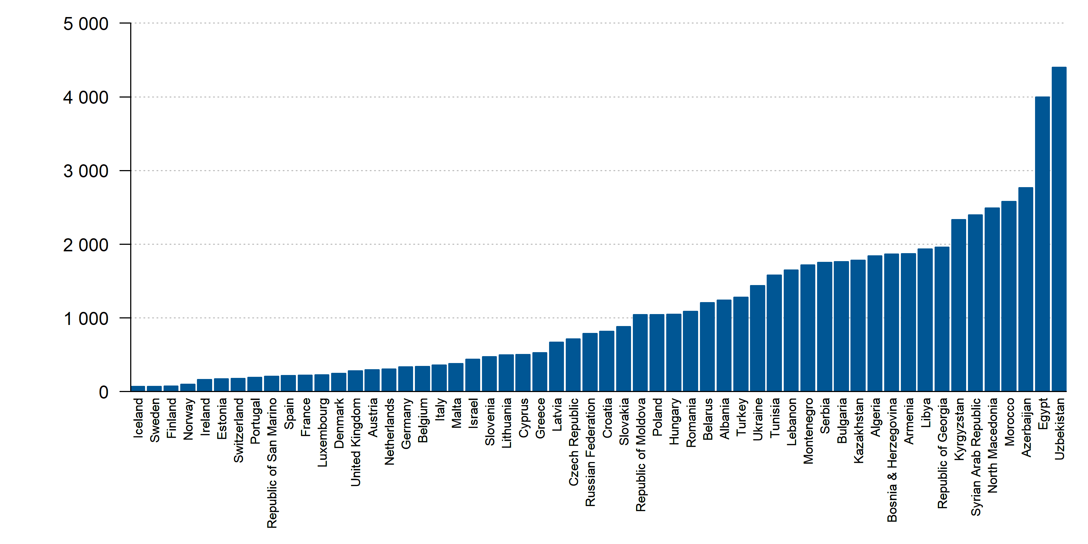
DALYs (Disability-Adjusted Life Years) of Particulate matter pollution (Rate, Age-standardized), 2019
Source: IHME. Data not available: Kosovo

Slide 41
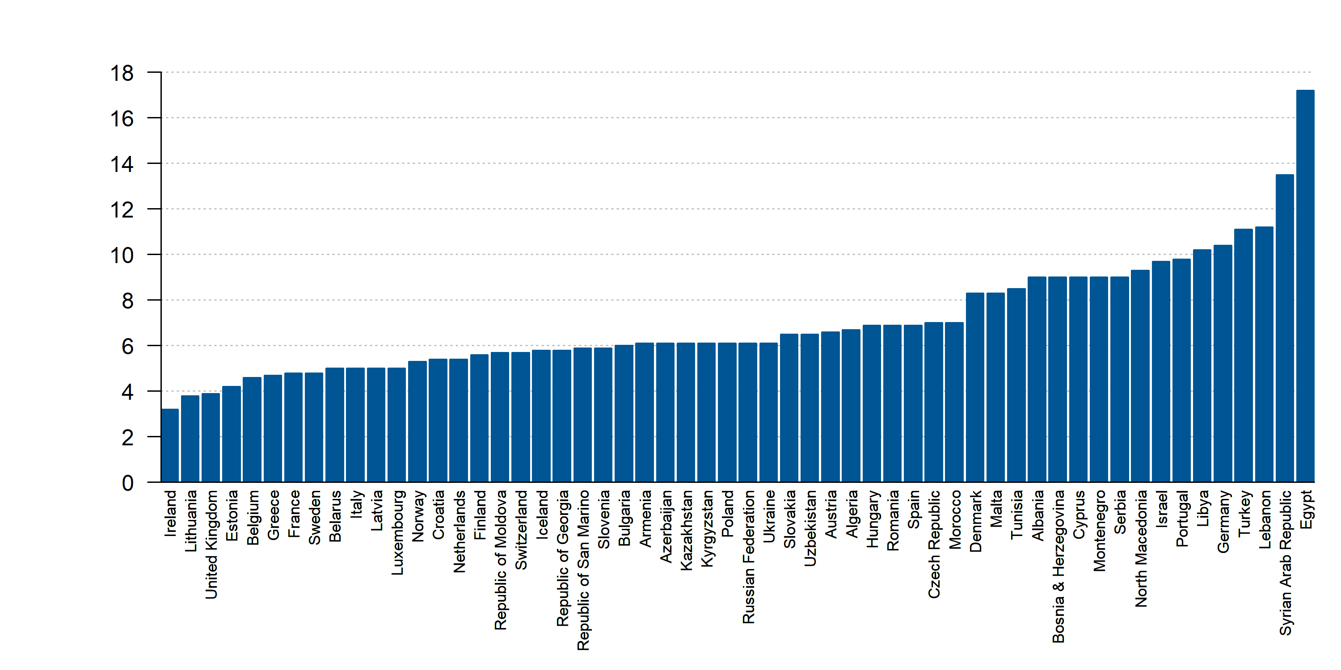
Diabetes prevalence (% of population ages 20 to 79), 2019
Source: World Bank. Data not available: Kosovo, San Marino

Slide 42
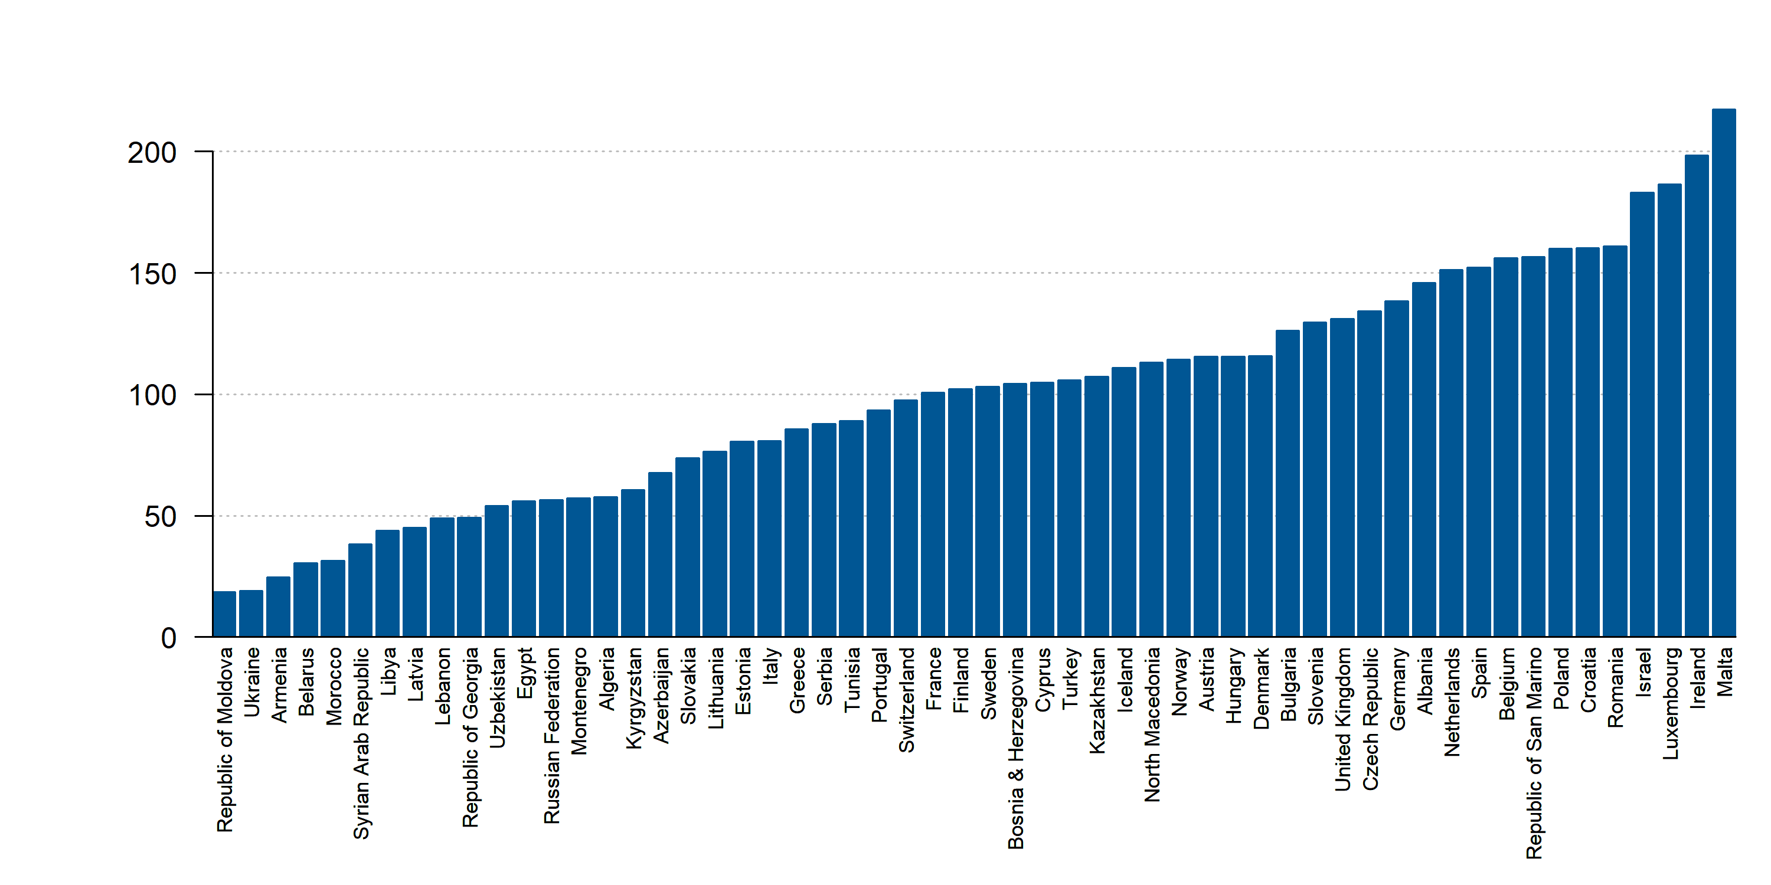
Estimated intake of sugar-sweetened beverages in adults aged 25 and older(g/day), 2019
Source: Global Nutrition Report. Data not available: Kosovo

Slide 43
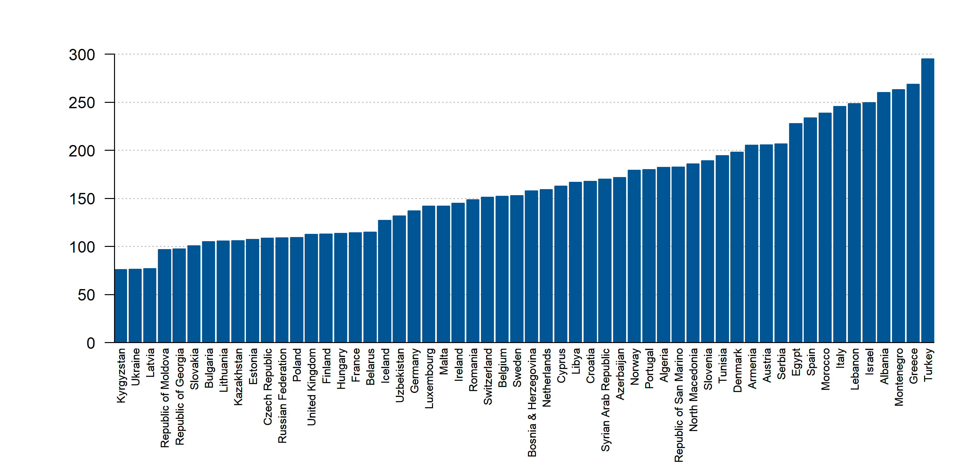
Estimated intake of fruit in adults aged 25 and older (g/day), 2019
Source: Global Nutrition Report. Data not available: Kosovo

Slide 44
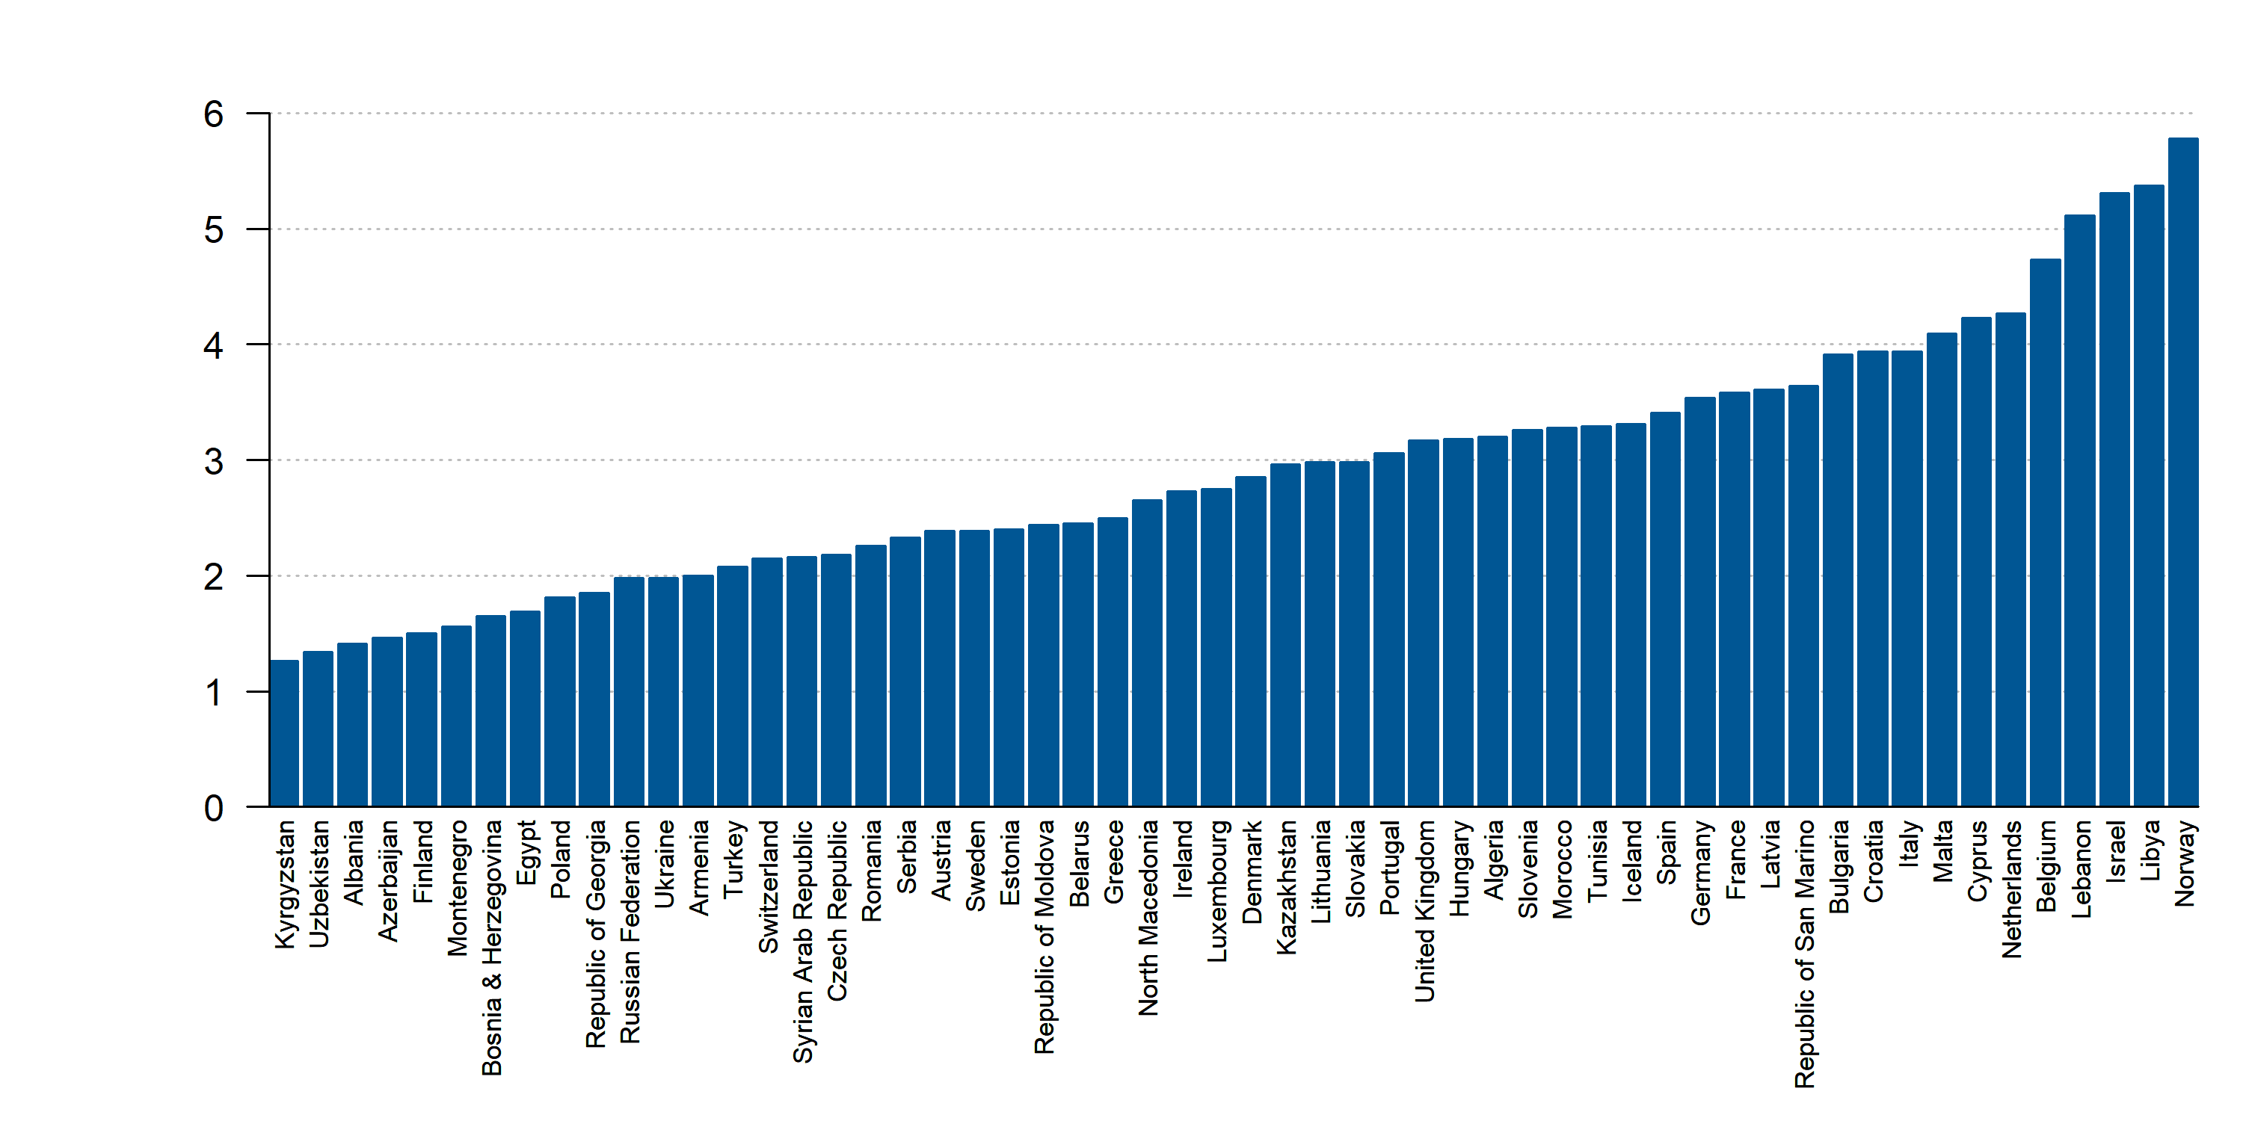
Estimated intake of polyunsaturated fatty acids in adults aged 25 and older (% of total daily energy), 2019
Source: Global Nutrition Report. Data not available: Kosovo

Slide 45
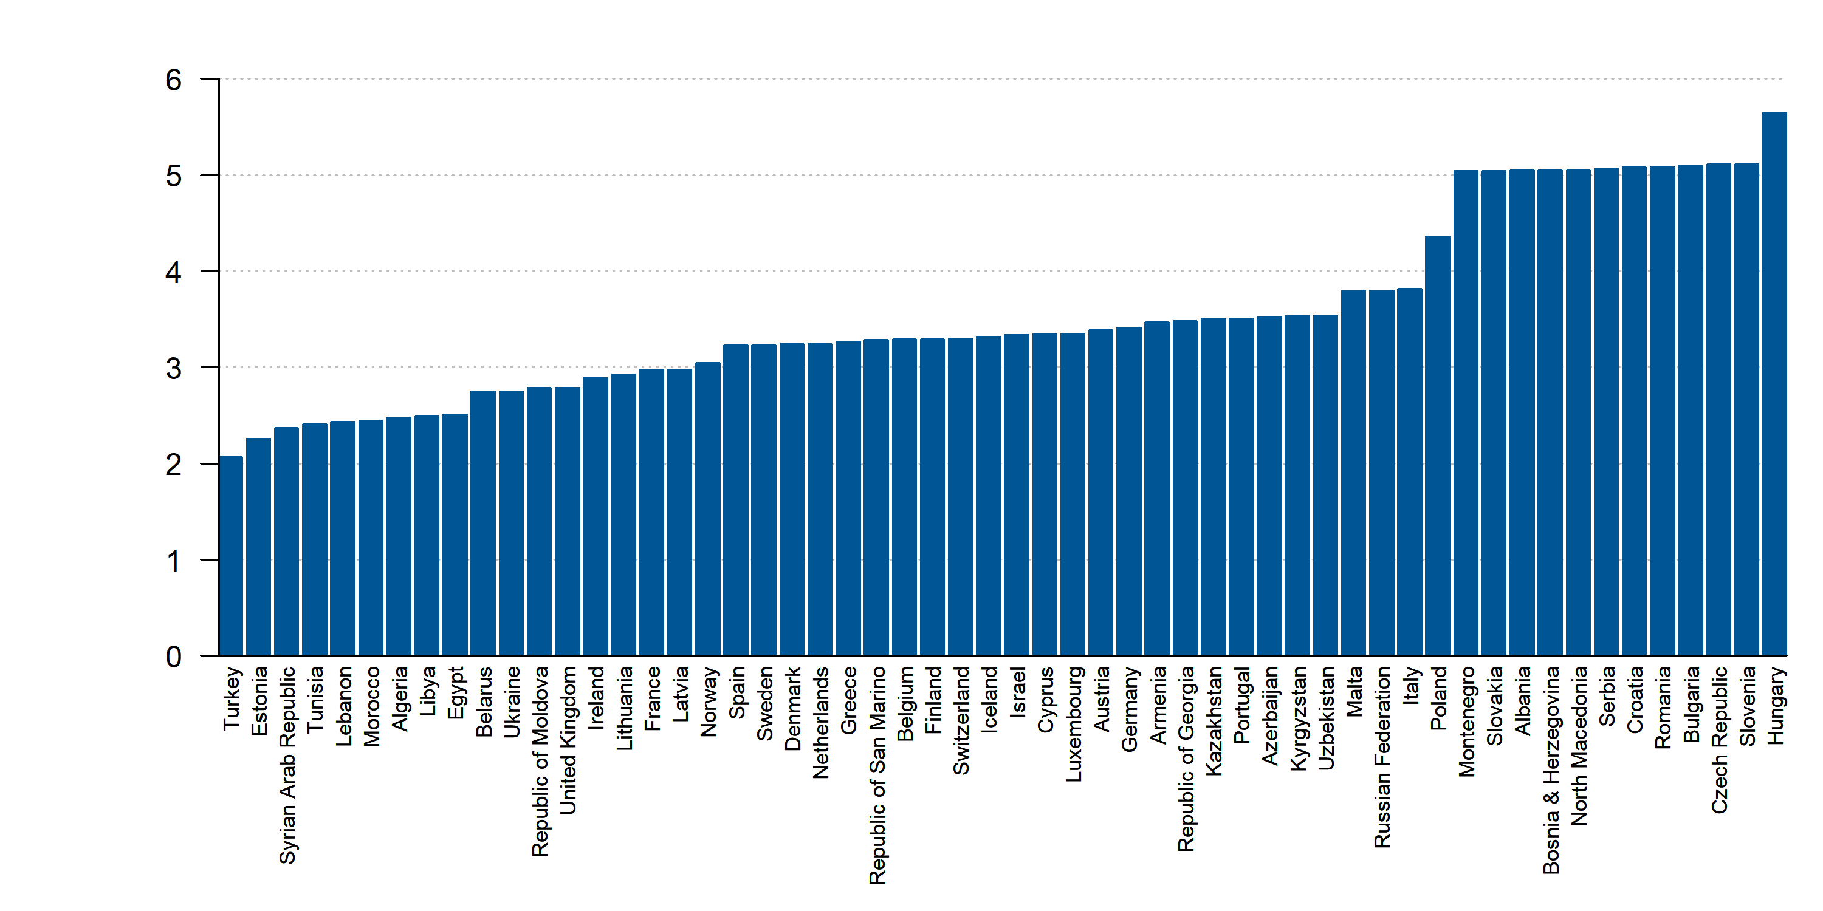
Estimated intake of sodium in adults aged 25 and older (g/day), 2019
Source: Global Nutrition Report. Data not available: Kosovo

Slide 46
Estimated intake of trans fatty acids in adults aged 25 and older (% of total daily energy), 2019
Source: Global Nutrition Report. Data not available: Kosovo

Slide 47
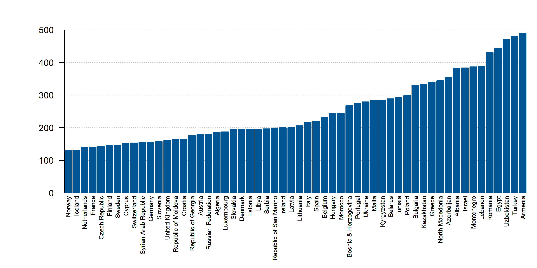
Estimated intake of vegetables in adults aged 25 and older (g/day), 2019
Source: Global Nutrition Report. Data not available: Kosovo

Slide 48
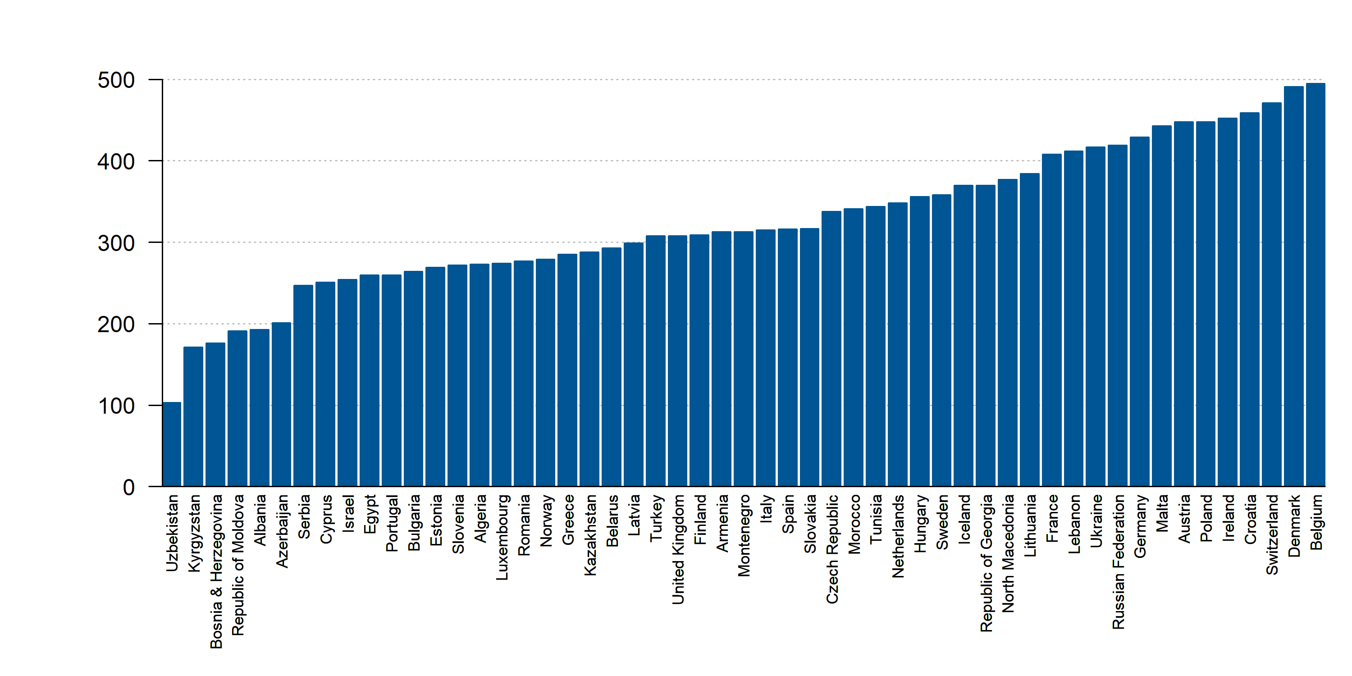
Food Balances Sugar and sweeteners supply (kcal/capita/day), 2018
Source: Food and Agriculture Organization of the United Nations. Data not available: Kosovo, Libya, San Marino, Syria

Slide 49
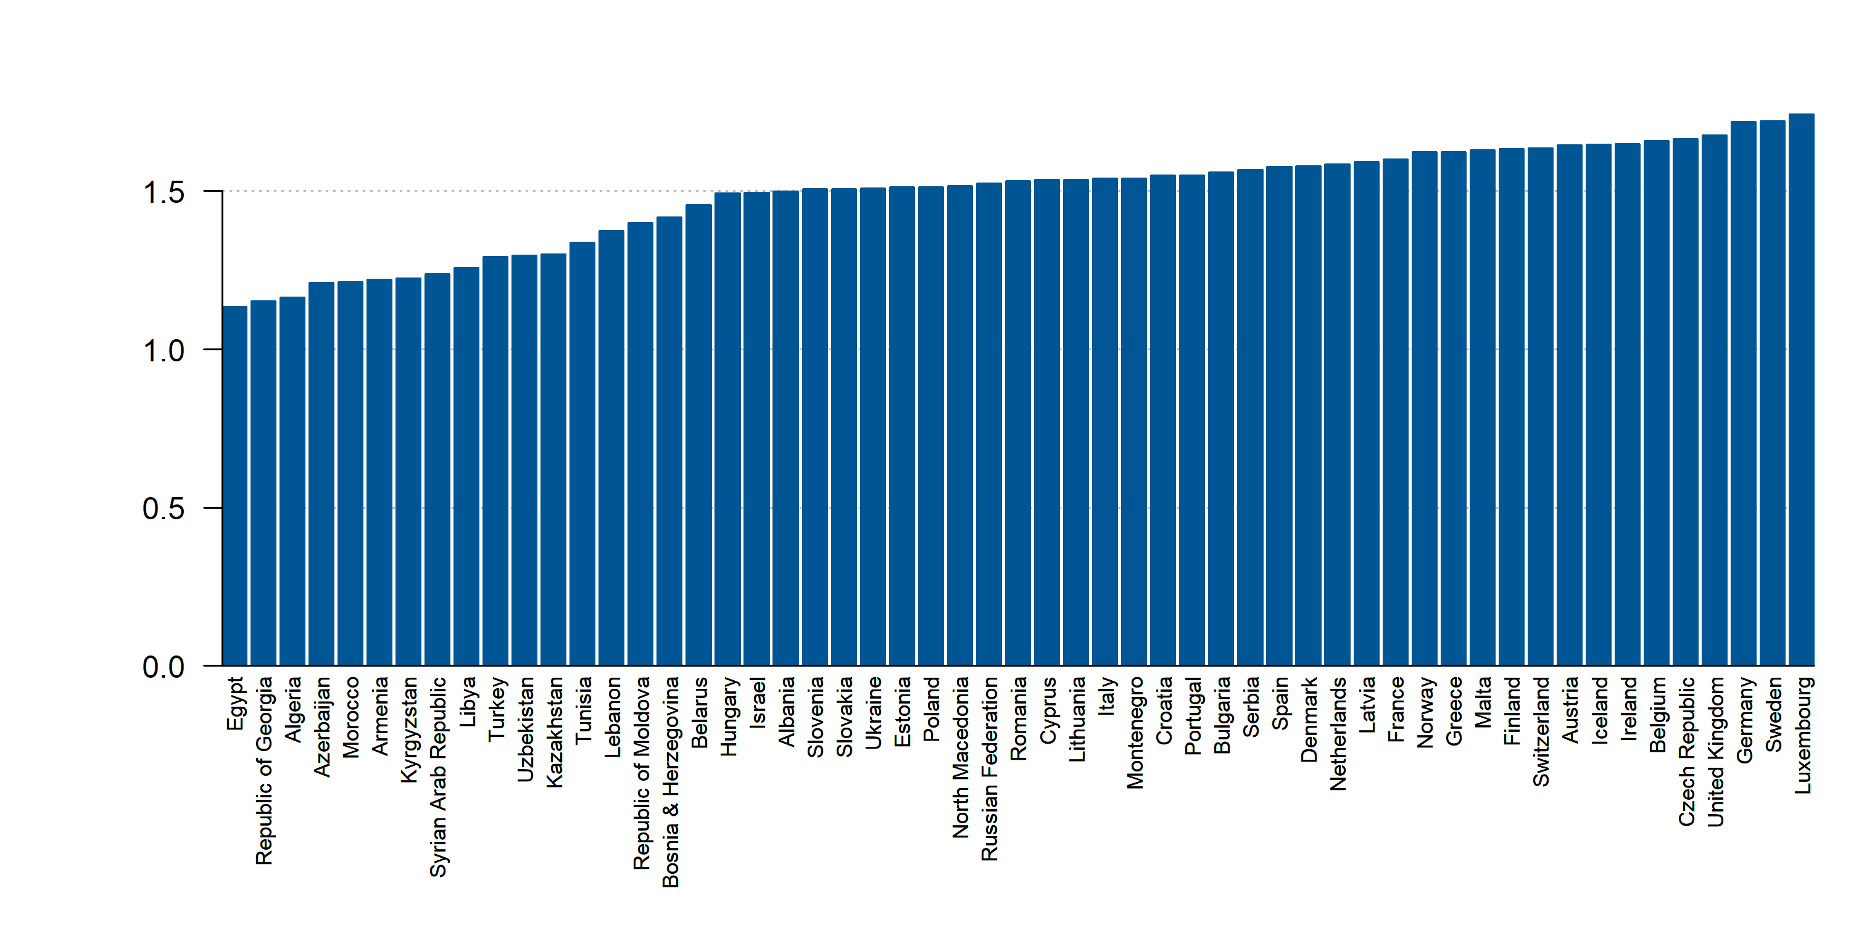
Mean HDL cholesterol (mmol/L) among females, 2018
Source: NCD Risk Factor Collaboration. Data not available: Kosovo, San Marino

Slide 50
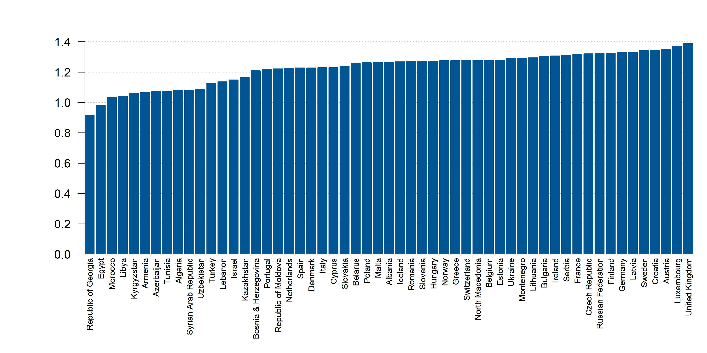
Mean HDL cholesterol (mmol/L) among males, 2018
Source: NCD Risk Factor Collaboration. Data not available: Kosovo, San Marino

Slide 51
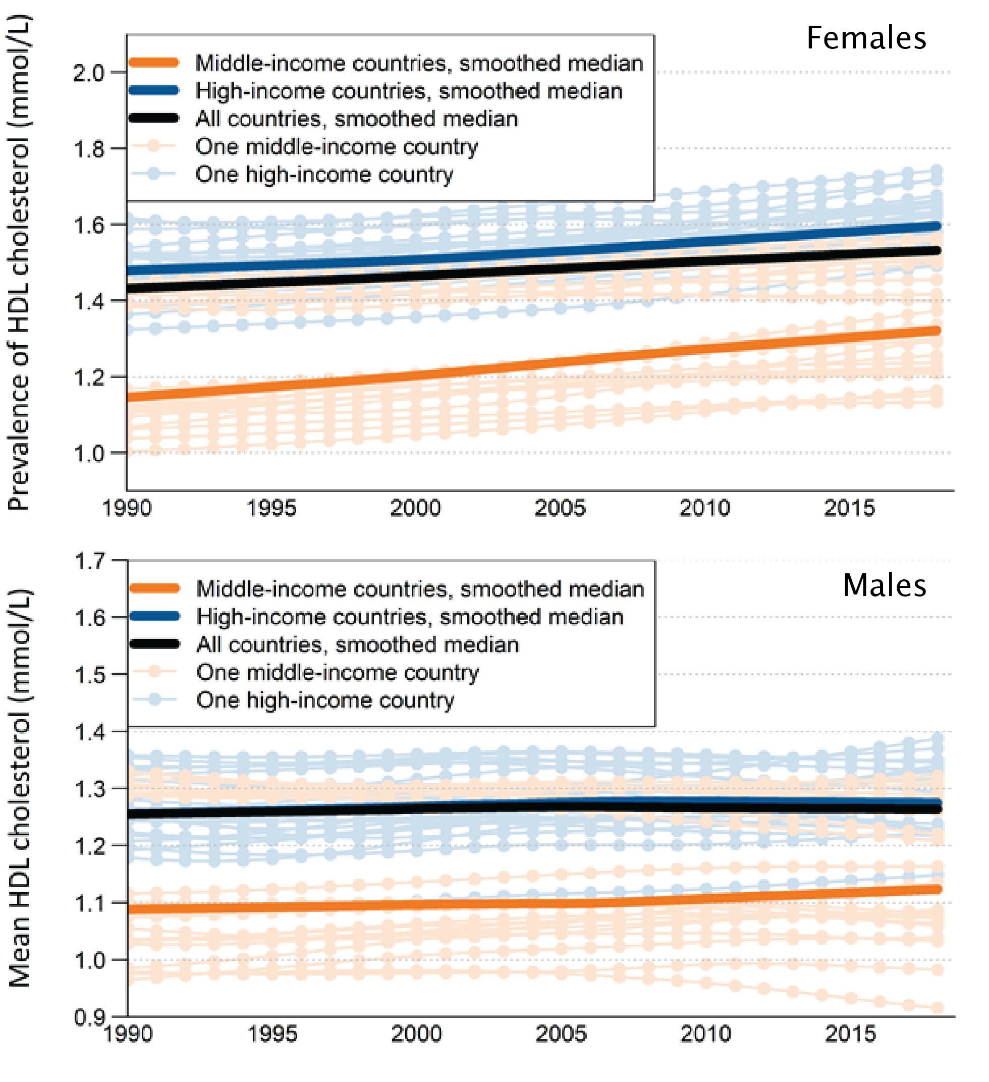
Mean HDL cholesterol (mmol/L) among males and females, 1990- 2018
Source: NCD Risk Factor Collaboration. Data not available: Kosovo, San Marino

Slide 52
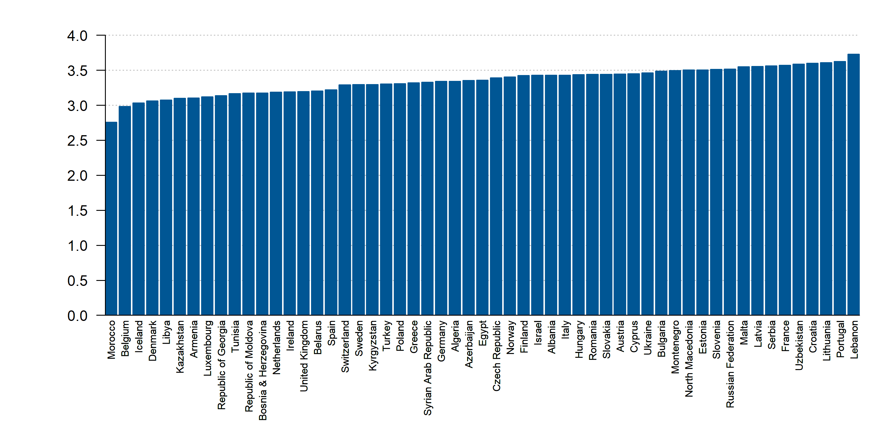
Mean non-HDL cholesterol (mmol/L) among females, 2018
Source: NCD Risk Factor Collaboration. Data not available: Kosovo, San Marino

Slide 53
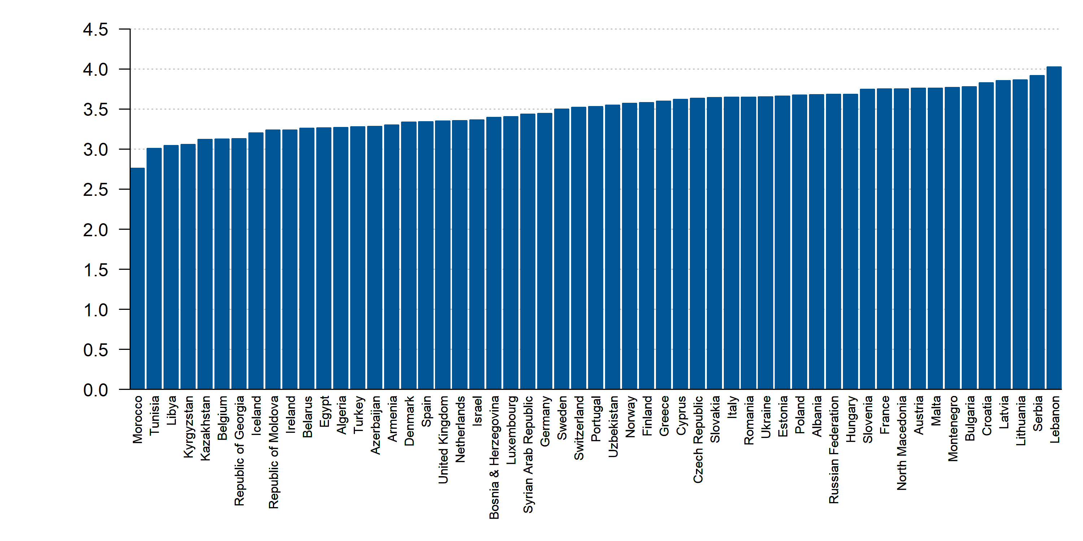
Mean non-HDL cholesterol (mmol/L) among males, 2018
Source: NCD Risk Factor Collaboration. Data not available: Kosovo, San Marino

Slide 54
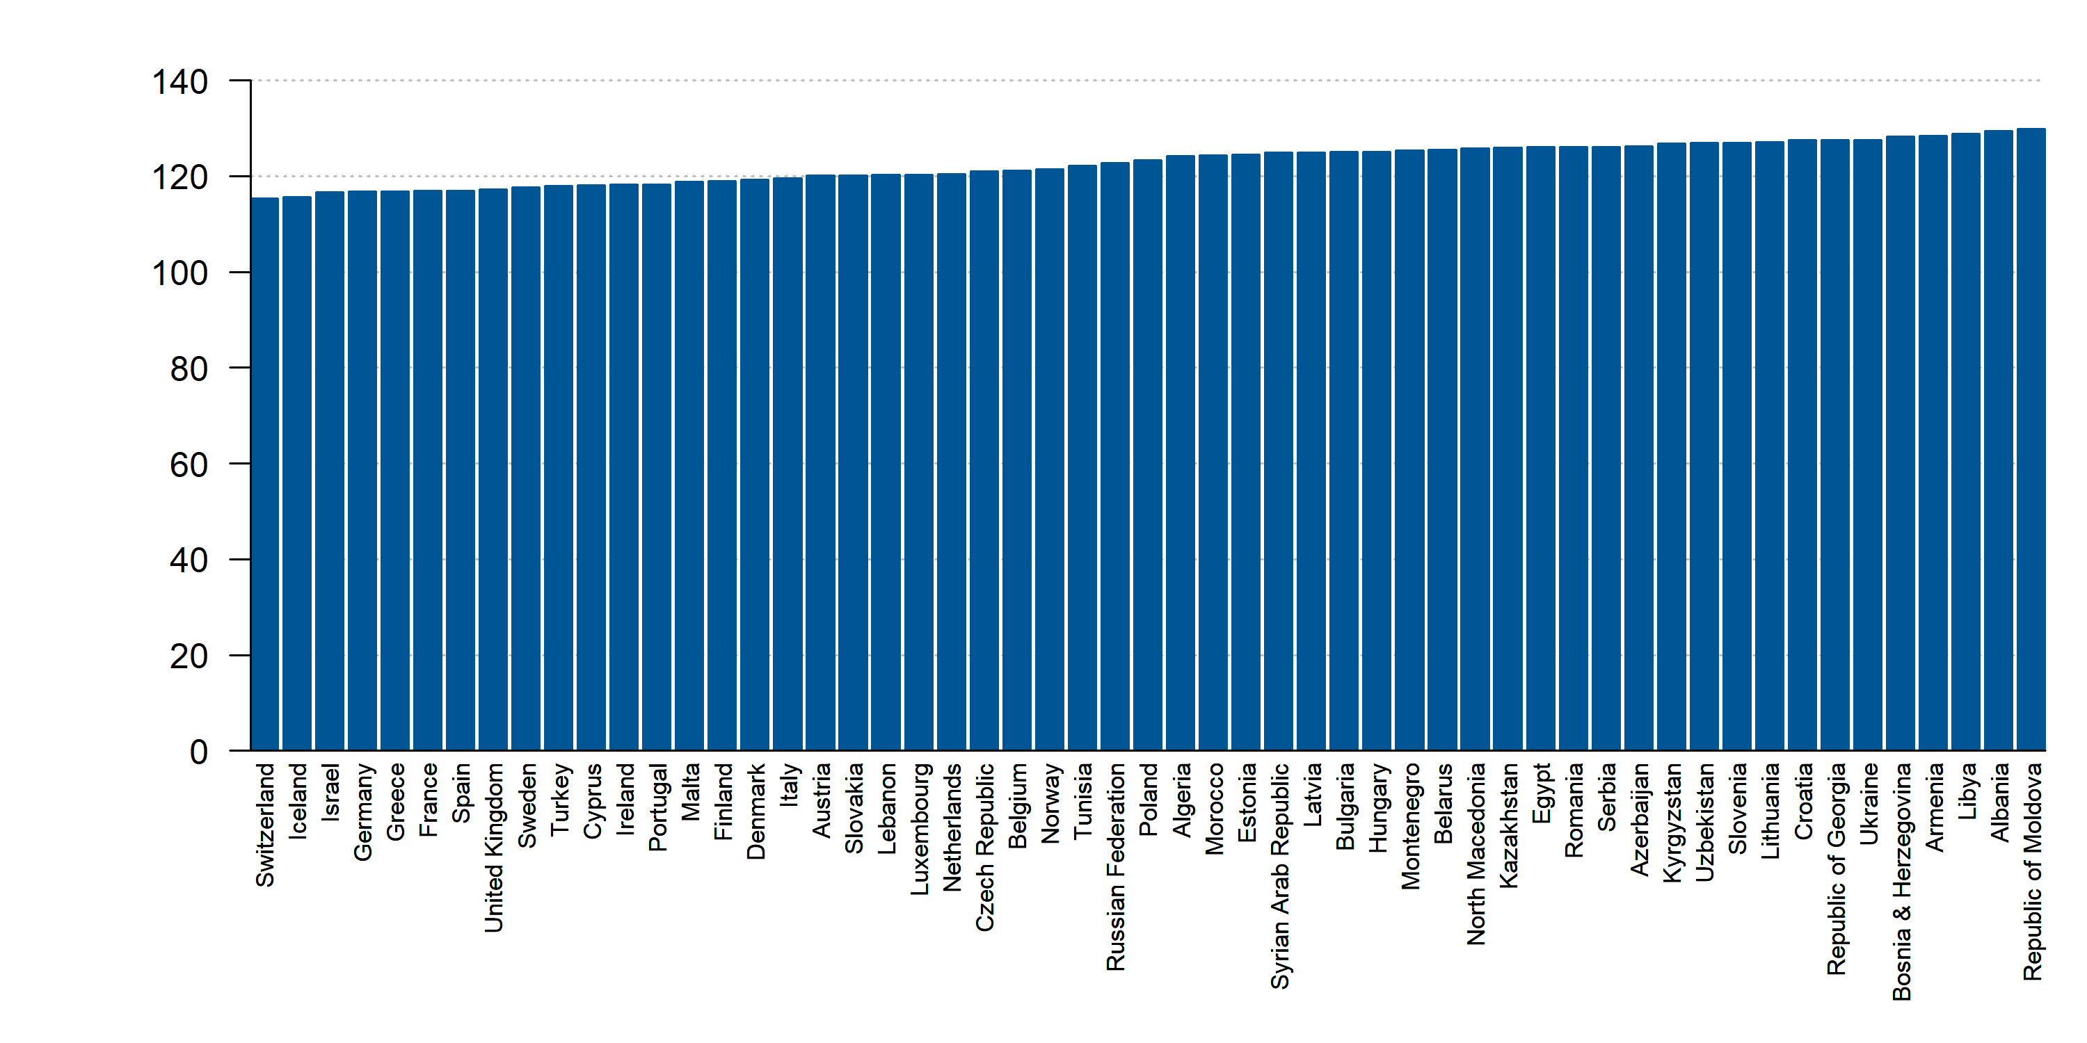
Mean systolic blood pressure (age-standardized estimate) among females 18+ years, 2015
Source: WHO. Data not available: Kosovo, San Marino

Slide 55
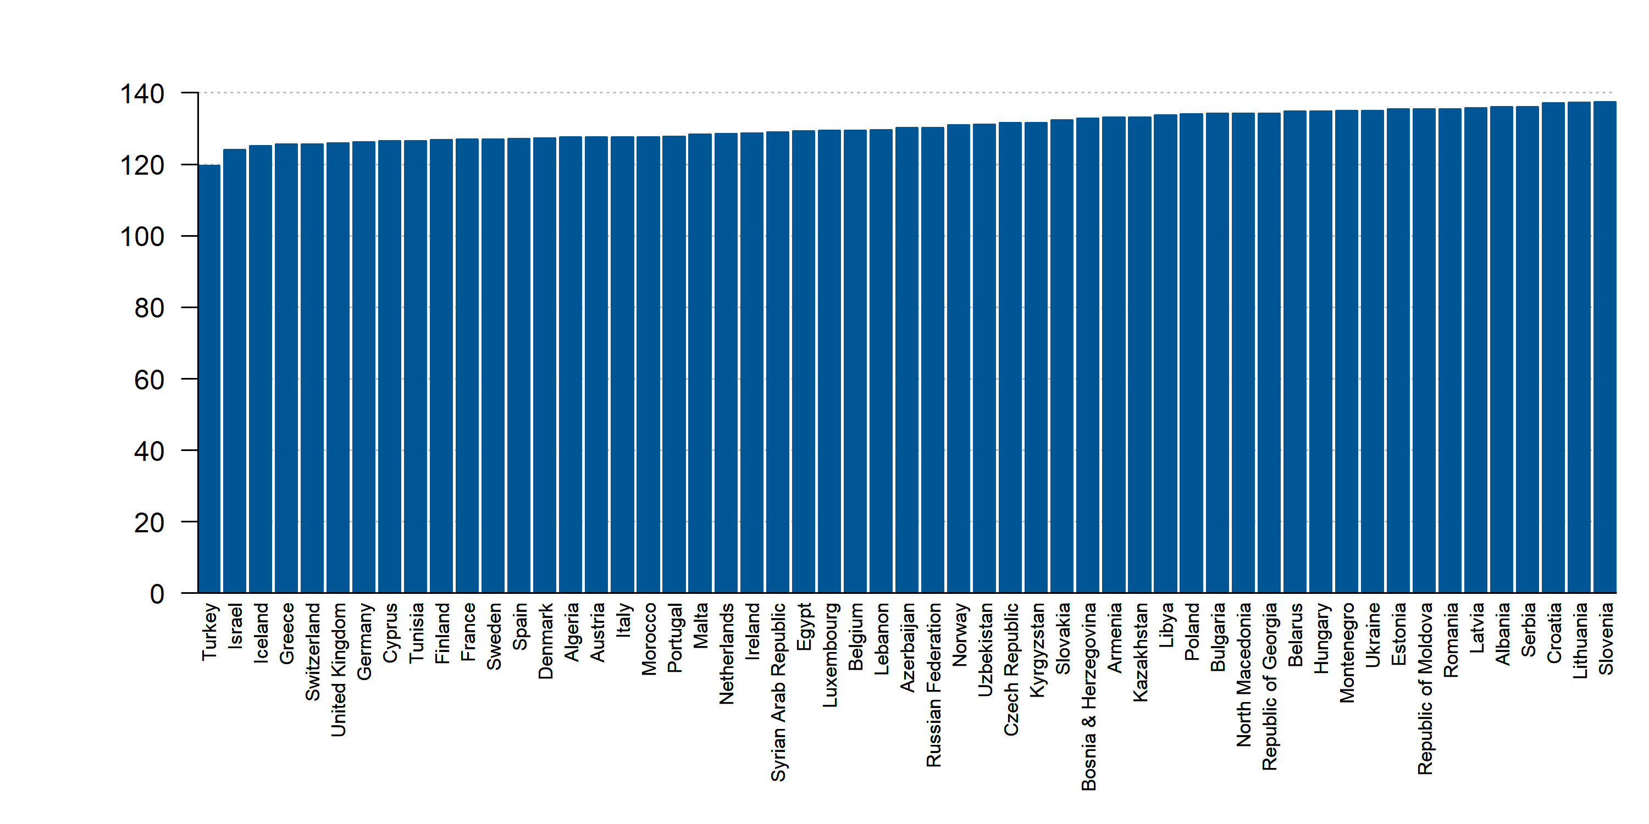
Mean systolic blood pressure (age-standardized estimate) among males 18+ years, 2015
Source: WHO. Data not available: Kosovo, San Marino

Slide 56
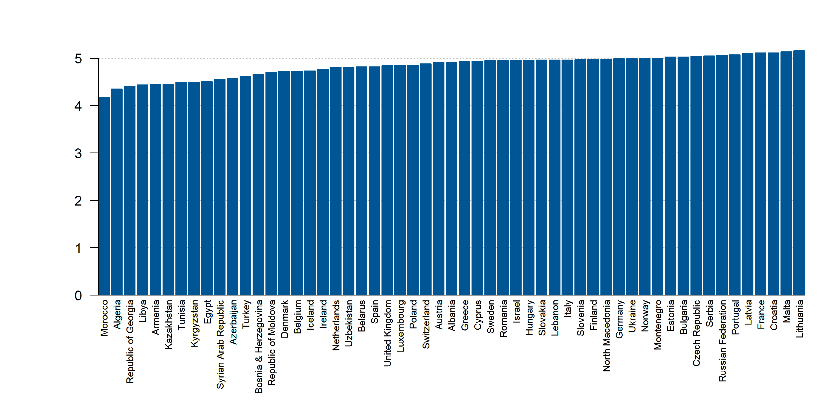
Mean total cholesterol (mmol/L) among females, 2018
Source: NCD Risk Factor Collaboration. Data not available: Kosovo, San Marino

Slide 57
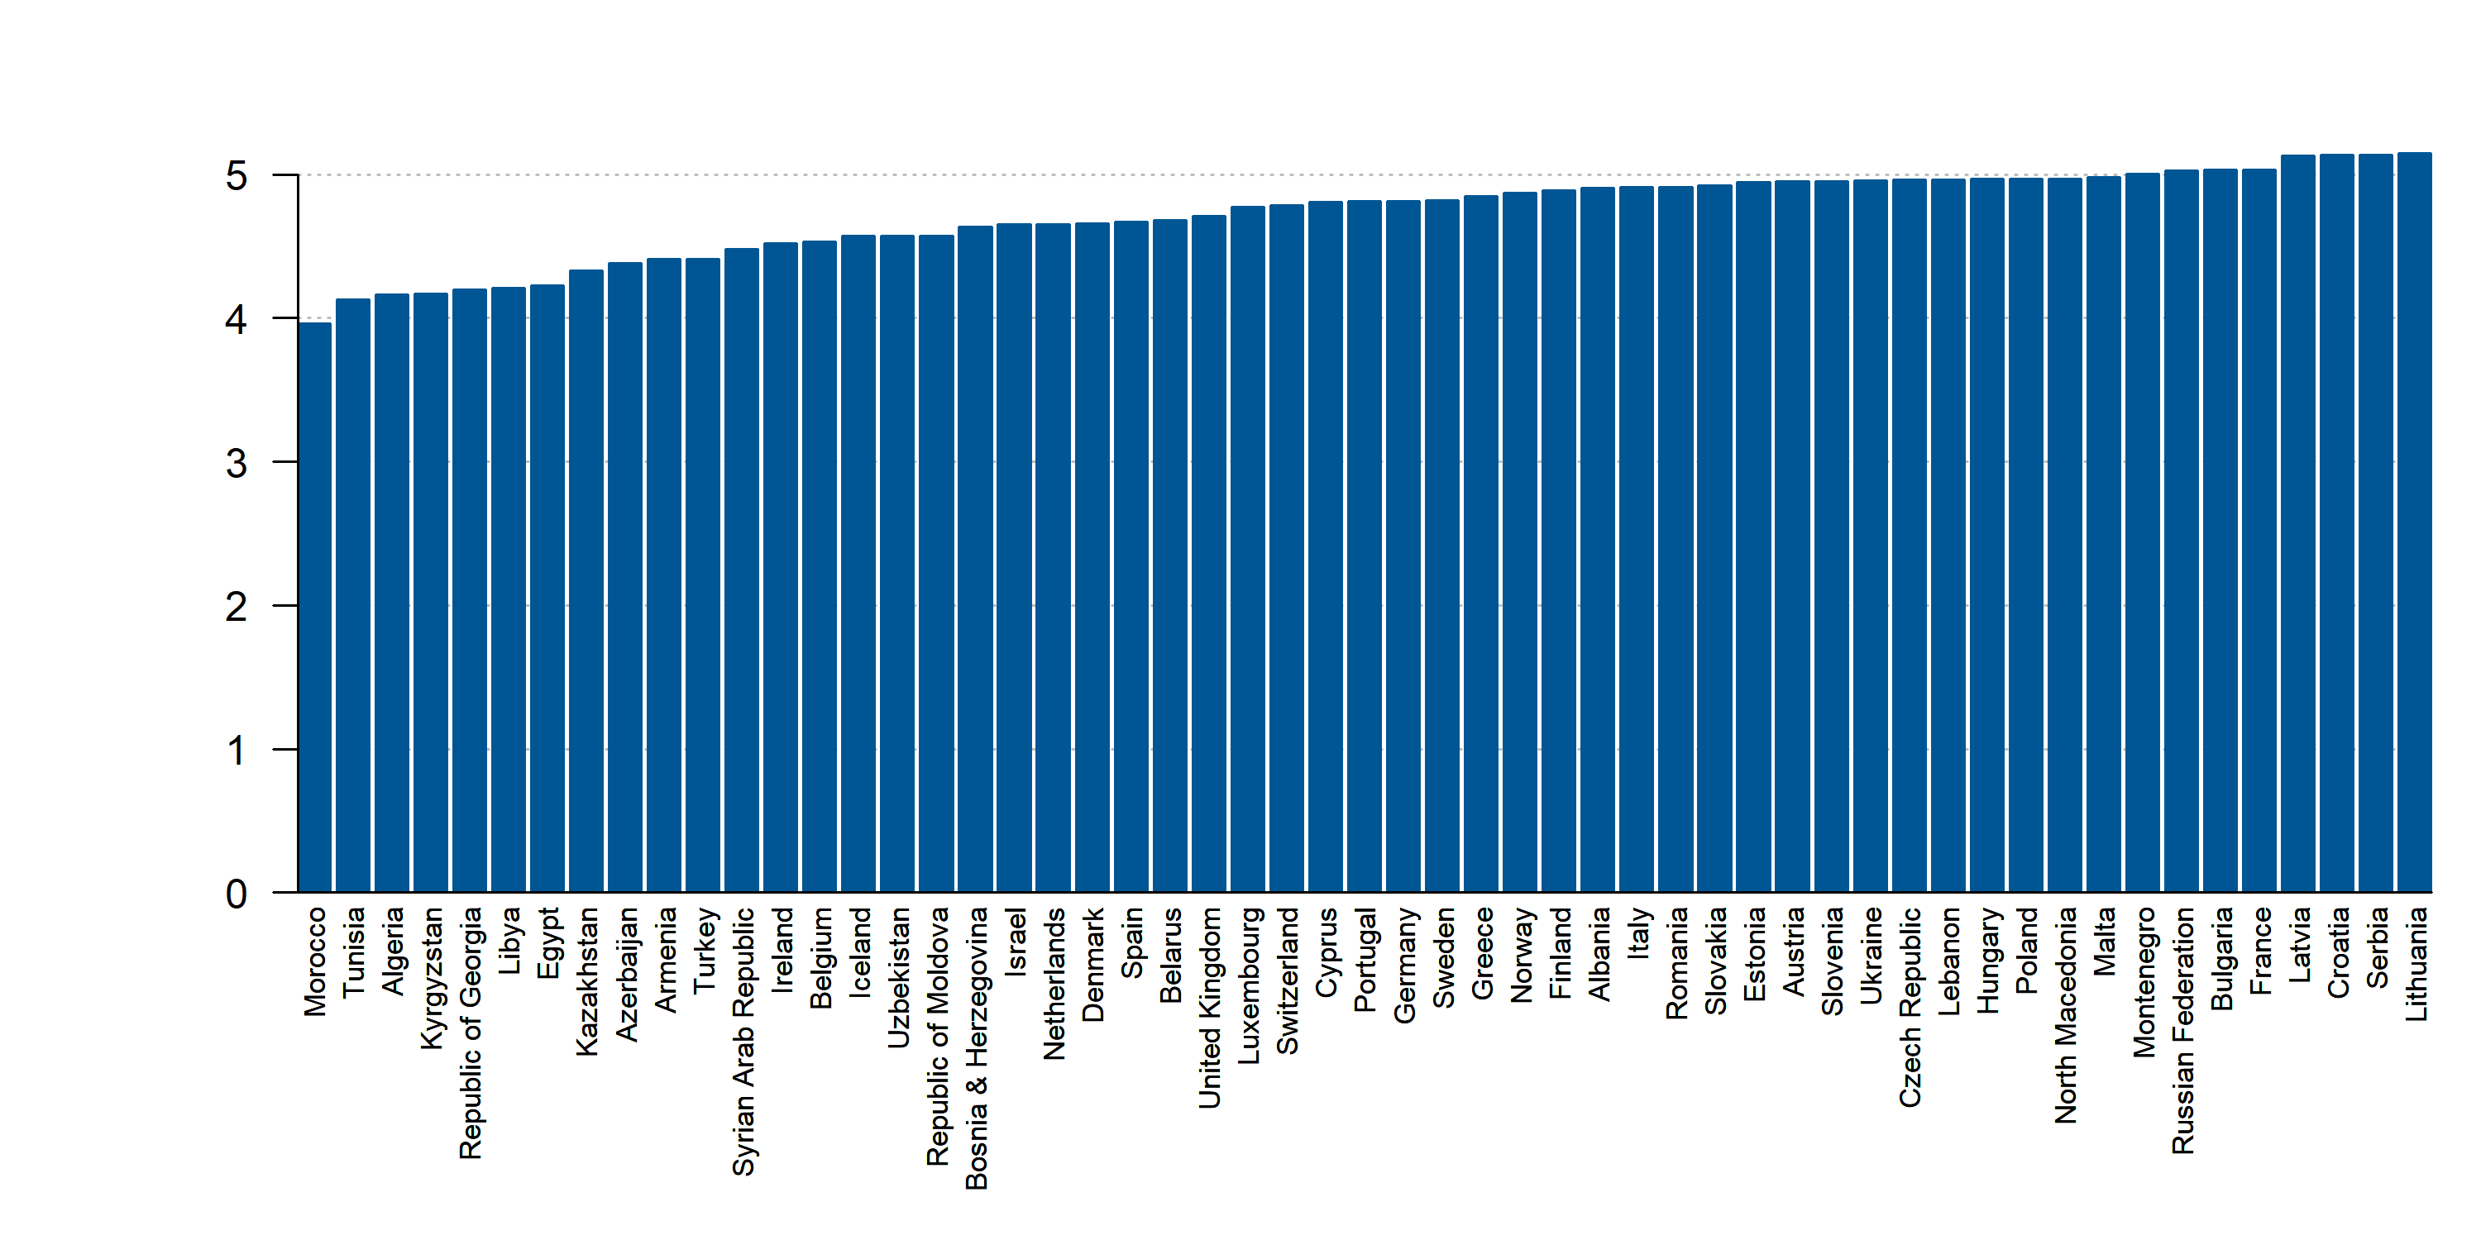
Mean total cholesterol (mmol/L) among males, 2018
Source: NCD Risk Factor Collaboration. Data not available: Kosovo, San Marino

Slide 58

Percentage of people exposed to high noise levels dB by rail, 2017
Source: European Environment Agency. Data not available: Albania, Algeria, Armenia, Azerbaijan, Belarus, Bosnia and Herzegovina, Egypt, Georgia, Israel, Kazakhstan, Kosovo, Kyrgyzstan, Lebanon, Libiya, Moldova, Montenegro, Morocco, North Macedonia, Russia, San Marino, Serbia, Syria, Tunisia, Turkey, Ukraine, Uzbekistan

Slide 59

Percentage of people exposed to high noise levels dB by road, 2017
Source: European Environment Agency. Data not available: Albania, Algeria, Armenia, Azerbaijan, Belarus, Bosnia and Herzegovina, Egypt, Georgia, Israel, Kazakhstan, Kosovo, Kyrgyzstan, Lebanon, Libiya, Moldova, Montenegro, Morocco, North Macedonia, Russia, San Marino, Serbia, Syria, Tunisia, Turkey, Ukraine, Uzbekistan

Slide 60

Percentage of total population who face the problem of crime, violence or vandalism in the local area, 2019
Source: Eurostat. Data not available: Albania, Algeria, Armenia, Azerbaijan, Belarus, Bosnia and Herzegovina, Egypt, Georgia, Israel, Kazakhstan, Kyrgyzstan, Lebanon, Libiya, Moldova, Morocco, Russia, San Marino, Syria, Tunisia, Ukraine, Uzbekistan

Slide 61

Prevalence of insufficient physical activity among adults aged 18+ years (age-standardized estimate), 2016
Source: WHO. Data not available: Iceland, Israel, San Marino

Slide 62

Prevalence of insufficient physical activity among adults females aged 18+ years (age-standardized estimate), 2016
Source: WHO. Data not available: Iceland, Israel, San Marino

Slide 63

Prevalence of insufficient physical activity among adults males aged 18+ years (age-standardized estimate), 2016
Source: WHO. Data not available: Iceland, Israel, San Marino

Slide 64

Prevalence of obesity among adults (age-standardized estimate) 18+ years, 2016
Source: WHO. Data not available: Kosovo

Slide 65

Prevalence of obesity among female adults (age-standardized estimate) 18+ years, 2016
Source: WHO. Data not available: Kosovo

Slide 66

Prevalence of obesity among male adults (age-standardized estimate) 18+ years, 2016
Source: WHO. Data not available: Kosovo

Slide 67

Raised blood pressure (age-standardized estimate) 18+ years, 2015
Source: WHO. Data not available: Kosovo, San Marino

Slide 68

Raised blood pressure (age-standardized estimate) among females 18+ years, 2015
Source: WHO. Data not available: Kosovo, San Marino

Slide 69

Raised blood pressure (age-standardized estimate) among males 18+ years, 2015
Source: WHO. Data not available: Kosovo, San Marino

Slide 70

Vaping population adults (aged 15+) of females who are regular users, 2018 or latest year
Source: WHO. Data not available: Austria, Croatia, Cyprus, Germany, Latvia, Lithuania, Luxembourg, Malta, Poland, Romania, San Marino, Slovakia, Slovenia, all middle-income countries

Slide 71

Vaping population adults (aged 15+) of males who are regular users, 2018 or latest year
Source: WHO. Data not available: Austria, Croatia, Cyprus, Germany, Latvia, Lithuania, Luxembourg, Malta, Poland, Romania, San Marino, Slovakia, Slovenia, all middle-income countries

Slide 72

Vaping population adults (aged 15+) of total population who are regular users, 2018 or latest year
Source: WHO. Data not available: Austria, Croatia, Cyprus, Germany, Latvia, Lithuania, Luxembourg, Malta, Poland, Romania, San Marino, Slovakia, Slovenia, all middle-income countries

Slide 73
CVD Morbidity

Slide 74

DALYs (Disability-Adjusted Life Years) of Cardiovascular diseases (Rate, Age-standardized) among females, 2019
Source: IHME. Data not available: Kosovo

Slide 75

DALYs (Disability-Adjusted Life Years) of Cardiovascular diseases (Rate, Age-standardized) among males, 2019
Source: IHME. Data not available: Kosovo

Slide 76

DALYs (Disability-Adjusted Life Years) of Cardiovascular diseases (Rate, Age-standardized), 2019
Source: IHME. Data not available: Kosovo

Slide 77

DALYs (Disability-Adjusted Life Years) of Cardiovascular diseases (Rate, Age-standardized), 1990- 2019
Source: IHME. Data not available: Kosovo

Slide 78

DALYs (Disability-Adjusted Life Years) of Atrial fibrillation and flutter (Rate, Age-standardized) among females, 2019
Source: IHME. Data not available: Kosovo

Slide 79

DALYs (Disability-Adjusted Life Years) of Atrial fibrillation and flutter (Rate, Age-standardized) among males, 2019
Source: IHME. Data not available: Kosovo

Slide 80

DALYs (Disability-Adjusted Life Years) of Atrial fibrillation and flutter (Rate, Age-standardized), 2019
Source: IHME. Data not available: Kosovo

Slide 81

DALYs (Disability-Adjusted Life Years) of Ischemic heart disease (Rate, Age-standardized) among females, 2019
Source: IHME. Data not available: Kosovo

Slide 82

DALYs (Disability-Adjusted Life Years) of Ischemic heart disease (Rate, Age-standardized) among males, 2019
Source: IHME. Data not available: Kosovo

Slide 83

DALYs (Disability-Adjusted Life Years) of Ischemic heart disease (Rate, Age-standardized), 2019
Source: IHME. Data not available: Kosovo

Slide 84

DALYs (Disability-Adjusted Life Years) of Ischemic heart disease (Rate, Age-standardized), 1990-2019
Source: IHME. Data not available: Kosovo

Slide 85

DALYs (Disability-Adjusted Life Years) of Non-rheumatic calcific aortic valve disease (Rate, Age-standardized) among females, 2019
Source: IHME. Data not available: Kosovo
Source: IHME. Data not available: Kosovo

Slide 86

DALYs (Disability-Adjusted Life Years) of Non-rheumatic calcific aortic valve disease (Rate, Age-standardized) among males, 2019
Source: IHME. Data not available: Kosovo

Slide 87

DALYs (Disability-Adjusted Life Years) of Non-rheumatic calcific aortic valve disease (Rate, Age-standardized), 2019
Source: IHME. Data not available: Kosovo

Slide 88

DALYs (Disability-Adjusted Life Years) of Non-rheumatic calcific aortic valve disease (Rate, Age-standardized), 1990- 2019
Source: IHME. Data not available: Kosovo

Slide 89

DALYs (Disability-Adjusted Life Years) of Non-rheumatic degenerative mitral valve disease (Rate, Age-standardized) among females, 2019
Source: IHME. Data not available: Kosovo

Slide 90

DALYs (Disability-Adjusted Life Years) of Non-rheumatic degenerative mitral valve disease (Rate, Age-standardized) among males, 2019
Source: IHME. Data not available: Kosovo

Slide 91

DALYs (Disability-Adjusted Life Years) of Non-rheumatic degenerative mitral valve disease (Rate, Age-standardized), 2019
Source: IHME. Data not available: Kosovo

Slide 92

DALYs (Disability-Adjusted Life Years) of Peripheral artery disease
(Rate, Age-standardized) among females, 2019
Source: IHME. Data not available: Kosovo

Slide 93

DALYs (Disability-Adjusted Life Years) of Peripheral artery disease
(Rate, Age-standardized) among males, 2019
Source: IHME. Data not available: Kosovo

Slide 94

DALYs (Disability-Adjusted Life Years) of Peripheral artery disease
(Rate, Age-standardized), 2019
Source: IHME. Data not available: Kosovo

Slide 95

DALYs (Disability-Adjusted Life Years) of Rheumatic heart disease
(Rate, Age-standardized) among females, 2019
Source: IHME. Data not available: Kosovo

Slide 96

DALYs (Disability-Adjusted Life Years) of Rheumatic heart disease
(Rate, Age-standardized) among males, 2019
Source: IHME. Data not available: Kosovo

Slide 97

DALYs (Disability-Adjusted Life Years) of Rheumatic heart disease
(Rate, Age-standardized), 2019
Source: IHME. Data not available: Kosovo

Slide 98

DALYs (Disability-Adjusted Life Years) of Rheumatic heart disease
(Rate, Age-standardized), 1990- 2019
Source: IHME. Data not available: Kosovo

Slide 99

DALYs (Disability-Adjusted Life Years) of Stroke (Rate, Age-standardized) among females, 2019
Source: IHME. Data not available: Kosovo

Slide 100

DALYs (Disability-Adjusted Life Years) of Stroke (Rate, Age-standardized) among males, 2019
Source: IHME. Data not available: Kosovo

Slide 101

DALYs (Disability-Adjusted Life Years) of Stroke (Rate, Age-standardized), 2019
Source: IHME. Data not available: Kosovo

Slide 102

DALYs (Disability-Adjusted Life Years) of Stroke (Rate, Age-standardized), 1990-2019
Source: IHME. Data not available: Kosovo

Slide 103

Incidence of Atrial fibrillation and flutter (Rate, Age-standardized) among females, 2019
Source: IHME. Data not available: Kosovo

Slide 104

Incidence of Atrial fibrillation and flutter (Rate, Age-standardized) among males, 2019
Source: IHME. Data not available: Kosovo

Slide 105

Incidence of Atrial fibrillation and flutter (Rate, Age-standardized), 2019
Source: IHME. Data not available: Kosovo

Slide 106

Incidence of Cardiovascular diseases (Rate, Age-standardized) among females, 2019
Source: IHME. Data not available: Kosovo

Slide 107

Incidence of Cardiovascular diseases (Rate, Age-standardized) among males, 2019
Source: IHME. Data not available: Kosovo

Slide 108

Incidence of Cardiovascular diseases (Rate, Age-standardized), 2019
Source: IHME. Data not available: Kosovo

Slide 109

Incidence and prevalence of Cardiovascular diseases (Rate, Age-standardized), 1990-2019
Source: IHME. Data not available: Kosovo

Slide 110

Incidence of Ischemic heart disease (Rate, Age-standardized) among females, 2019
Source: IHME. Data not available: Kosovo

Slide 111

Incidence of Ischemic heart disease (Rate, Age-standardized) among males, 2019
Source: IHME. Data not available: Kosovo

Slide 112

Incidence of Ischemic heart disease (Rate, Age-standardized), 2019
Source: IHME. Data not available: Kosovo

Slide 113

Incidence of Non-rheumatic calcific aortic valve disease (Rate, Age-standardized) among females, 2019
Source: IHME. Data not available: Kosovo

Slide 114

Incidence of Non-rheumatic calcific aortic valve disease (Rate, Age-standardized) among males, 2019
Source: IHME. Data not available: Kosovo

Slide 115

Incidence of Non-rheumatic calcific aortic valve disease (Rate, Age-standardized), 2019
Source: IHME. Data not available: Kosovo

Slide 116

Incidence of Non-rheumatic degenerative mitral valve disease
(Rate, Age-standardized) among females, 2019
Source: IHME. Data not available: Kosovo

Slide 117

Incidence of Non-rheumatic degenerative mitral valve disease
(Rate, Age-standardized) among males, 2019
Source: IHME. Data not available: Kosovo

Slide 118

Incidence of Non-rheumatic degenerative mitral valve disease
(Rate, Age-standardized), 2019
Source: IHME. Data not available: Kosovo

Slide 119

Incidence of Peripheral artery disease (Rate, Age-standardized) among females, 2019
Source: IHME. Data not available: Kosovo

Slide 120

Incidence of Peripheral artery disease (Rate, Age-standardized) among males, 2019
Source: IHME. Data not available: Kosovo

Slide 121

Incidence of Peripheral artery disease (Rate, Age-standardized), 2019
Source: IHME. Data not available: Kosovo

Slide 122

Incidence of Rheumatic heart disease (Rate, Age-standardized) among females, 2019
Source: IHME. Data not available: Kosovo

Slide 123

Incidence of Rheumatic heart disease (Rate, Age-standardized) among males, 2019
Source: IHME. Data not available: Kosovo

Slide 124

Incidence of Rheumatic heart disease (Rate, Age-standardized), 2019
Source: IHME. Data not available: Kosovo

Slide 125

Incidence of Stroke (Rate, Age-standardized) among females, 2019
Source: IHME. Data not available: Kosovo

Slide 126

Incidence of Stroke (Rate, Age-standardized) among males, 2019
Source: IHME. Data not available: Kosovo

Slide 127

Incidence of Stroke (Rate, Age-standardized), 2019
Source: IHME. Data not available: Kosovo

Slide 128

Incidence and prevalence of Stroke (Rate, Age-standardized), 1990- 2019
Source: IHME. Data not available: Kosovo

Slide 129

Prevalence of Atrial fibrillation and flutter (Rate, Age-standardized) among females, 2019
Source: IHME. Data not available: Kosovo

Slide 130

Prevalence of Atrial fibrillation and flutter (Rate, Age-standardized) among males, 2019
Source: IHME. Data not available: Kosovo

Slide 131

Prevalence of Atrial fibrillation and flutter (Rate, Age-standardized), 2019
Source: IHME. Data not available: Kosovo

Slide 132

Prevalence and incidence of Atrial fibrillation and flutter (Rate, Age-standardized), 1990- 2019
Source: IHME. Data not available: Kosovo

Slide 133

Prevalence of Cardiovascular diseases (Rate, Age-standardized) among females, 2019
Source: IHME. Data not available: Kosovo

Slide 134

Prevalence of Cardiovascular diseases (Rate, Age-standardized) among males, 2019
Source: IHME.

Slide 135

Prevalence of Cardiovascular diseases (Rate, Age-standardized), 2019
Source: IHME. Data not available: Kosovo

Slide 136

Prevalence of Ischemic heart disease (Rate, Age-standardized) among females, 2019
Source: IHME. Data not available: Kosovo

Slide 137

Prevalence of Ischemic heart disease (Rate, Age-standardized) among males, 2019
Source: IHME. Data not available: Kosovo

Slide 138

Prevalence of Ischemic heart disease (Rate, Age-standardized), 2019
Source: IHME. Data not available: Kosovo

Slide 139

Prevalence of Non-rheumatic calcific aortic valve disease (Rate, Age-standardized) among females, 2019
Source: IHME. Data not available: Kosovo

Slide 140

Prevalence of Non-rheumatic calcific aortic valve disease (Rate, Age-standardized) among males, 2019
Source: IHME. Data not available: Kosovo

Slide 141

Prevalence of Non-rheumatic calcific aortic valve disease (Rate, Age-standardized), 2019
Source: IHME. Data not available: Kosovo

Slide 142

Prevalence of Non-rheumatic degenerative mitral valve disease
(Rate, Age-standardized) among females, 2019
Source: IHME. Data not available: Kosovo

Slide 143

Prevalence of Non-rheumatic degenerative mitral valve disease
(Rate, Age-standardized) among males, 2019
Source: IHME. Data not available: Kosovo

Slide 144

Prevalence of Non-rheumatic degenerative mitral valve disease
(Rate, Age-standardized), 2019
Source: IHME. Data not available: Kosovo

Slide 145

Prevalence of Peripheral artery disease (Rate, Age-standardized) among females, 2019
Source: IHME. Data not available: Kosovo

Slide 146

Prevalence of Peripheral artery disease (Rate, Age-standardized) among males, 2019
Source: IHME. Data not available: Kosovo

Slide 147

Prevalence of Peripheral artery disease (Rate, Age-standardized), 2019
Source: IHME.

Slide 148

Prevalence and incidence of Peripheral artery disease (Rate, Age-standardized), 1990- 2019
Source: IHME. Data not available: Kosovo

Slide 149

Prevalence of Rheumatic heart disease (Rate, Age-standardized) among females, 2019
Source: IHME. Data not available: Kosovo

Slide 150

Prevalence of Rheumatic heart disease (Rate, Age-standardized) among males, 2019
Source: IHME. Data not available: Kosovo

Slide 151

Prevalence of Rheumatic heart disease (Rate, Age-standardized), 2019
Source: IHME. Data not available: Kosovo

Slide 152

Prevalence of Rheumatic heart disease (Rate, Age-standardized), 1990- 2019
Source: IHME. Data not available: Kosovo

Slide 153

Prevalence of Stroke (Rate, Age-standardized) among females, 2019
Source: IHME. Data not available: Kosovo

Slide 154

Prevalence of Stroke (Rate, Age-standardized) among males, 2019
Source: IHME. Data not available: Kosovo

Slide 155

Prevalence of Stroke (Rate, Age-standardized), 2019
Source: IHME. Data not available: Kosovo

Slide 156
CVD Mortality

Slide 157

Crude CVD mortality per 100,000 in females and males
Source: WHO. Data not available: Algeria, Kosovo, Libya, Morocco

Slide 158

CVD crude mortality rate in females and males vs GDP per capita
Source: WHO. Data not available: Algeria, Kosovo, Libya, Morocco

Slide 159

CVD crude mortality rate in females and males vs CHE per capita
Source: WHO. Data not available: Algeria, Kosovo, Libya, Morocco

Slide 160

Crude CVD mortality rates per 100,000 in females and males
Source: WHO. Data not available: Algeria, Kosovo, Libya, Morocco

Slide 161

Causes of death in females and males
Source: WHO. Data not available: Algeria, Kosovo, Libya

Slide 162

Premature CVD mortality in females and males, crude rates per 100,000.
Source: WHO. Data not available: Algeria, Kosovo, Libya, Morocco, Syria, Uzbekistan

Slide 163


Premature CVD crude mortality in females and males vs current health expenditure (CHE) per capita
Source: WHO. Data not available: Algeria, Kosovo, Libya, Morocco, Syria, Uzbekistan

Slide 164


Premature CVD crude mortality in females and males vs current health expenditure (CHE) per capita
Source: WHO. Data not available: Algeria, Kosovo, Libya, Morocco, Syria, Uzbekistan

Slide 165

Premature deaths by cause in females and males
Source: WHO. Data not available: Algeria, Kosovo, Libya, San Marino

Slide 166

Age-standardized mortality rates from CVD in females and males
per 100,000 people.
Source: WHO. Data not available: Algeria, Kosovo, Libya, Morocco, Syria, Uzbekistan

Slide 167
Services and Interventions Provided to Cardiac Patients

Slide 168

Coronary angiography and diagnostic cardiac catheterization (per million people), 2019
Source: ESC survey. Data not available: Albania, Algeria, Bulgaria, Cyprus, Israel, Kazakhstan, Lebanon, Libya, Morocco, Russia, San Marino, Syria, Tunisia, Turkey.

Slide 169

Coronary angiography and diagnostic cardiac catheterization (per million people), 2019
Source: ESC survey. Data not available: Albania, Algeria, Bulgaria, Cyprus, Israel, Kazakhstan, Lebanon, Libya, Morocco, Russia, San Marino, Syria, Tunisia, Turkey.

Slide 170

Primary percutaneous coronary intervention (pPCI) (per million people), 2019
Source: ESC survey. Data not available: Albania, Algeria, Bulgaria, Cyprus, Finland, Georgia, Germany, Israel, Kazakhstan, Lebanon, Libya, Morocco, Russia, San Marino, Syria, Tunisia, Turkey. Resource not available: Azerbaijan, Kosovo.

Slide 171

Primary percutaneous coronary intervention (pPCI) (per million people), 2019
Source: ESC survey. Data not available: Albania, Algeria, Bulgaria, Cyprus, Finland, Georgia, Germany, Israel, Kazakhstan, Lebanon, Libya, Morocco, Russia, San Marino, Syria, Tunisia, Turkey. Resource not available: Azerbaijan, Kosovo.

Slide 172

Percutaneous coronary interventions (PCI) (per million people), 2019
Source: ESC survey. Data not available: Albania, Algeria, Bulgaria, Cyprus, Israel, Kazakhstan, Lebanon, Libya, Morocco, San Marino, Syria, Turkey.

Slide 173

Percutaneous coronary interventions (PCI) (per million people), 2019
Source: ESC survey. Data not available: Albania, Algeria, Bulgaria, Cyprus, Israel, Kazakhstan, Lebanon, Libya, Morocco, San Marino, Syria, Turkey.

Slide 174

Coronary artery bypass graft surgery (CABG) (per million people), 2019
Source: ESC survey. Data not available: Albania, Algeria, Bulgaria, Cyprus, Georgia, Israel, Kazakhstan, Lebanon, Libya, Morocco, San Marino, Syria, Tunisia, Turkey, Ukraine.

Slide 175

Coronary artery bypass graft surgery (CABG) (per million people), 2019
Source: ESC survey. Data not available: Albania, Algeria, Bulgaria, Cyprus, Georgia, Israel, Kazakhstan, Lebanon, Libya, Morocco, San Marino, Syria, Tunisia, Turkey, Ukraine.

Slide 176

Pacemaker implantations (per million people), 2019
Source: ESC survey. Data not available: Albania, Algeria, Bulgaria, Cyprus, Denmark, Ireland, Israel, Kazakhstan, Lebanon, Libya, Lithuania, Morocco, San Marino, Syria, Tunisia.

Slide 177

Pacemaker implantations (per million people), 2019
Source: ESC survey. Data not available: Albania, Algeria, Bulgaria, Cyprus, Denmark, Ireland, Israel, Kazakhstan, Lebanon, Libya, Lithuania, Morocco, San Marino, Syria, Tunisia.

Slide 178

Implantable cardioverter defibrillator (ICD) implantations (per million people), 2019
Source: ESC survey. Data not available: Albania, Algeria, Bulgaria, Cyprus, Denmark, Ireland, Israel, Kazakhstan, Lebanon, Libya, Morocco, Russia, San Marino, Syria, Tunisia.

Slide 179

Implantable cardioverter defibrillator (ICD) implantations (per million people), 2019
Source: ESC survey. Data not available: Albania, Algeria, Bulgaria, Cyprus, Denmark, Ireland, Israel, Kazakhstan, Lebanon, Libya, Morocco, Russia, San Marino, Syria, Tunisia.

Slide 180

Cardiac resynchronization therapy device (CRT-D and CRT-P) implantations
(per million people), 2019
Source: ESC survey. Data not available: Albania, Algeria, Bulgaria, Cyprus, Denmark, Ireland, Israel, Kazakhstan, Lebanon, Libya, Lithuania, Morocco, Russia, San Marino, Syria. Resource not available: Moldova.

Slide 181

Cardiac resynchronization therapy device (CRT-D and CRT-P) implantations
(per million people), 2019
Source: ESC survey. Data not available: Albania, Algeria, Bulgaria, Cyprus, Denmark, Ireland, Israel, Kazakhstan, Lebanon, Libya, Lithuania, Morocco, Russia, San Marino, Syria. Resource not available: Moldova.

Slide 182

Ablations to correct heart rhythm disorders (per million people), 2019
Source: ESC survey. Data not available: Albania, Algeria, Bulgaria, Cyprus, Denmark, Ireland, Israel, Kazakhstan, Kosovo, Lebanon, Libya, Moldova, Morocco, San Marino, Syria, Tunisia.

Slide 183

Ablations to correct heart rhythm disorders (per million people), 2019
Source: ESC survey. Data not available: Albania, Algeria, Bulgaria, Cyprus, Denmark, Ireland, Israel, Kazakhstan, Kosovo, Lebanon, Libya, Moldova, Morocco, San Marino, Syria, Tunisia.

Slide 184

Percutaneous mitral valve interventions (per million people), 2019
Source: ESC survey. Data not available: Albania, Algeria, Armenia, Azerbaijan, Belarus, Bosnia and Herzegovina, Bulgaria, Croatia, Cyprus, Georgia, Hungary, Ireland, Israel, Kazakhstan, Kyrgyzstan, Lebanon, Libya, Moldova, Morocco, North Macedonia, Norway, Russia, San Marino, Sweden, Syria, Tunisia, Turkey, Ukraine. Resource not available: Estonia, Iceland, Kosovo, Montenegro, Serbia.

Slide 185

Percutaneous tricuspid valve interventions (per million people), 2019
Source: ESC survey. Data not available: Albania, Algeria, Armenia, Azerbaijan, Belarus, Belgium, Bosnia and Herzegovina, Bulgaria, Croatia, Cyprus, Egypt, Estonia, Finland, France, Georgia, Greece, Hungary, Iceland, Ireland, Israel, Italy, Kazakhstan, Kyrgyzstan, Lebanon, Libya, Malta, Moldova, Morocco, North Macedonia, Norway, Romania, Russia, San Marino, Slovakia, Sweden, Syria, Tunisia, Turkey, Ukraine, Uzbekistan. Resource not available: Kosovo, Luxembourg, Montenegro, Serbia, Slovenia.

Slide 186

Surgical aortic valve interventions (repairs and replacements) (per million people), 2019
Source: ESC survey. Data not available: Albania, Algeria, Belarus, Bulgaria, Cyprus, Ireland, Israel, Italy, Kazakhstan, Lebanon, Libya, Morocco, Russia, San Marino, Slovenia, Syria, Tunisia, Turkey, Ukraine.

Slide 187

Surgical aortic valve interventions (repairs and replacements) (per million people), 2019
Source: ESC survey. Data not available: Albania, Algeria, Belarus, Bulgaria, Cyprus, Ireland, Israel, Italy, Kazakhstan, Lebanon, Libya, Morocco, Russia, San Marino, Slovenia, Syria, Tunisia, Turkey, Ukraine.

Slide 188

Percutaneous aortic valve implantation (TAVI) (per million people), 2019
Source: ESC survey. Data not available: Albania, Algeria, Bulgaria, Cyprus, Hungary, Ireland, Israel, Kazakhstan, Lebanon, Libya, Lithuania, Morocco, Russia, San Marino, Syria, Tunisia, Turkey, Ukraine. Resource not available: Georgia, Kosovo, Kyrgyzstan.

Slide 189

Percutaneous aortic valve implantation (TAVI) (per million people), 2019
Source: ESC survey. Data not available: Albania, Algeria, Bulgaria, Cyprus, Hungary, Ireland, Israel, Kazakhstan, Lebanon, Libya, Lithuania, Morocco, Russia, San Marino, Syria, Tunisia, Turkey, Ukraine. Resource not available: Georgia, Kosovo, Kyrgyzstan.

Slide 190

Percutaneous procedures for congenital heart disease (per million people), 2019
Source: ESC survey. Data not available: Albania, Algeria, Belarus, Croatia, Cyprus, Denmark, Germany, Ireland, Kazakhstan, Lebanon, Libya, Morocco, Norway, Russia, San Marino, Switzerland, Syria, Tunisia, Turkey, Ukraine. Resource not available: Kosovo.

Slide 191

Percutaneous procedures for congenital heart disease (per million people), 2019
Source: ESC survey. Data not available: Albania, Algeria, Belarus, Croatia, Cyprus, Denmark, Germany, Ireland, Kazakhstan, Lebanon, Libya, Morocco, Norway, Russia, San Marino, Switzerland, Syria, Tunisia, Turkey, Ukraine. Resource not available: Kosovo.

Slide 192

Surgical interventions in congenital heart disease (per million people), 2019
Source: ESC survey. Data not available: Albania, Algeria, Belarus, Bulgaria, Cyprus, Denmark, Finland, Iceland, Ireland, Israel, Italy, Kazakhstan, Lebanon, Libya, Morocco, San Marino, Sweden, Syria, Tunisia, Turkey, Ukraine. Resource not available: Kosovo.

Slide 193

Surgical interventions in congenital heart disease (per million people), 2019
Source: ESC survey. Data not available: Albania, Algeria, Belarus, Bulgaria, Cyprus, Denmark, Finland, Iceland, Ireland, Israel, Italy, Kazakhstan, Lebanon, Libya, Morocco, San Marino, Sweden, Syria, Tunisia, Turkey, Ukraine. Resource not available: Kosovo.

Slide 194

Left, right and both ventricular assist device implantations (per million people), 2019
Source: ESC survey. Data not available: Albania, Algeria, Armenia, Azerbaijan, Bulgaria, Cyprus, Denmark, Iceland, Ireland, Israel, Italy, Kazakhstan, Kyrgyzstan, Lebanon, Libya, Malta, Moldova, Morocco, Russia, San Marino, Switzerland, Syria, Tunisia, Turkey, Ukraine, Uzbekistan. Resource not available: Georgia, Kosovo, Montenegro.

Slide 195

Left, right and both ventricular assist device implantations (per million people), 2019
Source: ESC survey. Data not available: Albania, Algeria, Armenia, Azerbaijan, Bulgaria, Cyprus, Denmark, Iceland, Ireland, Israel, Italy, Kazakhstan, Kyrgyzstan, Lebanon, Libya, Malta, Moldova, Morocco, Russia, San Marino, Switzerland, Syria, Tunisia, Turkey, Ukraine, Uzbekistan. Resource not available: Georgia, Kosovo, Montenegro.

Slide 196

Heart transplantations (per million people), 2019
Source: ESC survey. Data not available: Albania, Algeria, Armenia, Azerbaijan, Bosnia and Herzegovina, Bulgaria, Cyprus, Denmark, Egypt, Georgia, Iceland, Israel, Kazakhstan, Kyrgyzstan, Lebanon, Libya, Lithuania, Moldova, Morocco, Russia, San Marino, Slovenia, Syria, Tunisia, Turkey, Ukraine, Uzbekistan. Resource not available: Estonia, Kosovo, Latvia, Luxembourg, Montenegro.

Slide 197

Heart transplantations (per million people), 2019
Source: ESC survey. Data not available: Albania, Algeria, Armenia, Azerbaijan, Bosnia and Herzegovina, Bulgaria, Cyprus, Denmark, Egypt, Georgia, Iceland, Israel, Kazakhstan, Kyrgyzstan, Lebanon, Libya, Lithuania, Moldova, Morocco, Russia, San Marino, Slovenia, Syria, Tunisia, Turkey, Ukraine, Uzbekistan. Resource not available: Estonia, Kosovo, Latvia, Luxembourg, Montenegro.

Slide 198
Cardiac Capital Resources

Slide 199

Hospitals with dedicated coronary care units (per million people), 2021
Source: ESC survey. Data not available: Albania, Algeria, Belgium, Egypt, Finland, Germany, Kazakhstan, Lebanon, Libya, Morocco, San Marino, Syria, Turkey, Uzbekistan.

Slide 200

Hospitals with dedicated stroke units (per million people), 2021
Source: ESC survey. Data not available: Albania, Algeria, Belarus, Belgium, Finland, France, Georgia, Lebanon, Libya, Morocco, San Marino, Slovakia, Syria, Tunisia, Turkey, Ukraine, Uzbekistan.

Slide 201

Hospital with cath labs (per million people), 2021
Source: ESC survey. Data not available: Albania, Algeria, Georgia, Germany, Lebanon, Libya, Morocco, San Marino, Syria, Turkey.

Slide 202

Hospitals with cath labs on 24 hours/7 days service (per million people), 2021
Source: ESC survey. Data not available: Albania, Algeria, Georgia, Lebanon, Libya, Morocco, San Marino, Switzerland, Syria, Turkey, Uzbekistan. Resource not available: Kosovo.

Slide 203

Hospitals undertaking electrophysiology procedures (per million people), 2021
Source: ESC survey. Data not available: Albania, Algeria, Lebanon, Libya, Morocco, Russia, San Marino, Syria, Turkey, Ukraine. Resource not available: Kosovo.

Slide 204

Hospitals implanting pacemakers (per million people), 2021
Source: ESC survey. Data not available: Albania, Algeria, Lebanon, Libya, Morocco, San Marino, Syria, Turkey, Ukraine.

Slide 205

Hospitals implanting cardioverter defibrillators (ICDs) (per million people), 2021
Source: ESC survey. Data not available: Albania, Algeria, Lebanon, Libya, Morocco, Russia, San Marino, Syria, Turkey, Ukraine.

Slide 206

Hospitals implanting cardiac resynchronization therapy (CRT) devices (per million people), 2021
Source: ESC survey. Data not available: Albania, Algeria, Georgia, Germany, Lebanon, Libya, Morocco, Russia, San Marino, Spain, Syria, Turkey, Ukraine.

Slide 207

Hospitals with cath labs performing structural heart disease interventions in the adult (per million people), 2021
Source: ESC survey. Data not available: Albania, Algeria, Germany, Kazakhstan, Lebanon, Libya, Moldova, Morocco, Russia, San Marino, Switzerland, Syria, Turkey, Ukraine. Resource not available: Kosovo.

Slide 208

Hospitals with cath labs performing structural heart disease interventions in children (per million people), 2021
Source: ESC survey. Data not available: Albania, Algeria, Belgium, Ireland, Kazakhstan, Lebanon, Libya, Luxembourg, Morocco, Russia, San Marino, Switzerland, Syria, Turkey, Ukraine. Resource not available: Kosovo, Montenegro.

Slide 209

Hospitals with cardiac surgery (per million people), 2020
Source: ESC survey. Data not available: Albania, Algeria, Georgia, Israel, Lebanon, Libya, Morocco, Russia, San Marino, Syria, Turkey, Ukraine.

Slide 210

Hospitals undertaking congenital heart disease surgery (per million people), 2021
Source: ESC survey. Data not available: Albania, Algeria, Bulgaria, Cyprus, Israel, Kazakhstan, Lebanon, Libya, Morocco, Russia, San Marino, Spain, Syria, Turkey, Ukraine. Resource not available: Kosovo.

Slide 211

Hospitals with cardiac transplantation programmes (per million people), 2021
Source: ESC survey. Data not available: Albania, Algeria, Armenia, Azerbaijan, Bosnia and Herzegovina, Cyprus, Egypt, Estonia, Georgia, Iceland, Kyrgyzstan, Lebanon, Libya, Moldova, Morocco, Russia, San Marino, Syria, Turkey, Ukraine, Uzbekistan. Resource not available: Kosovo, Luxembourg, Montenegro.

Slide 212

Hospitals with cardiac rehabilitation programmes (per million people), 2021
Source: ESC survey. Data not available: Albania, Algeria, Armenia, Belarus, Belgium, Bulgaria, Cyprus, Czech Republic, Finland, Georgia, Germany, Kazakhstan, Lebanon, Libya, Morocco, Russia, San Marino, Slovakia, Syria, Turkey, Ukraine, Uzbekistan. Resource not available: Kosovo.

Slide 213
Cardiac Human Resources

Slide 214

Cardiologists (total) (per million people), 2021
Source: ESC survey. Data not available: Albania, Algeria, Lebanon, Libya, Morocco, San Marino, Syria, Turkey.

Slide 215

Cardiologists, females (% of cardiologists, total), 2021
Source: ESC survey. Data not available: Albania, Algeria, Armenia, Belarus, Bulgaria, Denmark, Georgia, Kazakhstan, Lebanon, Libya, Morocco, Russia, San Marino, Syria, Turkey, Ukraine, Uzbekistan.

Slide 216

Interventional cardiologists (per million people), 2021
Source: ESC survey. Data not available: Albania, Algeria, Finland, France, Georgia, Germany, Lebanon, Libya, Morocco, San Marino, Switzerland, Syria, Turkey.

Slide 217

Cardiac surgeons (per million people), 2021
Source: ESC survey. Data not available: Albania, Algeria, Georgia, Italy, Lebanon, Libya, Morocco, San Marino, Switzerland, Syria, Turkey, Ukraine.

Slide 218
Definitions of
Atlas Terms

Slide 219
Definitions
Fertility rate total (births per woman): Total fertility rate represents the number of children that would be born to a woman if she were to live to the end of her childbearing years and bear children in accordance with age-specific fertility rates of the specified year.
GDP, PPP (international $): PPP GDP is gross domestic product converted to international dollars using purchasing power parity rates. An international dollar has the same purchasing power over GDP as the U.S. dollar has in the United States. GDP is the sum of gross value added by all resident producers in the economy plus any product taxes and minus any subsidies not included in the value of the products. It is calculated without making deductions for depreciation of fabricated assets or for depletion and degradation of natural resources. Data are in current international dollars. For most economies PPP figures are extrapolated from the 2011 International Comparison Program (ICP) benchmark estimates or imputed using a statistical model based on the 2011 ICP. For 47 high- and upper middle-income economies conversion factors are provided by Eurostat and the Organisation for Economic Co-operation and Development (OECD).
GINI index: Gini index measures the extent to which the distribution of income (or, in some cases, consumption expenditure) among individuals or households within an economy deviates from a perfectly equal distribution. A Lorenz curve plots the cumulative percentages of total income received against the cumulative number of recipients, starting with the poorest individual or household. The Gini index measures the area between the Lorenz curve and a hypothetical line of absolute equality, expressed as a percentage of the maximum area under the line. Thus, a Gini index of 0 represents perfect equality, while an index of 100 implies perfect inequality.

Slide 220
Definitions
Life expectancy at birth (years) females: The average number of years that a female newborn could expect to live, if she were to pass through life exposed to the sex and age-specific death rates prevailing at the time of her birth, for a specific year, in a given country, territory or geographic area.
Life expectancy at birth (years) among males: The average number of years that a male newborn could expect to live, if he were to pass through life exposed to the sex and age-specific death rates prevailing at the time of his birth, for a specific year, in a given country, territory or geographic area.
Life expectancy at birth, total: The average number of years that a newborn could expect to live, if he or she were to pass through life exposed to the sex and age-specific death rates prevailing at the time of his or her birth, for a specific year, in a given country, territory or geographic area.
Median age by country. UN estimates: Age that divides the population in two parts of equal size, that is, there are as many persons with ages above the median as there are with ages below the median. It is expressed as years.
Infant mortality rate: Infant mortality rate is the probability of a child born in a specific year or period dying before reaching the age of one, if subject to age-specific mortality rates of that period. Infant mortality rate is strictly speaking not a rate (i.e. the number of deaths divided by the number of population at risk during a certain period of time) but a probability of death derived from a life table and expressed as rate per 1000 live births.

Slide 221
Definitions
Local population (% of total population) – percentage of indigenous people among the population
Percentage of population age 15 with tertiary schooling - Percentage of population age 15+ with tertiary schooling (Completed Tertiary).
Unemployment (% of labor force) (modeled ILO estimate) - share of the labor force that is without work but available for and seeking employment.
Population ages 65 and above (% of total population): Population ages 65 and above as a percentage of the total population. Population is based on the de facto definition of population, which counts all residents regardless of legal status or citizenship. World Bank staff estimates using the World Bank's total population and age/sex distributions of the United Nations Population Division's World Population Prospects: 2017 Revision.

Slide 222
Definitions
Unemployment, total (% of total labor force): Unemployment refers to the share of the labour force that is without work but available for and seeking employment. Source: International Labour Organization, ILOSTAT database.
Distribution of population, urban (%): Urban population (% of total population). Urban population refers to people living in urban areas as defined by national statistical offices. The data are collected and smoothed by United Nations Population Division.
Current health expenditure (CHE) (% of gross domestic product (GDP)): This indicator describes the share of spending on health in each country relative to the size of its economy, for a specific year. It shows the importance of the health sector in the economy and indicates the societal priority, measured in monetary terms, given to health. Current health expenditure corresponds to the final consumption of health care goods and services while excluding investment, exports and intermediate consumption.

Slide 223
Definitions
Current health expenditure (CHE) (per capita in PPP): This indicator estimates the expenditure on health per person in US dollars, taking into account the purchasing parity between currencies. It contributes to understanding of the health expenditure relative to the population size facilitating international comparison as well as to the purchasing power of the respective currency. This indicator approximates how much is spent on health on average on a person in respective year and country. It is calculated by dividing the CHE in national currency units by the relevant exchange rate into USD purchasing power parity (PPP) and further by dividing this by the number of people living in the country.
Domestic Private Health Expenditure (PVT-D) (% of Current Health Expenditure (CHE)): Share of current health expenditures funded from private sources. This indicator details the role of the private sector in funding health care in each country. Private sector funds stem from households, corporations and non-profit organizations. Such expenditures can be either prepaid to voluntary health insurance or paid directly to healthcare providers. This indicator describes the role of the private sector in funding healthcare relative to public or external sources.

Slide 224
Definitions
Percentage of regular daily smokers in the population. age 15+: Prevalence estimates for daily smoking of any tobacco product are age-standardized rates for people aged 15 years and over. "Tobacco smoking" includes cigarettes, cigars, pipes or any other smoked tobacco products. The definition of "daily tobacco smoking" varies between surveys, but often means current smoking of any tobacco product at least once a day. The estimate is age-standardized using the WHO standard.
Alcohol, total per capita (15+) consumption (in litres of pure alcohol): Pure alcohol consumption (PAC) is defined as the total (sum of recorded PAC three-year average and unrecorded PAC) amount of alcohol consumed per person (15+ years) over a calendar year, in litres of pure alcohol. Recorded alcohol consumption refers to official statistics (production, import, export, and sales or taxation data), while the unrecorded alcohol consumption refers to alcohol which is not taxed and is outside the usual system of governmental control. In circumstances in which the number of tourists per year is at least the number of inhabitants, the tourist consumption is also taken into account and is deducted from the country's recorded PAC.

Slide 225
Definitions
Average Annual Population-Weighted PM2.5, (ug/m3): Population-weighted annual average concentration of PM2.5 (Particulate matter less than or equal to 2.5 µm (micrometers) in aerodynamic diameter). PM2.5 is measured in units of micrograms per cubic meter (µg/m3).
Average Seasonal Population-Weighted Ozone: Human exposure to ozone in terms of the population-weighted average seasonal 8-hour daily maximum concentration for a given country or region
DALYs (Disability-Adjusted Life Years) of Particulate matter pollution (Rate, Age-standardized): Age-standardized rate per 100 000 people of disability-adjusted life years lost due to particulate matter air pollution
Diabetes prevalence (% of population ages 20 to 79): Diabetes refers to the percentage of people ages 20-79 who have type 1 or type 2 diabetes.
Estimated intake of sugar-sweetened beverages in adults aged 25 and older(g/day): Daily consumption of liquids that are sweetened with various forms of added sugars (g), in adult population aged 25 and older.
Estimated intake of fruit in adults aged 25 and older (g/day): Daily consumption of fruit in adult population aged 25 and older (g).

Slide 226
Definitions
Estimated intake of polyunsaturated fatty acids in adults aged 25 and older (% of total daily energy): Daily consumption of polyunsaturated fatty acids in adult population aged 25 and older
Estimated intake of sodium in adults aged 25 and older (g/day): Daily consumption of sodium in adult population aged 25 and older (grams)
Estimated intake of trans fatty acids in adults aged 25 and older (% of total daily energy): Daily consumption of trans fatty acids in adult population aged 25 and older
Estimated intake of vegetables in adults aged 25 and older (g/day): Daily consumption of vegetables in adult population aged 25 and older (grams)
Food Balances sugar and sweeteners supply (kcal/capita/day): Per capita kilocalorie supply from sugar and sweeteners per day. This measures the quantity that is available for consumption at the end of the supply chain. It does not account for consumer waste, so the quantity that is actually consumed may be lower than this value.

Slide 227
Definitions
Mean HDL cholesterol (mmol/L) among females: Mean high-density lipoprotein (HDL) cholesterol of defined population in mmol/l (female).
Mean HDL cholesterol (mmol/L) among males: Mean high-density lipoprotein (HDL) of defined population in mmol/l (male).
Mean non-HDL cholesterol (mmol/L) among females: Mean non-HDL cholesterol of defined population in mmol/l (female).
Mean non-HDL cholesterol (mmol/L) among males: Mean non-HDL cholesterol of defined population in mmol/l (male).
Mean systolic blood pressure (age-standardized estimate) among females 18+ years: Mean systolic blood pressure (in mm Hg). (female) Based on measured blood pressure. If multiple blood pressure readings were taken, first reading per participant was dropped and average of remaining readings was used.
Mean systolic blood pressure (age-standardized estimate) among males 18+ years: Mean systolic blood pressure (in mm Hg). (male) Based on measured blood pressure. If multiple blood pressure readings were taken, first reading per participant was dropped and average of remaining readings was used.

Slide 228
Definitions
Mean total cholesterol (mmol/L) (female): Mean total cholesterol, mean high-density lipoprotein (HDL) and mean non-HDL cholesterol of defined population in mmol/l (female). Desirable individual levels are: Total cholesterol <5.0 mmol/L
Mean total cholesterol (mmol/L) (male): Mean total cholesterol, mean high-density lipoprotein (HDL) and mean non-HDL cholesterol of defined population in mmol/l (male). Desirable individual levels are: Total cholesterol <5.0 mmol/L
Percentage of people exposed to high noise levels dB by rail: Percentage of people, living in the urban areas, exposed to high noise levels Lden ≥ 55 dB, emanating from the railways
Percentage of people exposed to high noise levels dB by road: Percentage of people, living in the urban areas, exposed to high noise levels Lden ≥ 55 dB, emanating from the roads
Percentage of total population who face the problem of crime, violence or vandalism in the local area: Percentage of total population who face the problem of crime, violence or vandalism in the local area in the relevant household type and income group.

Slide 229
Definitions
Physical inactivity, total (% population aged 18+, age-standardized): Percent of population aged 18+ attaining less than 150 minutes of moderate-intensity physical activity per week, or less than 75 minutes of vigorous-intensity physical activity per week, or equivalent. ). The estimate is age-standardized using the WHO standard.
Physical inactivity, female (% population aged 18+, age-standardized): Percent of females aged 18+ attaining less than 150 minutes of moderate-intensity physical activity per week, or less than 75 minutes of vigorous-intensity physical activity per week, or equivalent. ). The estimate is age-standardized using the WHO standard.
Physical inactivity, male (% population aged 18+, age-standardized): Percent of males aged 18+ attaining less than 150 minutes of moderate-intensity physical activity per week, or less than 75 minutes of vigorous-intensity physical activity per week, or equivalent. ). The estimate is age-standardized using the WHO standard.
Obesity (BMI >= 30), total (% population aged 18+, age-standardized): Percentage of total population aged 18+ with a body mass index (BMI) of 30 kg/m2 or higher. The estimate is age-standardized using the WHO standard.
Obesity (BMI >= 30), female (% population aged 18+, age-standardized): Percentage of females aged 18+ with a body mass index (BMI) of 30 kg/m2 or higher. The estimate is age-standardized using the WHO standard.
Obesity (BMI >= 30), male (% population aged 18+, age-standardized): Percentage of males aged 18+ with a body mass index (BMI) of 30 kg/m2 or higher. The estimate is age-standardized using the WHO standard.

Slide 230
Definitions
Raised blood pressure, total (% population aged 18+, age-standardized): Percent of population aged 18+ with raised blood pressure (obesity≥ 140 OR diastolic blood pressure ≥ 90). The estimate is age-standardized using the WHO standard.
Raised blood pressure, female (% population aged 18+, age-standardized): Percent of females aged 18+ with raised blood pressure (systolic blood pressure ≥ 140 OR diastolic blood pressure ≥ 90). The estimate is age-standardized using the WHO standard.
Raised blood pressure, male (% population aged 18+, age-standardized): Percent of males aged 18+ with raised blood pressure (systolic blood pressure ≥ 140 OR diastolic blood pressure ≥ 90). The estimate is age-standardized using the WHO standard.
Vaping population adults (aged 15+) of adult population who are regular users: Vapers, percentage of adults (total, females and males aged 15+) and young adults (total, females and males aged 15-24 years old), who are regular users. Regular users are defined as using vaping devices at least monthly, i.e. daily, weekly or monthly.

Slide 231
Definitions
DALYs (Disability-Adjusted Life Years) of Cardiovascular diseases (Rate, Age-standardized) among females: The sum of years of potential life lost due to premature mortality from cardiovascular diseases and the years of productive life lost due to disability from cardiovascular diseases; expressed as an age-standardized rate per 100,000 population, in females, using the IHME standard. DALY are also defined as years of healthy life lost. DALY is calculated as: DALY = YLL (Years of life lost) + YLD (Years lived with disability).
DALYs (Disability-Adjusted Life Years) of Cardiovascular diseases (Rate, Age-standardized) among males: The sum of years of potential life lost due to premature mortality from cardiovascular diseases and the years of productive life lost due to disability from cardiovascular diseases; expressed as an age-standardized rate per 100,000 population, in males, using the IHME standard. DALY are also defined as years of healthy life lost. DALY is calculated as: DALY = YLL (Years of life lost) + YLD (Years lived with disability).
DALYs (Disability-Adjusted Life Years) of Cardiovascular diseases (Rate, Age-standardized): The sum of years of potential life lost due to premature mortality from cardiovascular diseases and the years of productive life lost due to disability from cardiovascular diseases; expressed as an age-standardized rate per 100,000 population, using the IHME standard. DALY are also defined as years of healthy life lost. DALY is calculated as: DALY = YLL (Years of life lost) + YLD (Years lived with disability).

Slide 232
Definitions
DALYs (Disability-Adjusted Life Years) of atrial fibrillation and flutter (Rate, Age-standardized) among females: The sum of years of potential life lost due to premature mortality from atrial fibrillation and flutter and the years of productive life lost due to disability from atrial fibrillation and flutter; expressed as an age-standardized rate per 100,000 population, in females, using the IHME standard. DALY are also defined as years of healthy life lost. DALY is calculated as: DALY = YLL (Years of life lost) + YLD (Years lived with disability).
DALYs (Disability-Adjusted Life Years) of atrial fibrillation and flutter (Rate, Age-standardized) among males: The sum of years of potential life lost due to premature mortality from atrial fibrillation and flutter and the years of productive life lost due to disability from atrial fibrillation and flutter; expressed as an age-standardized rate per 100,000 population, in males, using the IHME standard. DALY are also defined as years of healthy life lost. DALY is calculated as: DALY = YLL (Years of life lost) + YLD (Years lived with disability).
DALYs (Disability-Adjusted Life Years) of atrial fibrillation and flutter (Rate, Age-standardized): The sum of years of potential life lost due to premature mortality from atrial fibrillation and flutter and the years of productive life lost due to disability from atrial fibrillation and flutter; expressed as an age-standardized rate per 100,000 population, using the IHME standard. DALY are also defined as years of healthy life lost. DALY is calculated as: DALY = YLL (Years of life lost) + YLD (Years lived with disability).

Slide 233
Definitions
DALYs (Disability-Adjusted Life Years) of ischemic heart disease (Rate, Age-standardized) among females: The sum of years of potential life lost due to premature mortality from ischemic heart disease and the years of productive life lost due to disability from ischemic heart disease; expressed as an age-standardized rate per 100,000 population, in females, using the IHME standard. DALY are also defined as years of healthy life lost. DALY is calculated as: DALY = YLL (Years of life lost) + YLD (Years lived with disability).
DALYs (Disability-Adjusted Life Years) of ischemic heart disease (Rate, Age-standardized) among males: The sum of years of potential life lost due to premature mortality from ischemic heart disease and the years of productive life lost due to disability from ischemic heart disease; expressed as an age-standardized rate per 100,000 population, in males, using the IHME standard. DALY are also defined as years of healthy life lost. DALY is calculated as: DALY = YLL (Years of life lost) + YLD (Years lived with disability).
DALYs (Disability-Adjusted Life Years) of ischemic heart disease (Rate, Age-standardized): The sum of years of potential life lost due to premature mortality from ischemic heart disease and the years of productive life lost due to disability from ischemic heart disease; expressed as an age-standardized rate per 100,000 population, using the IHME standard. DALY are also defined as years of healthy life lost. DALY is calculated as: DALY = YLL (Years of life lost) + YLD (Years lived with disability).

Slide 234
Definitions
DALYs (Disability-Adjusted Life Years) of non-rheumatic calcific aortic valve diseases (Rate, Age-standardized) among females: The sum of years of potential life lost due to premature mortality from non-rheumatic calcific aortic valve diseases and the years of productive life lost due to disability from non-rheumatic calcific aortic valve diseases; expressed as an age-standardized rate per 100,000 population, in females, using the IHME standard. DALY are also defined as years of healthy life lost. DALY is calculated as: DALY = YLL (Years of life lost) + YLD (Years lived with disability).
DALYs (Disability-Adjusted Life Years) of non-rheumatic calcific aortic valve diseases (Rate, Age-standardized) among males: The sum of years of potential life lost due to premature mortality from non-rheumatic calcific aortic valve diseases and the years of productive life lost due to disability from non-rheumatic calcific aortic valve diseases; expressed as an age-standardized rate per 100,000 population, in males, using the IHME standard. DALY are also defined as years of healthy life lost. DALY is calculated as: DALY = YLL (Years of life lost) + YLD (Years lived with disability).
DALYs (Disability-Adjusted Life Years) of non-rheumatic calcific aortic valve diseases (Rate, Age-standardized): The sum of years of potential life lost due to premature mortality from non-rheumatic calcific aortic valve diseases and the years of productive life lost due to disability from non-rheumatic calcific aortic valve diseases; expressed as an age-standardized rate per 100,000 population, using the IHME standard. DALY are also defined as years of healthy life lost. DALY is calculated as: DALY = YLL (Years of life lost) + YLD (Years lived with disability).

Slide 235
Definitions
DALYs (Disability-Adjusted Life Years) of non-rheumatic degenerative mitral valve diseases (Rate, Age-standardized) among females: The sum of years of potential life lost due to premature mortality from non-rheumatic degenerative mitral valve diseases and the years of productive life lost due to disability from non-rheumatic degenerative mitral valve diseases; expressed as an age-standardized rate per 100,000 population, in females, using the IHME standard. DALY are also defined as years of healthy life lost. DALY is calculated as: DALY = YLL (Years of life lost) + YLD (Years lived with disability).
DALYs (Disability-Adjusted Life Years) of non-rheumatic degenerative mitral valve diseases (Rate, Age-standardized) among males: The sum of years of potential life lost due to premature mortality from non-rheumatic degenerative mitral valve diseases and the years of productive life lost due to disability from non-rheumatic degenerative mitral valve diseases; expressed as an age-standardized rate per 100,000 population, in males, using the IHME standard. DALY are also defined as years of healthy life lost. DALY is calculated as: DALY = YLL (Years of life lost) + YLD (Years lived with disability).
DALYs (Disability-Adjusted Life Years) of non-rheumatic degenerative mitral valve diseases (Rate, Age-standardized): The sum of years of potential life lost due to premature mortality from non-rheumatic degenerative mitral valve diseases and the years of productive life lost due to disability from non-rheumatic degenerative mitral valve diseases; expressed as an age-standardized rate per 100,000 population, using the IHME standard. DALY are also defined as years of healthy life lost. DALY is calculated as: DALY = YLL (Years of life lost) + YLD (Years lived with disability).

Slide 236
Definitions
DALYs (Disability-Adjusted Life Years) of peripheral artery diseases (Rate, Age-standardized) among females: The sum of years of potential life lost due to premature mortality from peripheral artery diseases and the years of productive life lost due to disability from peripheral artery diseases; expressed as an age-standardized rate per 100,000 population, in females, using the IHME standard. DALY are also defined as years of healthy life lost. DALY is calculated as: DALY = YLL (Years of life lost) + YLD (Years lived with disability).
DALYs (Disability-Adjusted Life Years) of peripheral artery diseases (Rate, Age-standardized) among males: The sum of years of potential life lost due to premature mortality from peripheral artery diseases and the years of productive life lost due to disability from peripheral artery diseases; expressed as an age-standardized rate per 100,000 population, in males, using the IHME standard. DALY are also defined as years of healthy life lost. DALY is calculated as: DALY = YLL (Years of life lost) + YLD (Years lived with disability).
DALYs (Disability-Adjusted Life Years) of peripheral artery diseases (Rate, Age-standardized): The sum of years of potential life lost due to premature mortality from peripheral artery diseases and the years of productive life lost due to disability from peripheral artery diseases; expressed as an age-standardized rate per 100,000 population, using the IHME standard. DALY are also defined as years of healthy life lost. DALY is calculated as: DALY = YLL (Years of life lost) + YLD (Years lived with disability).

Slide 237
Definitions
DALYs (Disability-Adjusted Life Years) of rheumatic heart diseases (Rate, Age-standardized) among females: The sum of years of potential life lost due to premature mortality from rheumatic heart diseases and the years of productive life lost due to disability from rheumatic heart diseases; expressed as an age-standardized rate per 100,000 population, in females, using the IHME standard. DALY are also defined as years of healthy life lost. DALY is calculated as: DALY = YLL (Years of life lost) + YLD (Years lived with disability).
DALYs (Disability-Adjusted Life Years) of rheumatic heart diseases (Rate, Age-standardized) among males: The sum of years of potential life lost due to premature mortality from rheumatic heart diseases and the years of productive life lost due to disability from rheumatic heart diseases; expressed as an age-standardized rate per 100,000 population, in males, using the IHME standard. DALY are also defined as years of healthy life lost. DALY is calculated as: DALY = YLL (Years of life lost) + YLD (Years lived with disability).
DALYs (Disability-Adjusted Life Years) of rheumatic heart diseases (Rate, Age-standardized): The sum of years of potential life lost due to premature mortality from rheumatic heart diseases and the years of productive life lost due to disability from rheumatic heart diseases; expressed as an age-standardized rate per 100,000 population, using the IHME standard. DALY are also defined as years of healthy life lost. DALY is calculated as: DALY = YLL (Years of life lost) + YLD (Years lived with disability).

Slide 238
Definitions
DALYs (Disability-Adjusted Life Years) of Cardiovascular diseases (Rate, Age-standardized) among females: The sum of years of potential life lost due to premature mortality from cardiovascular diseases and the years of productive life lost due to disability from cardiovascular diseases; expressed as an age-standardized rate per 100,000 population, in females, using the IHME standard. DALY are also defined as years of healthy life lost. DALY is calculated as: DALY = YLL (Years of life lost) + YLD (Years lived with disability).
DALYs (Disability-Adjusted Life Years) of Cardiovascular diseases (Rate, Age-standardized) among males: The sum of years of potential life lost due to premature mortality from cardiovascular diseases and the years of productive life lost due to disability from cardiovascular diseases; expressed as an age-standardized rate per 100,000 population, in males, using the IHME standard. DALY are also defined as years of healthy life lost. DALY is calculated as: DALY = YLL (Years of life lost) + YLD (Years lived with disability).
DALYs (Disability-Adjusted Life Years) of Cardiovascular diseases (Rate, Age-standardized): The sum of years of potential life lost due to premature mortality from cardiovascular diseases and the years of productive life lost due to disability from cardiovascular diseases; expressed as an age-standardized rate per 100,000 population, using the IHME standard. DALY are also defined as years of healthy life lost. DALY is calculated as: DALY = YLL (Years of life lost) + YLD (Years lived with disability).

Slide 239
Definitions
DALYs (Disability-Adjusted Life Years) of stroke (Rate, Age-standardized) among females: The sum of years of potential life lost due to premature mortality from stroke and the years of productive life lost due to disability from stroke; expressed as an age-standardized rate per 100,000 population, in females, using the IHME standard. DALY are also defined as years of healthy life lost. DALY is calculated as: DALY = YLL (Years of life lost) + YLD (Years lived with disability).
DALYs (Disability-Adjusted Life Years) of stroke (Rate, Age-standardized) among males: The sum of years of potential life lost due to premature mortality from stroke and the years of productive life lost due to disability from stroke; expressed as an age-standardized rate per 100,000 population, in males, using the IHME standard. DALY are also defined as years of healthy life lost. DALY is calculated as: DALY = YLL (Years of life lost) + YLD (Years lived with disability).
DALYs (Disability-Adjusted Life Years) of stroke (Rate, Age-standardized): The sum of years of potential life lost due to premature mortality from stroke and the years of productive life lost due to disability from stroke; expressed as an age-standardized rate per 100,000 population, using the IHME standard. DALY are also defined as years of healthy life lost. DALY is calculated as: DALY = YLL (Years of life lost) + YLD (Years lived with disability).

Slide 240
Definitions
Incidence of atrial fibrillation, Female: Number of new cases of atrial fibrillation per 100,000 population, in females , age-standardized
Incidence of atrial fibrillation, Male: Number of new cases of atrial fibrillation per 100,000 population, in males, age-standardized
Incidence of atrial fibrillation, Both: Number of new cases of atrial fibrillation per 100,000 population, age-standardized
CVD incidence, Female: Number of new cases of CVD per 100,000 population, in females , age-standardized
CVD incidence, Male: Number of new cases of CVD per 100,000 population, in males, age-standardized
CVD incidence, Both: Number of new cases of CVD per 100,000 population, age-standardized

Slide 241
Definitions
CVD prevalence: Number of cases of CVD per 100,000 population, age-standardized
IHD incidence, Female: Number of new cases of IHD per 100,000 population, in females, age-standardized
IHD incidence, Male: Number of new cases of IHD per 100,000 population, in males, age-standardized
IHD incidence: Number of new cases of IHD per 100,000 population, age-standardized
Calcific aortic valve disease incidence, Female: Number of new cases of calcific aortic valve disease per 100,000 population, in females, age-standardized.
Calcific aortic valve disease incidence, Male: Number of new cases of calcific aortic valve disease per 100,000 population, in males, age-standardized
Calcific aortic valve disease incidence: Number of new cases of calcific aortic valve disease per 100,000 population, age-standardized

Slide 242
Definitions
Degenerative mitral valve disease incidence, Female: Number of new cases of degenerative mitral valve disease per 100,000 population, in females, age-standardized.
Degenerative mitral valve disease incidence, Male: Number of new cases of degenerative mitral valve disease per 100,000 population, in males, age-standardized.
Degenerative mitral valve disease incidence: Number of new cases of degenerative mitral valve disease per 100,000 population, age-standardized.
Incidence of peripheral arterial disease, Female: Number of new cases of peripheral arterial disease per 100,000 population, in females, age-standardized
Incidence of peripheral arterial disease, Male: Number of new cases of peripheral arterial disease per 100,000 population, in males, age-standardized
Incidence of peripheral arterial disease: Number of new cases of peripheral arterial disease per 100,000 population, age-standardized

Slide 243
Definitions
Rheumatic heart disease incidence, Female: Number of new cases of rheumatic heart disease per 100,000 population, in females, age-standardized
Rheumatic heart disease incidence, Male: Number of new cases of rheumatic heart disease per 100,000 population, in males, age-standardized
Rheumatic heart disease incidence: Number of new cases of rheumatic heart disease per 100,000 population, age-standardized
Stroke incidence, Female: Number of new cases of stroke per 100,000 population, in females, age-standardized
Stroke incidence, Male: Number of new cases of stroke per 100,000 population, in males, age-standardized
Stroke incidence: Number of new cases of stroke per 100,000 population, age-standardized
Stroke prevalence: Number of cases of stroke per 100,000 population, age-standardized

Slide 244
Definitions
Prevalence of atrial fibrillation, Female: Number of cases of atrial fibrillation per 100,000 population, in females, age-standardized
Prevalence of atrial fibrillation, Male: Number of cases of atrial fibrillation per 100,000 population, in males, age-standardized
Prevalence of atrial fibrillation: Number of cases of atrial fibrillation per 100,000 population, age-standardized
CVD prevalence, Female: Number of cases of CVD per 100,000 population, in females, age-standardized
CVD prevalence, Male: Number of cases of CVD per 100,000 population, in males, age-standardized
CVD prevalence: Number of cases of CVD per 100,000 population, age-standardized

Slide 245
Definitions
IHD prevalence, Female: Number of cases of IHD per 100,000 population, in females, age-standardized
IHD prevalence, Male: Number of cases of IHD per 100,000 population, in males, age-standardized
IHD prevalence: Number of cases of IHD per 100,000 population, age-standardized
Calcific aortic valve disease prevalence, Female: Number of cases of calcific aortic valve disease per 100,000 population, in females, age-standardized
Calcific aortic valve disease prevalence, Male: Number of cases of calcific aortic valve disease per 100,000 population, in males, age-standardized
Calcific aortic valve disease prevalence: Number of cases of calcific aortic valve disease per 100,000 population, age-standardized

Slide 246
Definitions
Degenerative mitral valve disease prevalence, Female: Number of cases of degenerative mitral valve disease per 100,000 population, in females, age-standardized
Degenerative mitral valve disease prevalence, Male: Number of cases of degenerative mitral valve disease per 100,000 population, in males, age-standardized
Degenerative mitral valve disease prevalence: Number of cases of degenerative mitral valve disease per 100,000 population, age-standardized
Prevalence of peripheral arterial disease, Female: Number of cases of peripheral arterial disease per 100,000 population, in females, age-standardized
Prevalence of peripheral arterial disease, Male: Number of cases of peripheral arterial disease per 100,000 population, in males, age-standardized
Prevalence of peripheral arterial disease: Number of cases of peripheral arterial disease per 100,000 population, age-standardized

Slide 247
Definitions
Rheumatic heart disease prevalence, Female: Number of cases of rheumatic heart disease per 100,000 population, in females, age-standardized
Rheumatic heart disease prevalence, Male: Number of cases of rheumatic heart disease per 100,000 population, in males, age-standardized
Rheumatic heart disease prevalence: Number of cases of rheumatic heart disease per 100,000 population, age-standardized
Stroke prevalence, Female: Number of cases of stroke per 100,000 population, in females, age-standardized
Stroke prevalence, Male: Number of cases of stroke per 100,000 population, in males, age-standardized
Stroke prevalence: Number of cases of stroke per 100,000 population, age-standardized

Slide 248
Definitions
CVD crude mortality rate in females: Annual number of deaths from CVD per 100,000 people the female population
CVD crude mortality rate in males: Annual number of deaths from CVD per 100,000 people the male population
CVD premature crude mortality rate in females: CVD crude mortality rate per 100,000 people among females under 70 years old
CVD premature crude mortality rate in males: CVD crude mortality rate per 100,000 people among males under 70 years old

Slide 249
Definitions
Number of deaths (causes of death): Number of deaths per cause in the ESC member countries for the latest year available, expressed as a percentage of deaths from all causes combined (stratified per sex).
Number of premature deaths (premature deaths by cause): Number of deaths per cause in people under age of 70 in the ESC member countries for the latest year available, expressed as a percentage of deaths in people under age of 70 from all causes combined (stratified per sex).
Age-standardized mortality rates from CVD: Mortality from CVD, age-standardized rate per 100,000 (European Standard Population, 2013)

Slide 250
Definitions
Coronary angiography and diagnostic cardiac catheterization: Total annual number of coronary angiography and/or diagnostic (left and/or right) cardiac catheterization.
Primary percutaneous coronary intervention (pPCI): Total annual number of coronary interventions performed as first reperfusion therapy in patients with ST elevation myocardial infarction (STEMI).
Percutaneous coronary interventions (PCI): Total annual number of coronary interventions including balloon angioplasties, with or without stent. or scaffold implantation, including procedures that use coronary ablation techniques, etc.
Coronary artery bypass graft surgery (CABG): Total annual number of CABG procedures undertaken. All kinds of surgical revascularization are included.
Pacemaker implantations: Total annual number of pacemaker implantations. This includes first implantation as well as replacements. Caution: this excludes cardiac resynchronization therapy pacemakers (CRT-P).
Implantable cardioverter defibrillator (ICD) implantations: Total annual number of implantable cardioverter defibrillator (ICD) implantations. This includes first implantation as well as replacements. It also includes subcutaneously-placed ICDs. Caution: this excludes cardiac resynchronization therapy ICD devices (CRT-D) implantations.

Slide 251
Definitions
Cardiac resynchronization therapy device (CRT-D and CRT-P) implantations (per million people): Total annual number of cardiac resynchronization device implantations. This includes devices with pacemaker capability or devices with defibrillator capability, or both.
Ablations to correct heart rhythm disorders (per million people): The total annual number of ablation procedures to correct heart rhythm disorders.
Percutaneous mitral valve interventions: Total annual number of percutaneous mitral valve interventions in adult patients with mitral regurgitation/stenosis (e.g. Mitraclip, valve in prosthesis/ring, etc.)
Percutaneous tricuspid valve interventions: Total annual number of percutaneous tricuspid valve interventions in adult patients with tricuspid regurgitation/stenosis (e.g. TriClip, etc.)
Surgical aortic valve interventions: Total annual number of surgical aortic valve interventions performed in adult patients with aortic stenosis/regurgitation. Both classical surgery and thoracoscopic surgery are included.

Slide 252
Definitions
Percutaneous aortic valve implantation (TAVI): Total annual number of TAVI procedures performed in adult patients with aortic stenosis/regurgitation. Transapical and transfemoral interventions are included.
Percutaneous procedures for congenital heart disease: Total annual number of percutaneous procedures used to treat congenital heart disease (pulmonary valve stenosis (PVS), ventricular septal defect (VSD), atrial septal defect (ASD), coarctation of the aorta, patent foramen ovale (PFO)), in either children or adults.
Surgical interventions in congenital heart disease: Total annual number of surgical interventions used to treat congenital heart disease (pulmonary valve stenosis (PVS), ventricular septal defect (VSD), atrial septal defect (ASD), patent foramen ovale (PFO), coarctation of the aorta, coarctation of the aorta (CoA), tetralogy of Fallot (TOF), and transposition of the great arteries (TGA)), in either children or adults.
Left, right and both ventricular assist device implantations: Total annual number of implantable left, right and both ventricular assist devices. Caution: intra-aortic balloon pump (IABP) and IMPELLA-like devices should be excluded.
Heart transplantations: Total annual number of heart transplantations undertaken.

Slide 253
Definitions
Hospitals with dedicated coronary care units: Hospitals with dedicated coronary care units.
Hospitals with dedicated stroke units: Total number of hospitals, public or private, with dedicated stroke units.
Hospital with cath labs: Total number of hospitals, public or private, with one or more cardiac cath labs. If a hospital has more than one cath lab it is counted as one.
Hospitals with cath labs on 24 hours/7 days service: Total number of hospitals, public or private, with one or more cath labs performing urgent or primary percutaneous coronary interventions in patients with acute coronary syndromes 24 hours a day, 7 days a week.
Hospitals undertaking electrophysiology procedures: Total number of hospitals, public or private, undertaking electrophysiology procedures for diagnostic or interventional purposes
Hospitals implanting pacemakers: Total number of hospitals, public or private, implanting pacemakers. One centre may have more than one lab implanting pacemakers but is counted as one.

Slide 254
Definitions
Hospitals implanting cardioverter defibrillators (ICDs): Total number of hospitals, public or private, implanting ICDs. One centre may have more than one lab implanting ICDs, but it is counted as one.
Hospitals implanting cardiac resynchronization therapy (CRT) devices: Total number of hospitals, public or private, implanting CRT devices, pacemakers and/or ICDs.
Hospitals with cath labs performing structural heart disease interventions in the adult: Total number of hospitals, public or private, with one or more cath labs performing percutaneous transcatheter aortic valve implantations (TAVI), mitral and/or tricuspid valve interventions, left atrial appendage (LAA) closures, patent foramen ovale (PFO) closures, atrial septal defects (ASD) closures or ventricular septal defects (VSD) closures, with or without on-site cardiac surgery.
Hospitals with cath labs performing structural heart disease interventions in children: Total number of hospitals, public or private, in which percutaneous techniques are used to treat structural heart disease in children.
Hospitals with cardiac surgery: Total number of hospitals, public or private, in which cardiac surgery is undertaken onsite.

Slide 255
Definitions
Hospitals undertaking congenital heart disease surgery: Total number of hospitals, public or private, in which surgical techniques are used to treat congenital heart disease in either children or adults.
Hospitals with cardiac transplantation programmes: Total number of hospitals, public or private, undertaking cardiac transplantations in either children or adults.
Hospitals with cardiac rehabilitation programmes: Total number of hospitals, public or private, with cardiac rehabilitation programmes.
Cardiologists (total): Total number of cardiologists (officially recognized) practicing in the country.
Cardiologists, females: Cardiologists, females (% of cardiologists, total)
Interventional cardiologists: Total number of trained cardiologists performing percutaneous interventions.
Cardiac surgeons: Total number of cardiac surgeons. This includes qualified thoracic surgeons routinely undertaking cardiac operations

Slide 256
Legal Mentions

Slide 257
Legal Mentions
The European Society of Cardiology (ESC) does its utmost to provide users with available and verified information and tools and shall not be liable for any errors, absence, unavailability of data of authorisation.
ESC shall not be liable for any unauthorised use of data collected from external sources by ESC members.
Data provided by ESC is for information purposes only. ESC cannot guarantee the correctness, accuracy, completeness and currency of data published on the website, nor its appropriateness to any user's requirements.
Users hereby confirm they are solely liable for the use made of the data available in this report.
Users undertake not to use the site services or any information to which they might have access for purposes that might conflict with public policy or common decency or infringe third party rights.

Slide 258
Legal Mentions
Use of the data from World Bank data.
The World Bank Group authorises the use of the material subject to the terms and conditions
on its website, https://datacatalog.worldbank.org/dataset/world-development-indicators
Use of the data from World Health Organisation (WHO).
The World Health Organization data is made available under the : http://apps.who.int/gho/data
Use of the data from the Institute of Health Metrics and Evaluation (IHME).
The IHME data is made available under : http://ghdx.healthdata.org/gbd-results-tool
Use of the data from the Organization for Economic Co-operation and Development (OECD).
The OECD data is made available under the : https://stats.oecd.org/index.aspx?DataSetCode

Slide 259
Abbreviations

Slide 260
Abbreviations
BMI Body Mass Index
CT Computed Tomography
CHE Current health expenditure
CHI Compulsory Health Insurance
DALY Disability-Adjusted Life Years
ESC European Society of Cardiology
EP Electrophysiology Procedures
GGHE-D Domestic General Government Health Expenditure
GDP Gross domestic product
ICD Implantable Cardioverter Defibrillator
LVAD Left Ventricular Assist Devices
OOPs Out-of-pocket payments
MRI Magnetic Resonance Imaging
YLL Years of life lost
YLD Years lived with disability

